Slide 1
XTRA BY AXA
Free wellness personal coach
that rewards you for living a healthy lifestyle

Slide 2
THE PROJECT
AXA HONG KONG
AXA LAB SHANGHAI
BOUNDLSS
Australian InsurTech Startup of the year 2016
Part of the Asian InsurTech Startup Roadshow 2017

Slide 3
MISSION
Improve health and wellness life of Hong Kong people
VISION
Moving from
Health Payer
to Health Partner

Slide 4
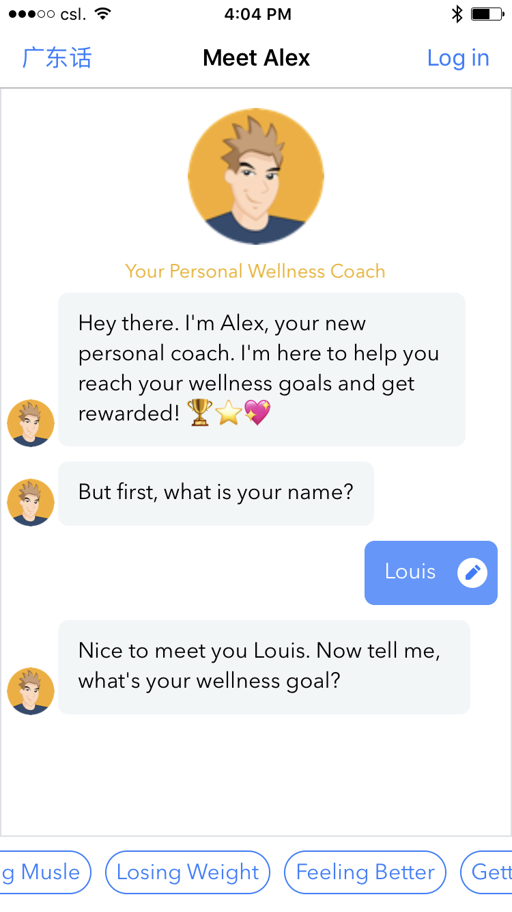
THE APP
Alex
24/7 wellness personal coach
Smart coach part Human / part Robot
Personalized advices on Fitness, Nutrition, Activity, HK sport events…

Slide 5
FEATURES
Follow your Fitness Activity
200+ wearables and health mobile apps compatible
Fitbit, Apple, Withings, Strava
Complete Challenges
8000 steps / day
Walk to Tian Tian Buddha
Talk to Alex
Redeem Great Rewards
Up to 40% discount
20+ partners
Misfit, Guava Pass, Rumi X, Ten Ren’s Tea

Slide 6
MAIN FIGURES
83%
40
35k
4.5/5
Of registered users are active
seconds average response time
Downloads in less than
6 months
Apple Store/ Google Play average rating

Slide 7
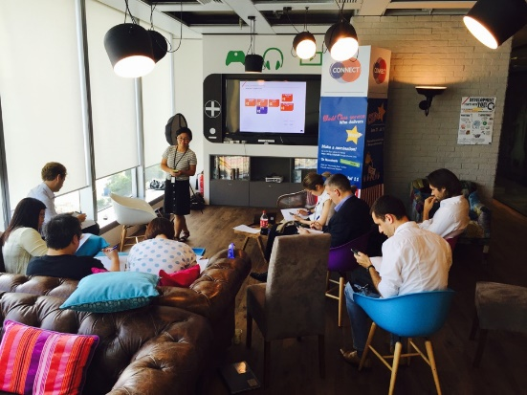
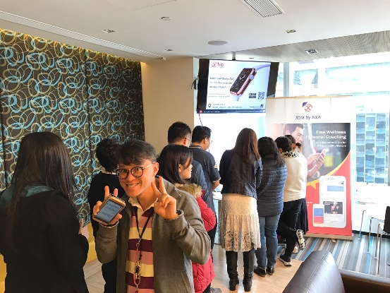
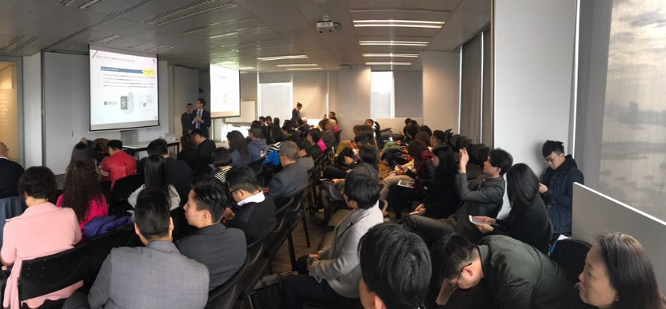
Bringing innovation to AXA HK
AXA HK Beta testers
XTRA booths in our offices
Animating a pool of +50 Beta testers, to learn about innovation and try Xtra
Organizing booths to raise AXA HK & Region awareness => +200 users
Distribution Challenge
Organizing a Challenge to bring 80 selected agents to invite their clients on board => +400 users

Slide 8
Positioning AXA on the HK Fintech landscape
GLOBAL, REGINAL AND LOCAL INTEREST
RAISING MEDIA INTEREST
6
AXA entities:
AXA Group:
Health global line Is considering to integrate the bot as a Global asset
Group has selected Xtra to participate to EFMA Innovation Challenge
KAMET , InsurTech start-up studio would like to know more
Earned media:
By incorporating the best of what’s gone before and wrapping it in machine learning technology, AXA presents a new kind of customer engagement for the insurance industry The Digital Insurer
To ensure long term engagement, Xtra uses an intelligent chatbot, to hyper personalize messages and pro actively give advise Cpasmonidee
Thailand
Singapore
Indonesia
Korea
Germany
UK
http://www.the-digital-insurer.com/blog/using-ai-customer-engagement/
http://en.finance.sia-partners.com/20161212/interview-marine-boris-head-innovation- partnerships-axa-china-region
http://cestpasmonidee.blogspot.hk/2016/11/axa-teste-un-robot-coach-sante.html

Slide 9
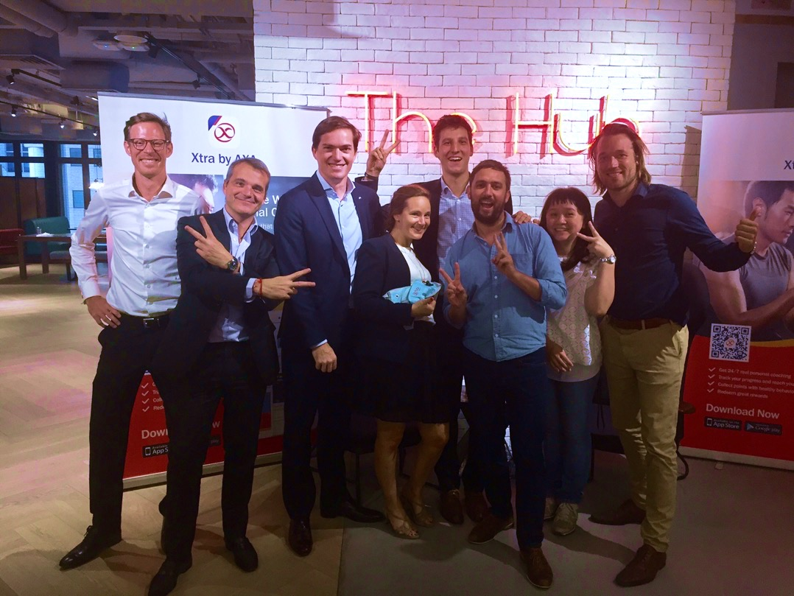
THANK YOU

