Slide 1
Now Health International
The Digital Insurer Asian Insurance Innovation Award 2017

Slide 2
Innovative Digital Tools
At Now Health International, we’re committed to offering a simple and accessible approach to international health insurance. Our digital tools form a key part of our core business strategy to make things easier for our customers, so they can manage their health insurance and get the care they need, even when on the move.
Our secure online portfolio and smartphone App are some of the best digital in the international health insurance market - they offer practical advice and information and are totally free for our members!

Slide 3
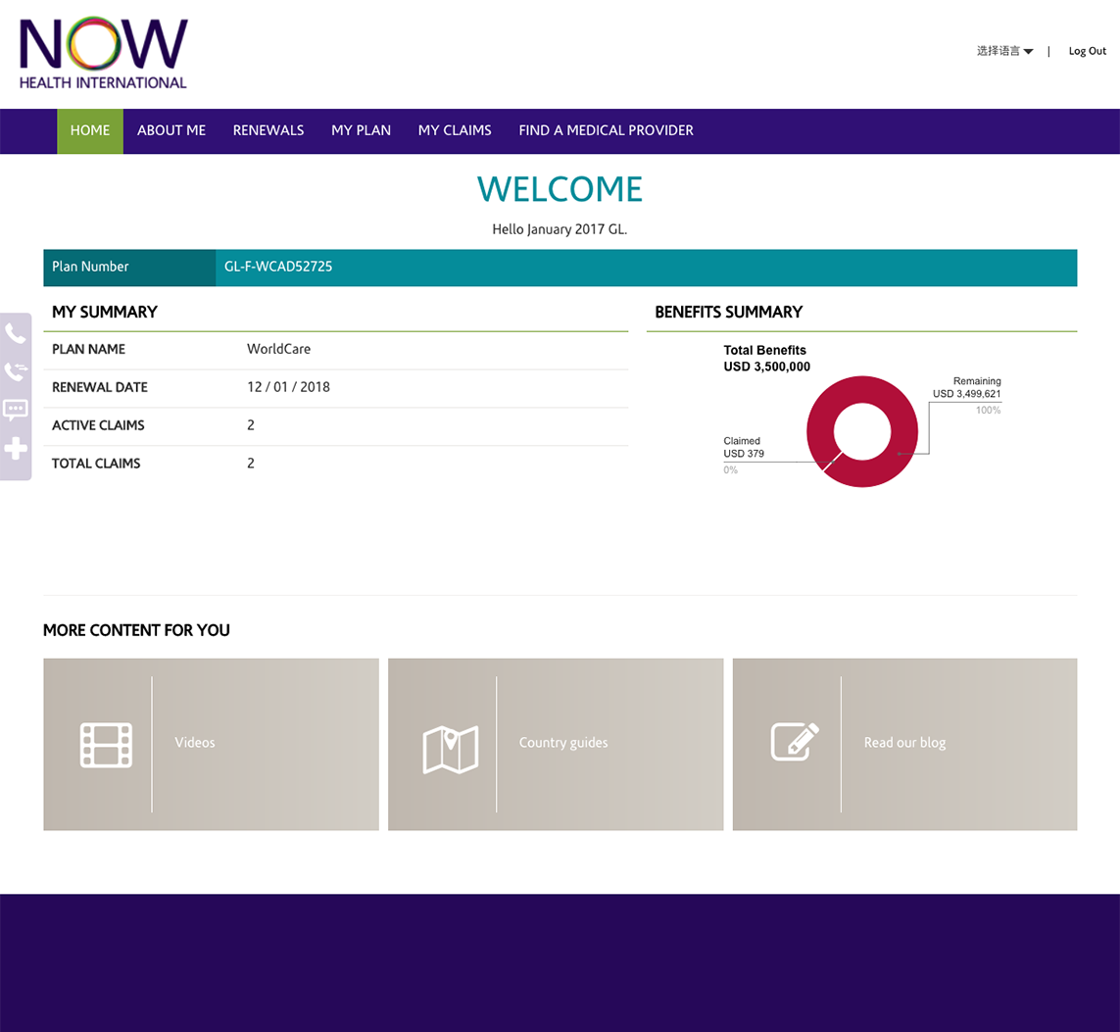
Secure Online Portfolio
Now Health International has recently upgraded our secure online portfolio to make it even easier and faster for our customers to access their international health insurance plan online.

Slide 4
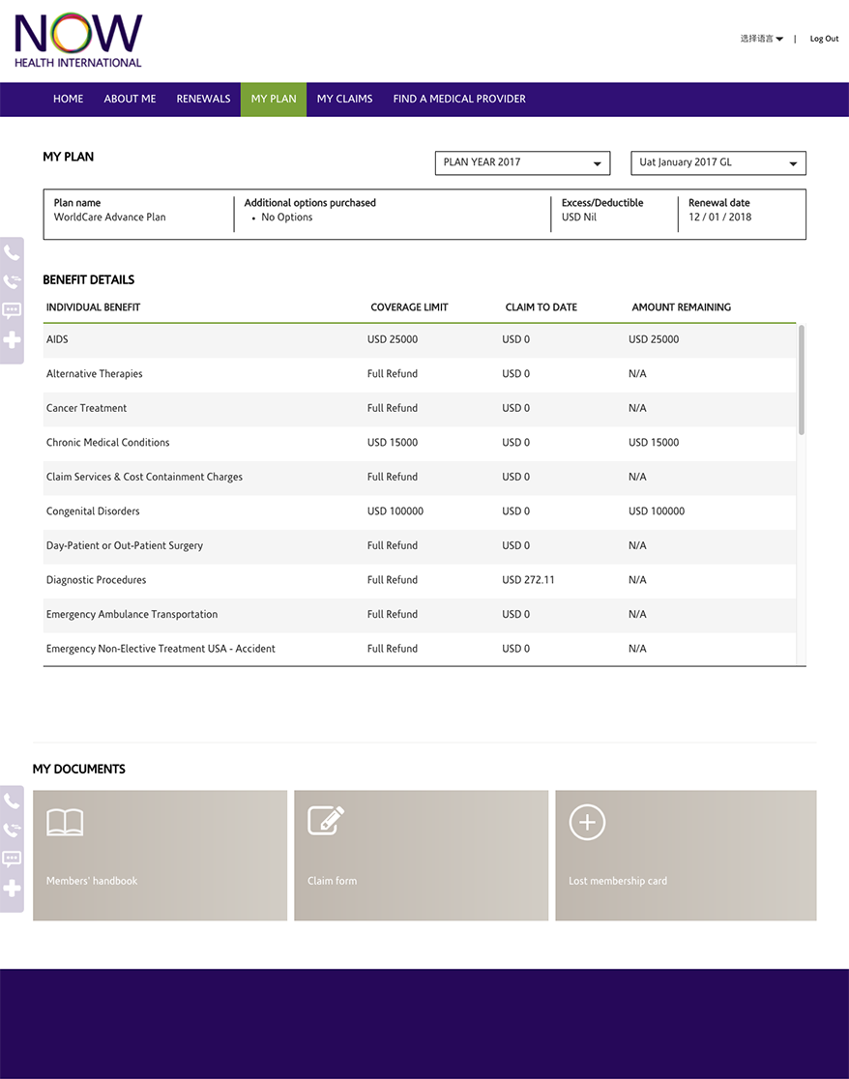
Secure Online Portfolio – Member Plan Information
To provide reassurance to our customers about what they’re covered for, the upgraded secure online portfolio provides a simple snapshot of each member’s plan, including a complete overview of their benefit limits and how much they’ve claimed to date.
They can also use the portfolio to view and download their plan documents and Member Handbook.

Slide 5
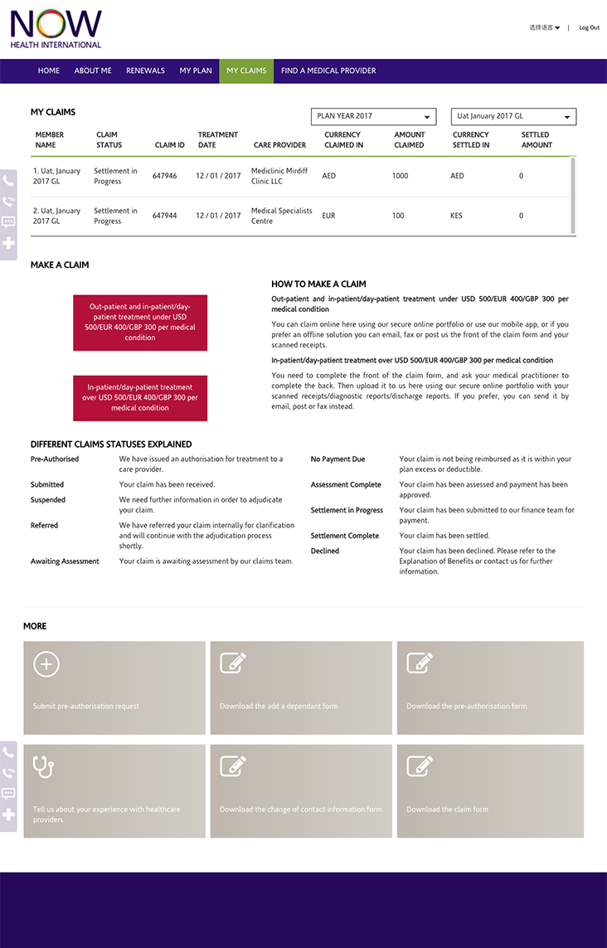
Secure Online Portfolio – Making Claims Online
For the first time, customers can now use our secure online portfolio to submit claims, in addition to submitting claims via our smartphone App – making it simpler for members to manage their claims, anytime, anywhere.
We take our commitment to process claims within five working days seriously, which is why our members can also use the online portfolio to track claims in real time, and see when payments have been made.
Our members can also request treatment pre-authorisation online before seeking in-patient, hospital treatment - helping ensure they don’t need to pay up front.

Slide 6
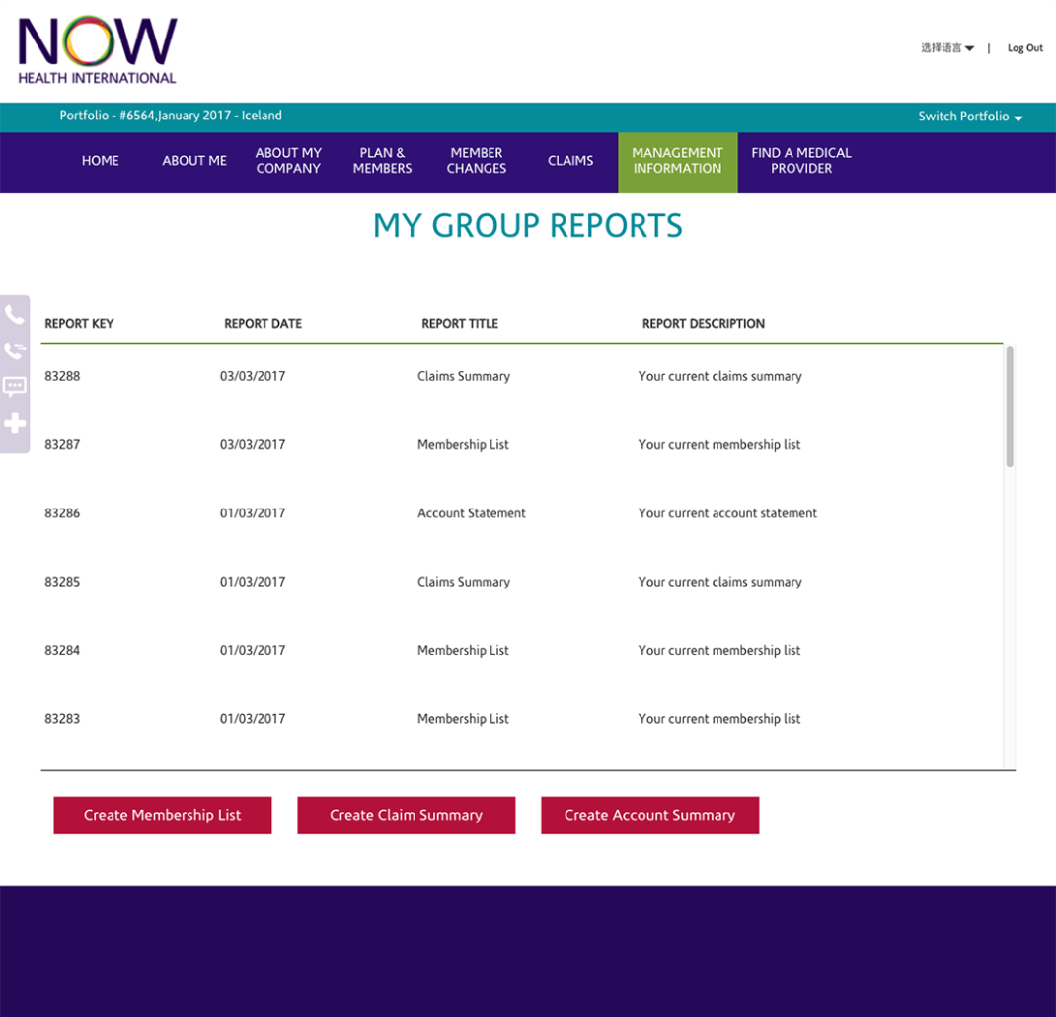
Secure Online Portfolio – Group Management Information
We’ve also tailored the secured online platform for our corporate customers, so Group Administrators can better manage their employee’s health insurance needs.
Group Administrators can access specialised Management Information about their Group Plan, including downloading a Membership List, a Claims Summary or an Account Summary.
They can also easily add or edit Group members via the portfolio.

Slide 7
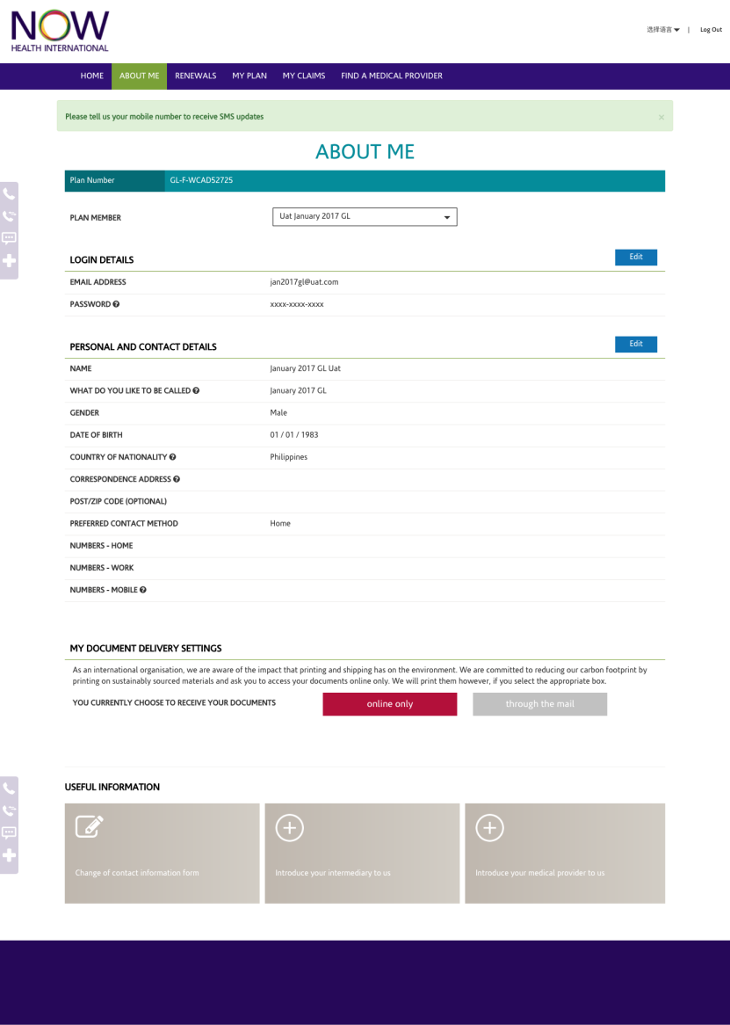
Secure Online Portfolio – Other Key Features
We’ve also added a Simplified Chinese language toggle to meet the needs of our growing base of Chinese speaking customers.
Other New features include the option for members to request a new membership card or introduce us to their favourite medical provider.

Slide 8
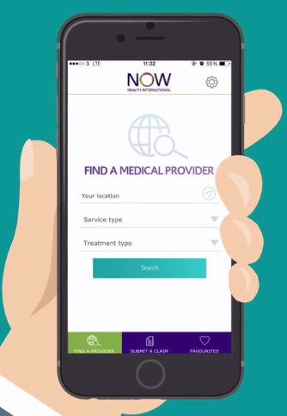
Upgraded Smartphone App
At the end of 2016 we upgraded our smartphone App to make it even easier for our members to use. Key new features include:
1. A drop down menu so members can more easily search for a medical provider from either our comprehensive or restricted networks.
2. New feature to map the closest health professionals closest and get directions to their door.
3. An improved treatment list, so members can more easily and quickly pinpoint the condition they need to treat.
4. New function brings our preferred medical providers to the top of the search, so our members always know where to find the best care.
5.Two language options to choose from - English and Chinese.

Slide 9
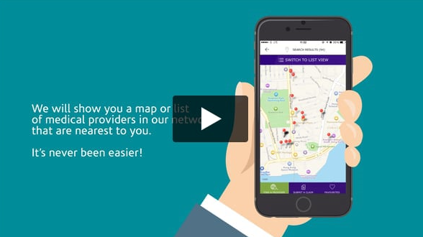
Explainer Videos
We’ve even created simple Explainer Videos to help our members make the most of our innovative digital tools.

Slide 10
Impact
To date 4,901 of our customers have downloaded the smartphone App and a fifth of all claims are currently submitted using this tool.
Our 2016 Customer Satisfaction Survey also shows a 24% increase in the number of respondents that said it was easy to submit claims in comparison to last year, which is likely related to recent improvements to our digital tools.

Slide 11
Thank you
Liane Cresswell
Group Senior Corporate Communications Manager
Now Health International
T | +852 2279 7328 M | +852 6651 2357
E | Liane.Cresswell@now-health.com

