Slide 1
#InsurTech #LegalTech #CyberInsurance
In MLD are recorded our will
in the net
It constitutes a digital testament, with which to complement the traditional analogical testament.
We are
TO THE DIGITAL LIFE
WHAT
IS TO THE eCOMMERCE
Bequest Digital Trust, S.L. | CONFIDENCIAL
Judith Giner | Pitch Deck 2017-02 V1.0

Slide 2
PROBLEM
Increased use of internet and the contents
Online reputation without control, also post-Mortem
Family ignorance faced with the decease
Crimes agaisnt the image and the privacy, piratery…
Bequest Digital Trust, S.L. | CONFIDENCIAL
Judith Giner | Pitch Deck 2017-02 V1.0

Slide 3
SOLUTION
A WEB PLATAFORM WHERE TO MANAGE DIGITAL WILLS
EXECUTOR
PROTECTION
Advice and administration of the digital assets
· Online Reputation
· Fundamental rights
DIGITAL TESTAMENT
QUIET FAMILY
In the moment of the decease
Complementing the traditional
Bequest Digital Trust, S.L. | CONFIDENCIAL
Judith Giner | Pitch Deck 2017-02 V1.0

Slide 4
VALIDATION OF THE MARKET
RECEIVES 120.000 APPLICATIONS OF RIGHT TO OBLIVION IN 3 MONTHS
EACH MINUTE DIE 3 USERS
422.568 DECEASES IN SPAIN IN 2015
3.000.000 > 45 YEARS OLD AND WITH TECHNOLOGICAL PROFILE HAVE MADE TESTAMENT
Bequest Digital Trust, S.L. | CONFIDENCIAL
Judith Giner | Pitch Deck 2017-02 V1.0

Slide 5
SIZE OF THE
MARKET
In 10 years all worldwide population
7.400.000.000
Will be users of internet
92%
Will have a digital legacy
387 K
Deceases/year in Spain
7.900 K
Death insurance in Spain
Facebook will have more die users than alive in the 2098
Bequest Digital Trust, S.L. | CONFIDENCIAL
Judith Giner | Pitch Deck 2017-02 V1.0

Slide 6
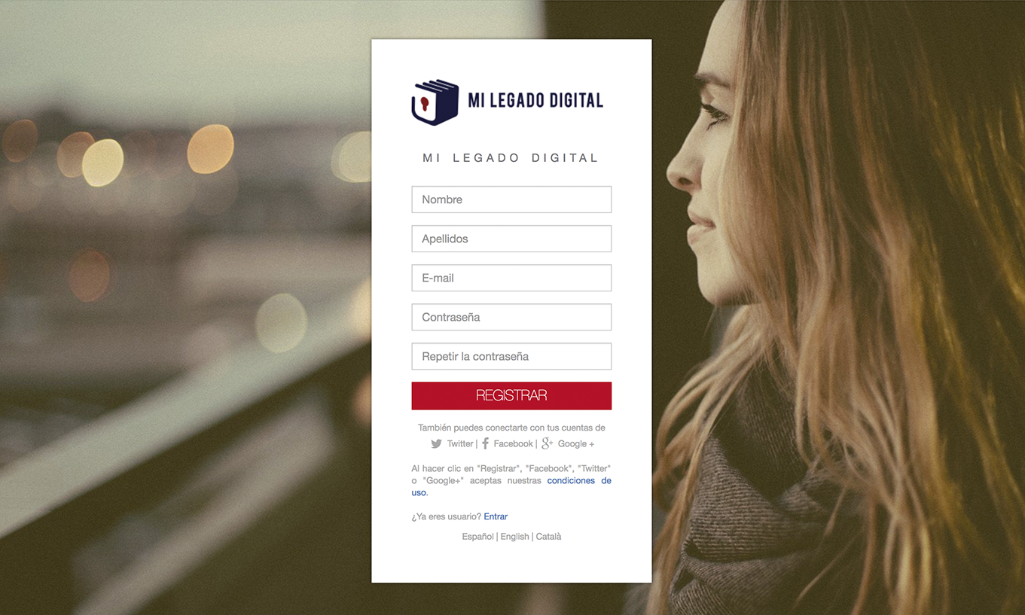
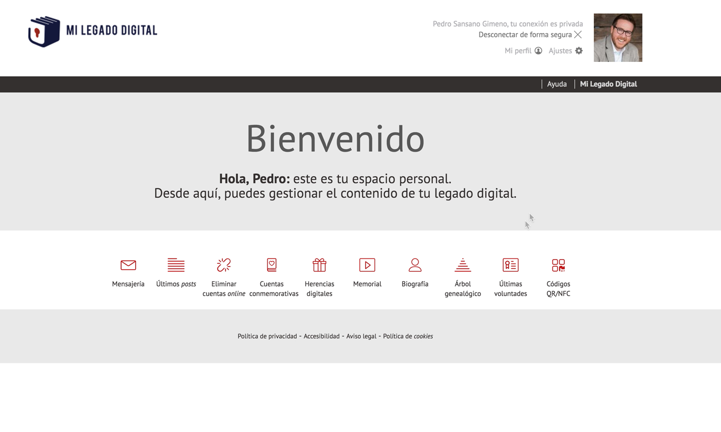
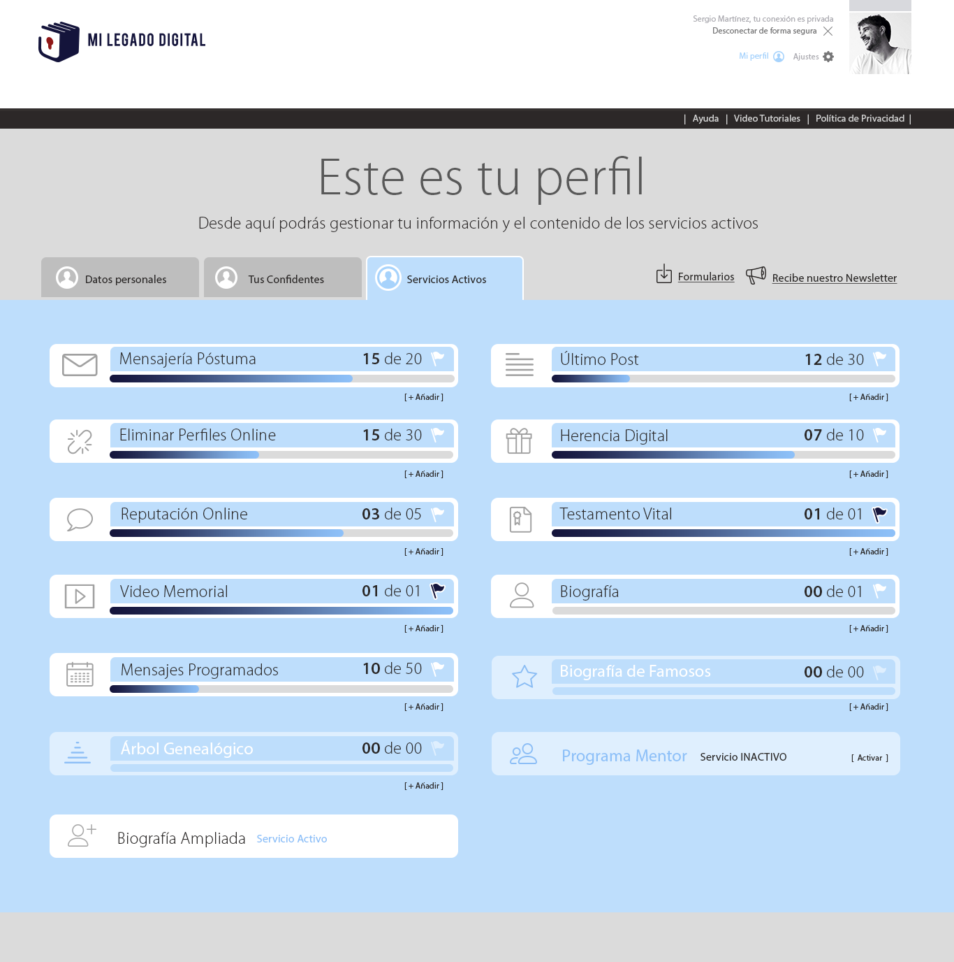
SERVICE
REGISTER
MANAGES
Begins here
Your digital legacy
¡DONE!
Edit when you want
Bequest Digital Trust, S.L. | CONFIDENCIAL
Judith Giner | Pitch Deck 2017-02 V1.0

Slide 7
BUSSINES MODEL
USERS
INSURERS
PARTNERS
85 $
0,86$ - 1,02$
20%
Basic plan
Annual for insurance policy
Commission per client
Posibility of Personalized plan
o free trial during 30 days
Bequest Digital Trust, S.L. | CONFIDENCIAL
Judith Giner | Pitch Deck 2017-02 V1.0

Slide 8
ADOPTION STRATEGY
PARTNERS
EVENTS
MARKETING
Among others...
· Insurance week
·Cryopreservation and Longevity Summit
· Forinvest
· Funermostra
· Digital Enterprise Show
· Miami Funner
·Insurance Revolution
·Digital Insurance Agenda
· SEO
· SEM
· Growth hacking
· CRM
· Banners
· Blog
· RRSS
Bequest Digital Trust, S.L. | CONFIDENCIAL
Judith Giner | Pitch Deck 2017-02 V1.0

Slide 9
COMPETITION
WITH Scalable technological platform
Best SEO
Worst SEO
WITHOUT Scalable technological platform
Bequest Digital Trust, S.L. | CONFIDENCIAL
Judith Giner | Pitch Deck 2017-02 V1.0

Slide 10
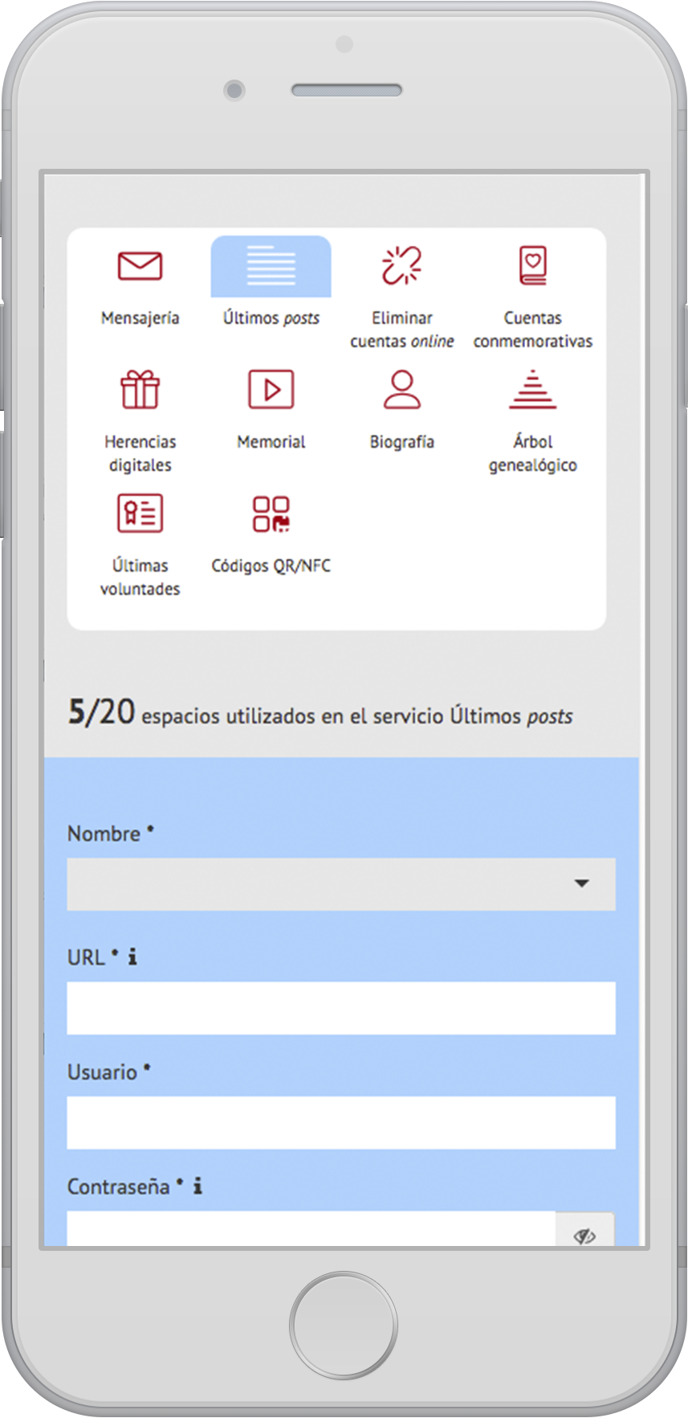
COMPETITIVE ADVANTAGES
SCARCE COMPETITION
BEST POSITIONING
For the novelty activity, especially in Spain.
It is a fundamental part of the strategic of MLD since their beginnings
SERVICES MORE COMPLETE
WEB QUALITY
MLD take care of all digital trace without requiring third parties. The majority only solve one part.
Unique web portal, attractive and functional with a brand that transmit values and quality services
INTEGRATED IN THE MARKET
We work with insurance companies related with deceases, life, accidents, home, etcetera.
Bequest Digital Trust, S.L. | CONFIDENCIAL
Judith Giner | Pitch Deck 2017-02 V1.0

Slide 11
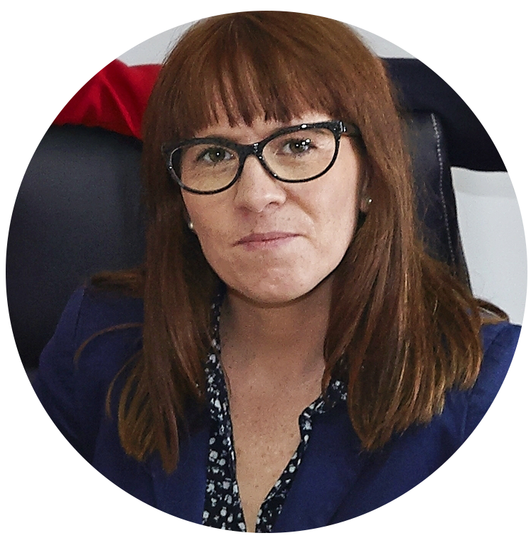
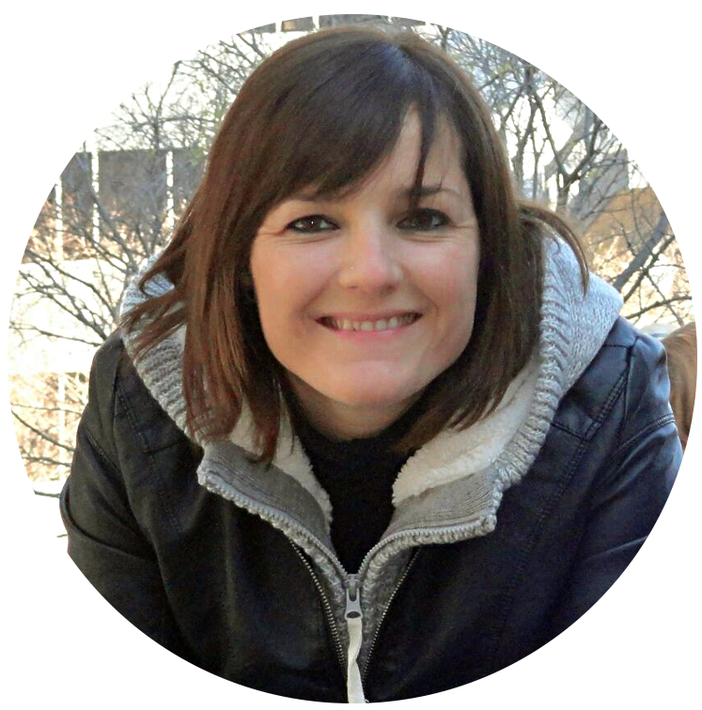
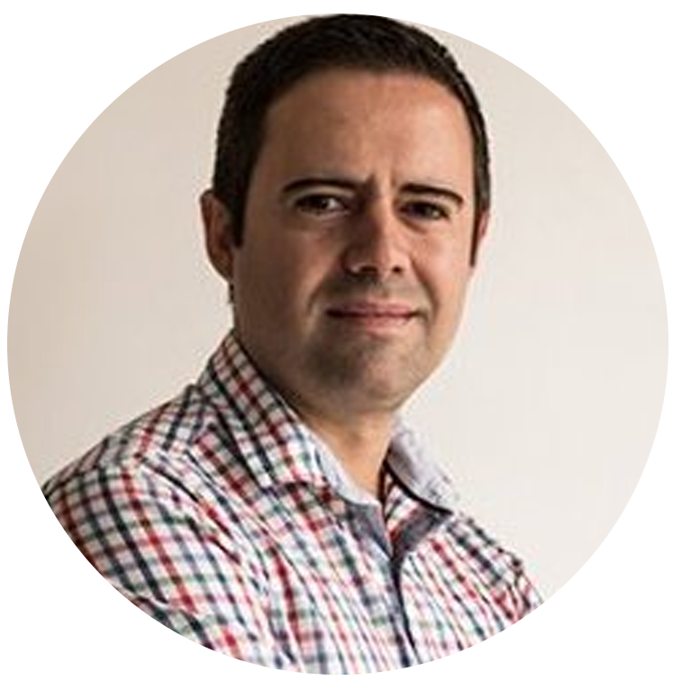
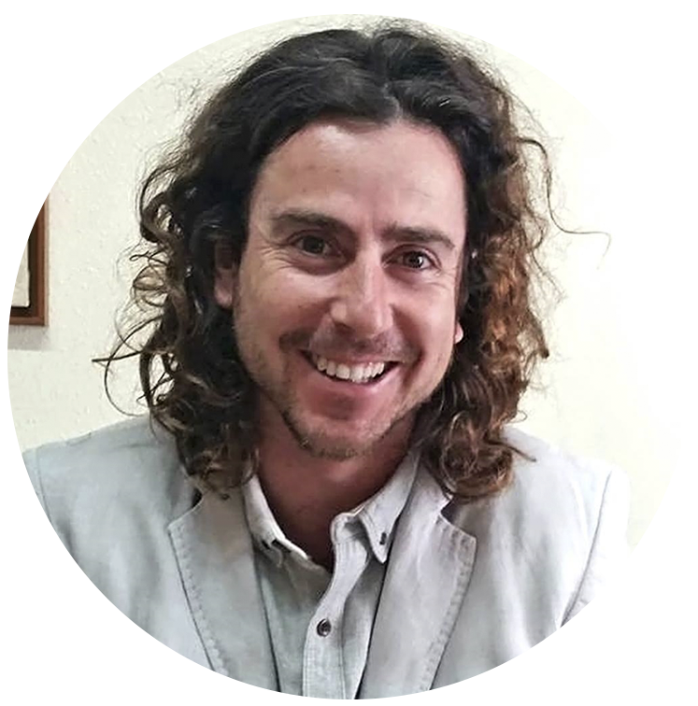
TEAM
Judith Giner – Founder & CEO
Alba González - CMO
More than 10 years in the insurance sector and networking company specialist with digital identity. Co-author of the book “Testamento ¿Digital?”.
Degree in Psychology. Dedicated to Marketing and managing human resources. With experience in the insurance sector.
Juan Seguí - CTO
José Luis Perez – CLO
Telecommunications enginer, teacher in the Valencia University and entrepreneur. Technological component.
Law Degree from the Alicante University. Master’s degree in legal company advice from Fundasem, specialst in ICT rights.
Bequest Digital Trust, S.L. | CONFIDENCIAL
Judith Giner | Pitch Deck 2017-02 V1.0

Slide 12
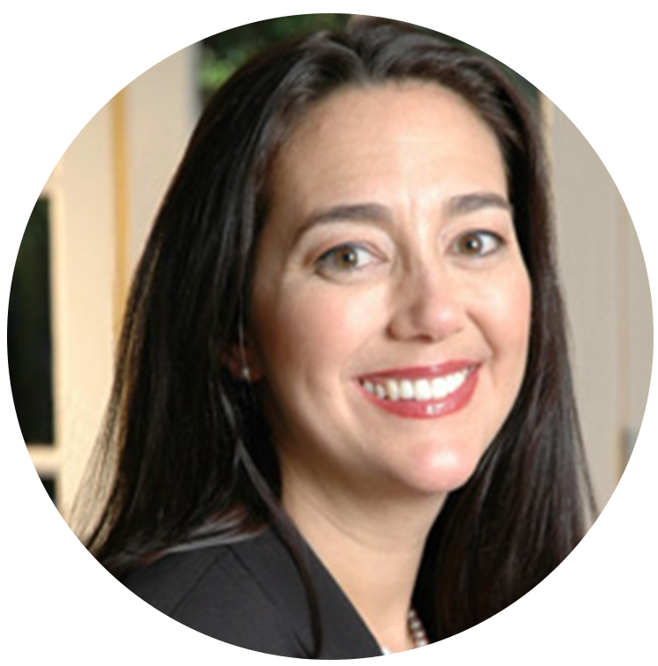
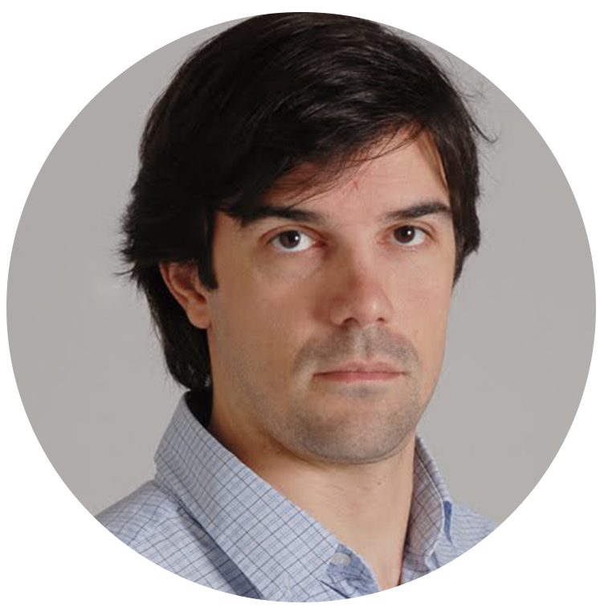
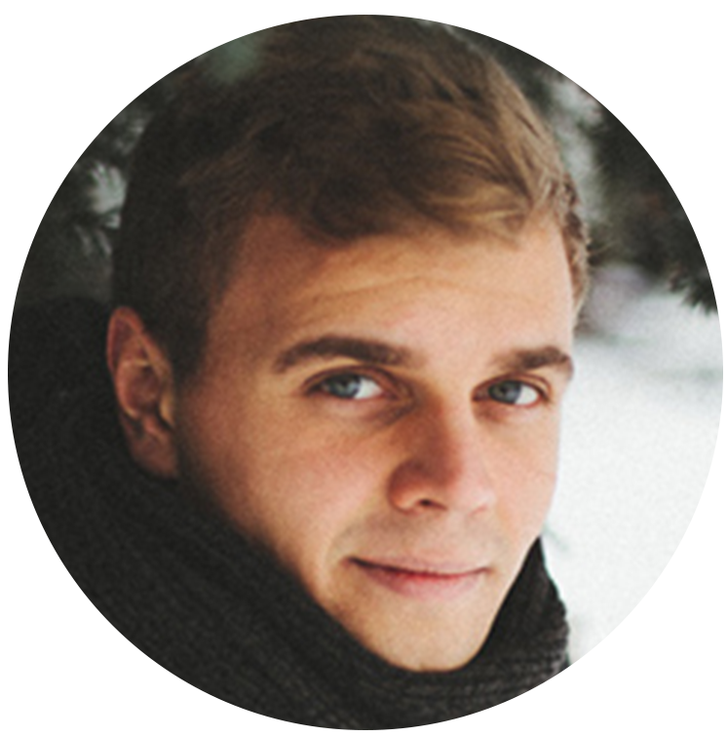
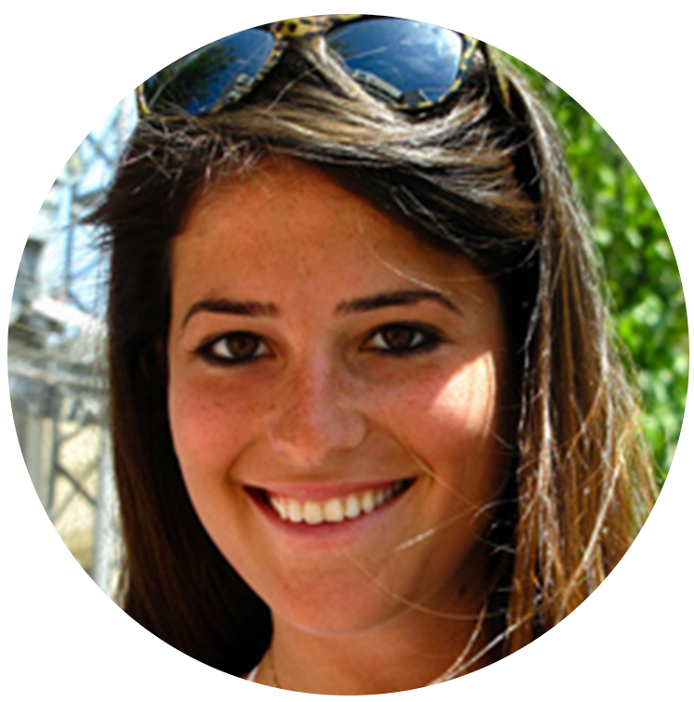
TESTIMONIES
“I discovered that it could be a good present for my familiy"
“A quality service and without incidents"
Joan M. Cervera - NH Seguros (Barcelona)
Vanessa del Peral (Palencia)
“My sister deceased and they were friendly and quick"
“My case was complicated but they did it all very easy to me "
Juan C. Ruiz (Granada)
Maite Climent (Alicante)
Bequest Digital Trust, S.L. | CONFIDENCIAL
Judith Giner | Pitch Deck 2017-02 V1.0

