Slide 1
THE DIGITAL INSURER ASIAN INSURANCE INNOVATION AWARD
November 2017

Slide 2
To be customers’ trusted lifetime partner through innovative life and health solutions by putting customers at heart of everything we do
OUR VISION

Slide 3
To be customers’ trusted lifetime partner through innovative life and health solutions by putting customers at heart of everything we do
Agency Recruitment and Management
Advisory-based
Sales Process
Agent Development

Slide 4
Efficiency starts from the foundation
SCOUT
RECRUITMENT
TEAM MANAGEMENT
Online and social media tools
Recruitment Application
Smart Web

Slide 5
E-learning platform to access knowledge bank and online courses anytime anywhere, to better serve our customers

Slide 6
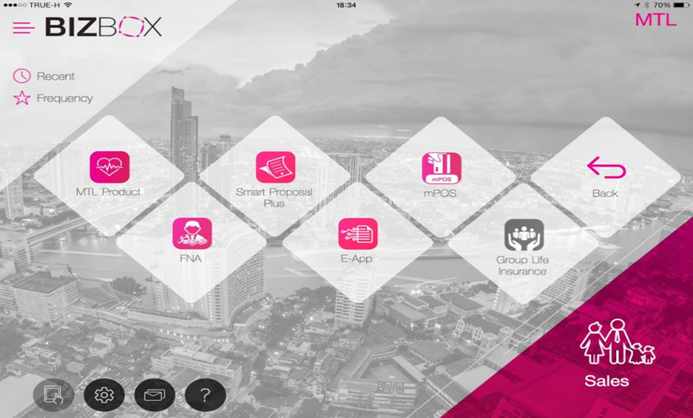
Innovative tool to improve agents to serve our customers
SALES
FINANCIAL NEEDS ANALYSIS
SERVICE
MANAGEMENT

Slide 7
Your trusted lifetime partner

