Slide 1
RiskAdvisor Client specific risk profiles and benchmarks in minutes

Slide 2
RiskAdvisor overview
Intelligent insurance and risk profiling in minutes
- built by insurance industry experts for insurance industry
Benchmark client risk against their own industry
Identify, rank and prioritize risks along with their treatments
Generate clear risk control activity and status reports
Create sales opportunities by better matching client needs
Improve governance and compliance outcomes
Provide a point of difference from competitors

Slide 3
Basic functionality
600 industries, 60 risk areas, 160,000+ exposures & controls
Industry benchmarks including A.M. Best’s
Mobile/tablet friendly
Facilitates white-labelling
Integrates with CRM and broker systems

Slide 4
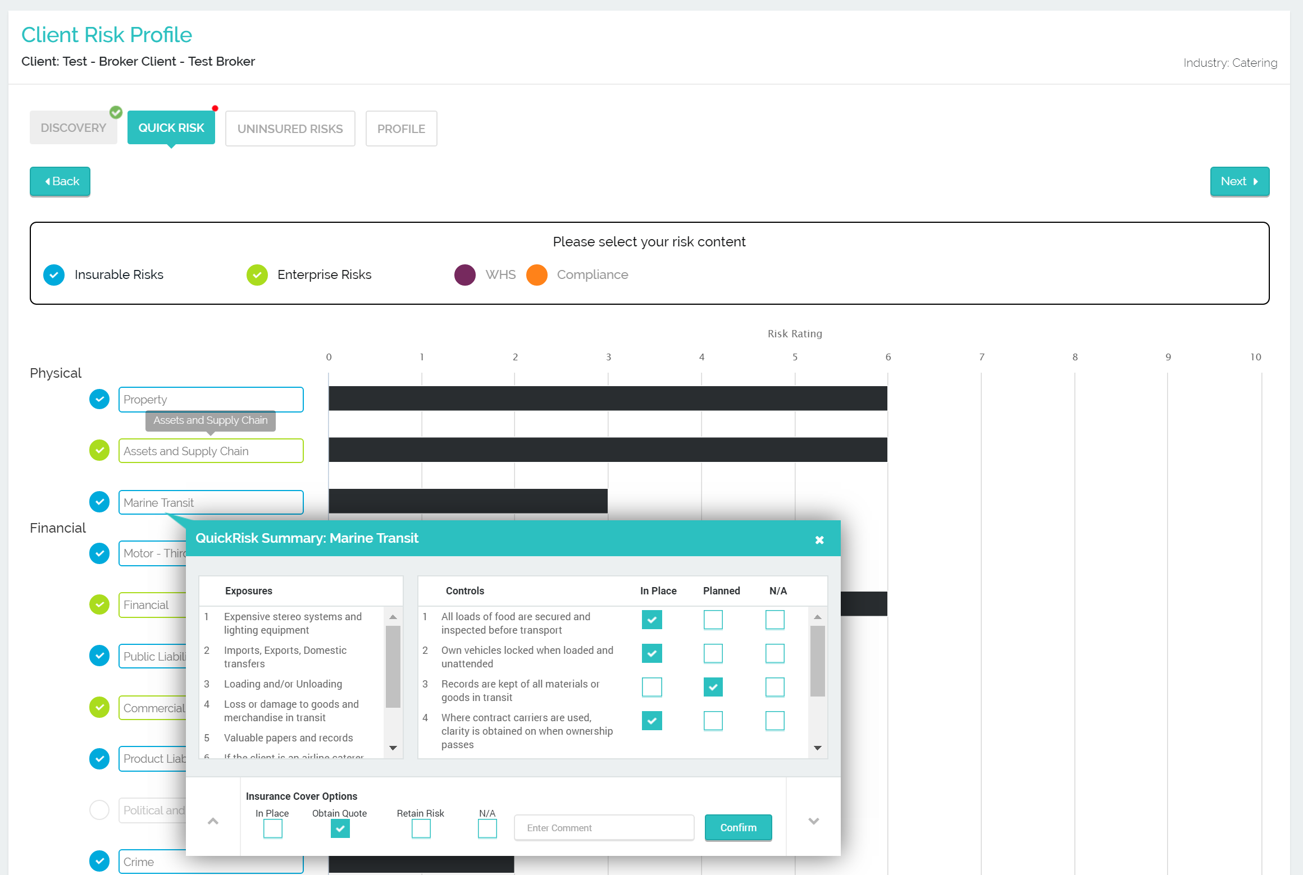
One screen - Exposures, Controls and Insurance Actions
Record status of risk controls – in place, planned or not applicable.
Record insurance cover status including actions for advisors in cases where a quote must be obtained, then select confirm. This will add the requested quote to the final action report.

Slide 5
Industry benchmarks – including A.M. Best

Slide 6
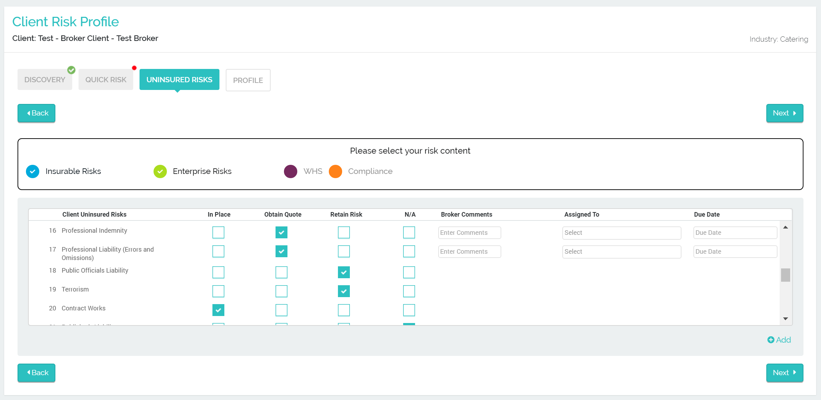
Uninsured Risks Summary
Review all uninsured risks. If an insurance quote is required, fill in the advisor comments, assigned to and due date columns. This action with then be added to the final report.
To add an uninsured risk, select ‘Add’, enter the risk in the pop up text box and click ‘Save’

Slide 7
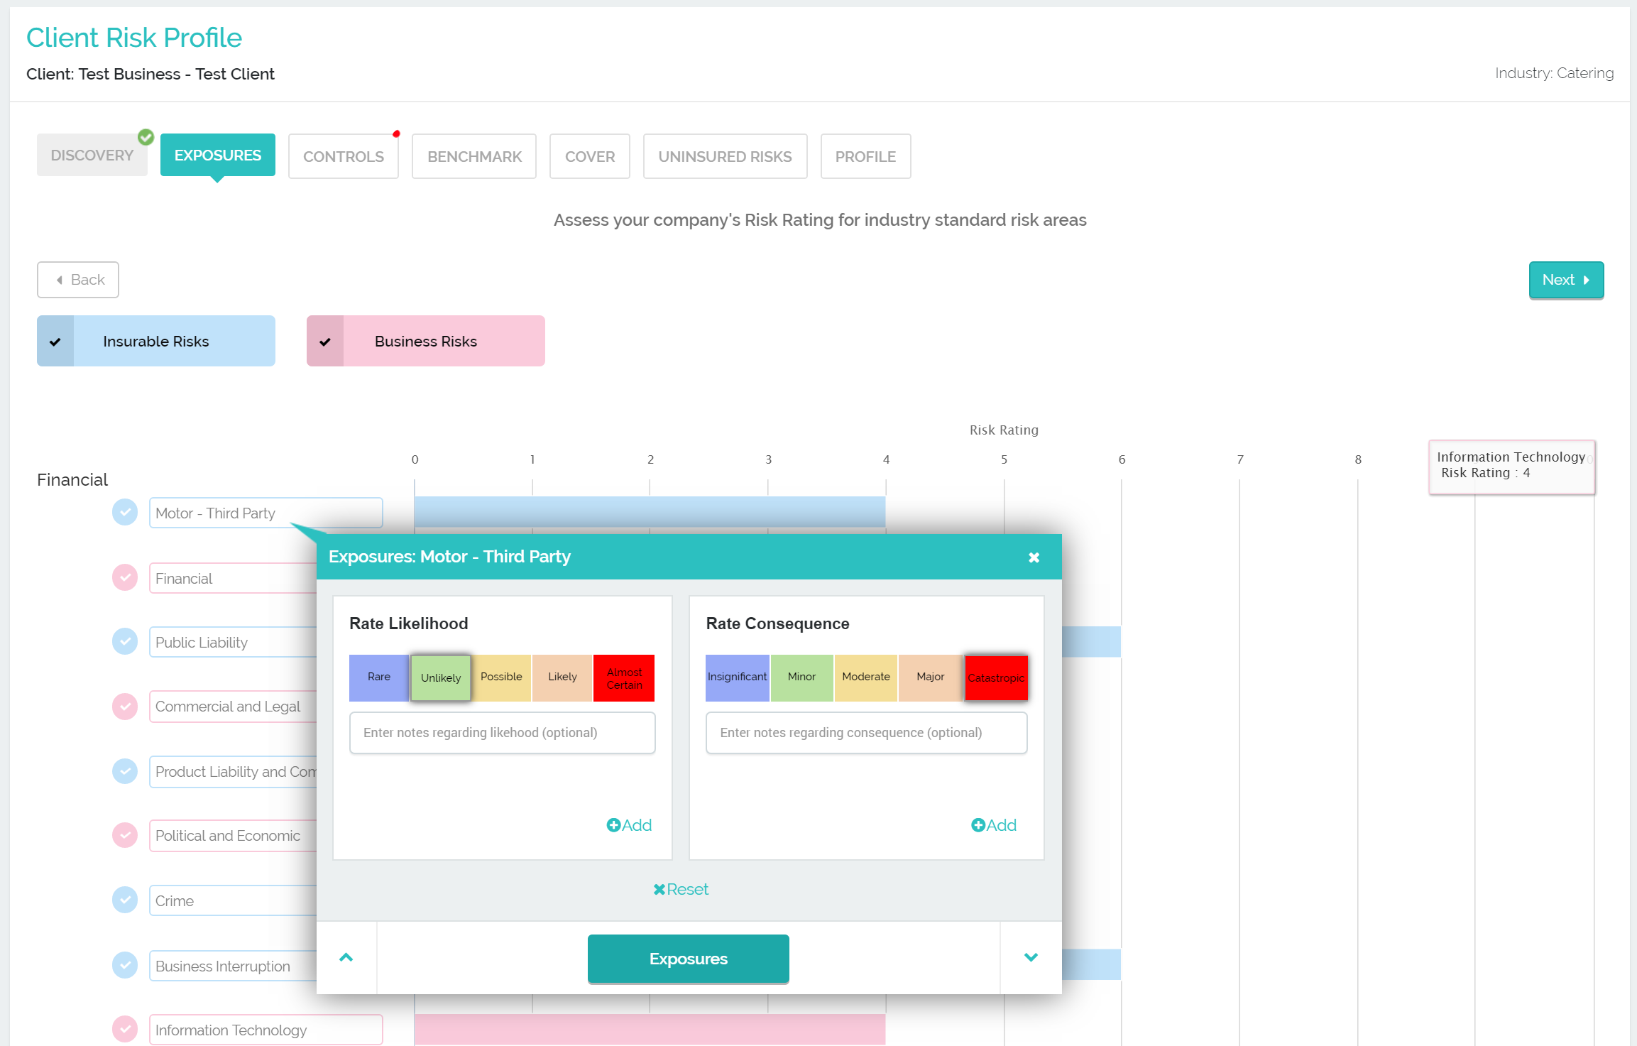
DeepRisk mode enables you to add client Risk Ratings
RISKADVISOR | PLANNING WORKSHOP

Slide 8
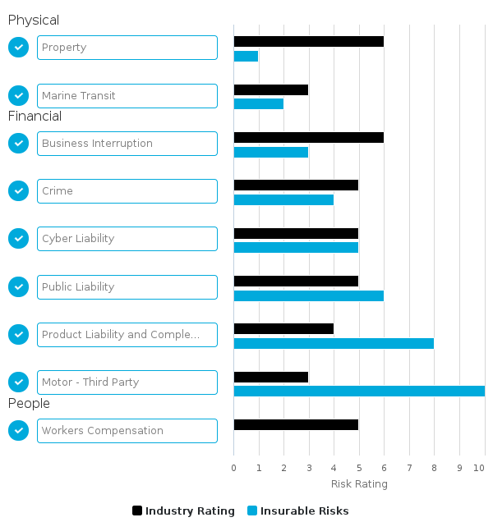
Compare client risk with industry specific risk benchmarks
Compare client risks with benchmarks to identify areas of concern and increase client engagement in risk conversations

Slide 9
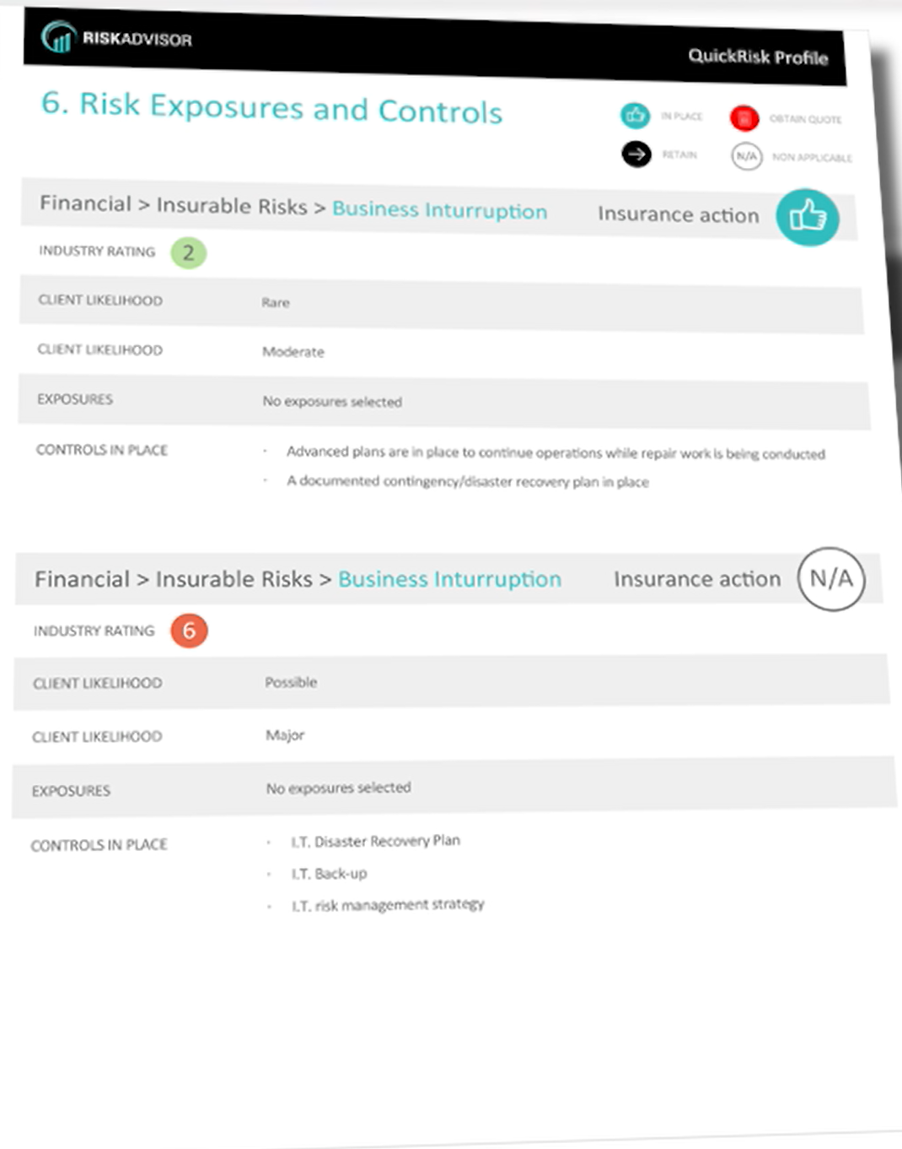
Comprehensive report produced in Word format
Review all uninsured risks. If an insurance quote is required, fill in the broker comments, assigned to and due date columns. This action with then be added to the final report.
To add an uninsured risk, select ‘Add’, enter the risk in the pop up text box and click ‘Save’

Slide 10
Tell me more
For further information:
Web: www.riskadvisor.io
Email: nick.hill@riskadvisor.io
Tel. +61 (0)419 371 018

