Slide 1
ORIGAMITM
Deliver 4P Technology Enablers
to
Power for effective technology driven insurance operations in Asia
^{Submission to Digital Insurer}
June 26 2017
数保信息科技

Slide 2
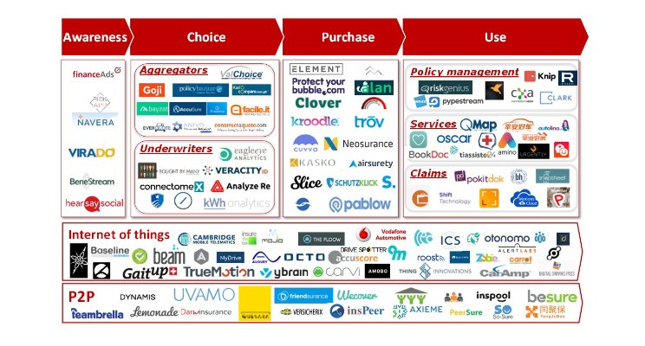
Global Insurance Tech Startup Boom,
Asia awakening…
Source：linkedin.com/in/matteocarbone

Slide 3
Shortage of Vertical and Horizontal Technology Enablers
Origami provides a-z enablers for clients moving across vertical and horizontal axis secure competitive advantage!!
Social Media
P2P/IoT/AI
Europe
Italy
USA
USA
China/Asia
Neosurance
Mobile/Pads
US, UK, Europe, Australia and New Zealand
EU, UK, USA, AU, NZ
SH/BJ
大特保
UK/oz
Europe
USA
Traditional UW
Singapore
UK,
www/Enterprise
Traditional Insurers
Car/Travel
PA/P.Prop/Home
Health/EB/Life
SME
Commercial Q&B/Schemes
LR
Individual
Commercial

Slide 4
Origami For Business Critical Success
Many sites have few traffic or lots of traffic but few sales…
Transitional Approach: Traditional distribution with new technological means and social media reach must be enabled for insurance purchase differences across markets
Customer Reach
Sales Conversion
Retention
1
Lots of sites with simple, easy, transparent but lack of
Specific product to specific customer groups or
Affinity sales via technological means
2
Seamless renewal, ncb points accumulation for good risk customers
Seamless offer of other products
Discount on referrals
Seamless& transparent claims via connected devices
Risk managing with seamless risk prevention offerings and pre indication of premium rise for failure of taking up preventions…
3

Slide 5
Origami Functionality Snapshot
Current rating methodology
Transferred digitally for automations
ORIGAMI TM
Seamless Sales & Service Delivery to diverse digital media
Data Connect for Personalised product offer based on individualised underwriting
Any-Digital Device
Configuration
Process
Management
Products
UW Rules
Quote
Policy
Document
Email
Document Templates
Rating/Algorithms
Communication
Account
Dashboard
Task
UI/UX
Claim
Portfolio
Automation
Distribution
Control
New/Renew
Follow-up
Customer Portal
Intermediary Portal
Risk Appetite
User Access
Endorsement
Jobs
Gateway
Affinity
UW Guideline
Version
Payment
Legacy
Audit

Slide 6
Central Management, Multiple Applications for Seamless Sales and Services Deliveries
PRODUCT CONFIGURATION
&
CENTRAL MANAGEMENT PLATFORM
Website Direct/Affinity
Intermediary Sales Management Portal
Personalised Customer Portal
Insurance management Portal
Full Product Suite
Fast and Frequent Launches
Simple, fast and tailored for high takeup
Seamless a-z transactions management by direct Admin or TPA
Can also be Call Centre Sales Management Platform
Commercial, advise based product sales and services
Via digital tools for seamless sales and services
Capture potential customer from quote
Multi-policy management
New product direct sales
Cross-sell marketing

Slide 7
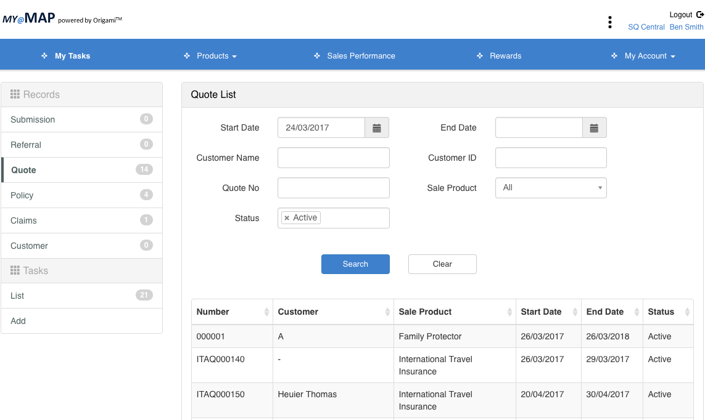
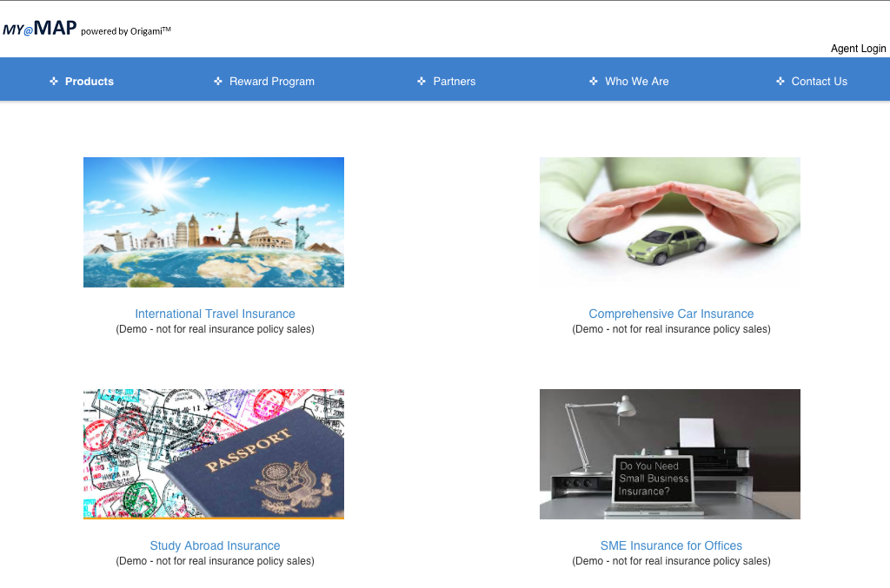
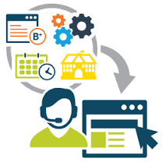
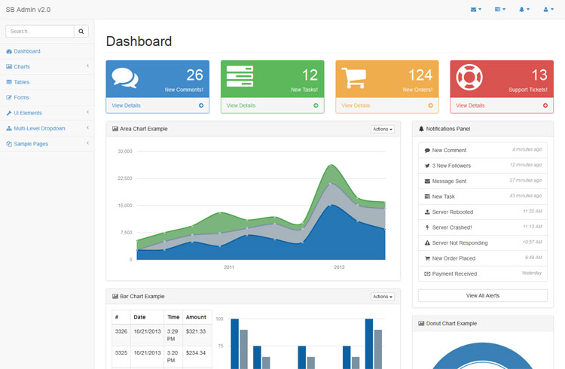
Modular Designs
for secure, flexible and fast adaptations for diverse business applications
Central Module Repository
Product Configuration
Claims Process
Document Management
Rating/UW Rules/
Algorithsm
Reporting
Communication Management
System Configuration
Global/Local country, language, currency
Sales process design
Customer Profile
Security Control
Lifecycle
User Management
Data Connect
My Protections
Agent Sales Portal
Website direct/Affinity
Admin/Call Centre
Reporting

Slide 8
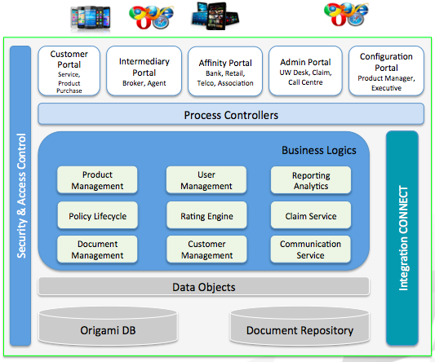
Scalable Platform – an example for a regional insurer with multi-country/language operations
Cloud
China
Chinese
English
On Premises
Configuration
Export / import
Vietnam
Vietnamese
English
Centralized Configuration & Analysis to Maximize Control & Economic of Scale
Deploy multi-product lines, multi-distribution channels in different country/language, … as Required
Configuration
Export / import
Regional Platform
Malaysia
Malay
English
Configuration
Export / import
Same Code Base, Modular Deployment, Security Risk Reduction

Slide 9
Internal Systems
Flexible Integrations
CRM
Policy Admin (P&C/Life)
Rating Engine (P&C/Life)
Claim System (P&C/Life)
Finance System (P&C/Life)
SMS / Email Gateway
Adapter
Payment Gateway
Adapter
……
Adapter
External Source
Adapter
Telematics
Adapter
Connected Home / Wearable
Nimble Adapter development through Data Mapping
Any Type, Any Format
Real-Time, Batch Processing, …
SOAP, JSON, Excel, …
Data Provider
Property Information
Social Network
……

Slide 10
Digital DNA Build For Digital Insurance P&L Success
Fast, simple & convenient
Truly tailored products to pinpoint needs
Seamless lifecycle service/other product sales at touch-point
Successful New Business Acquisition & Retention / Cross-Sale / Up-sale
Structured underwriting methodology
Precise and Realtime portfolio managing
Full data capture, insight for business improvements/innovationS
Loss Control Underwriting Profit
Streamline product sales & processing
Maximise product automation
For Large-scale Cost Reduction gained from many productivity gains
Eliminate duplication of sales platform build for different product, channel, country and languages

Slide 11
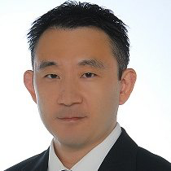
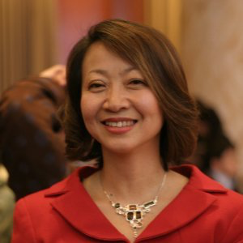
We know Insurance and Insurance Technology
Kevin Jin has been working for multinational insurers in many different IT roles including positions in charge of system architectural design, legacy modernization, frontend white-label system development for many different insurance product sales and lifecycle service deliveries.
He is instrumental in designing the highly configurable Origami platform designed to truly deliver insurance business efficiency right from insurance product development stage down to sales and lifecycle services.
Kevin leads a team of highly skilled and productive developers in Singapore who have the most advanced programming skills across different disciplines.
Susan He is an insurance product SME with over 18 years of experience running various insurance product divisions for multinational insurers.
She has successfully managed many insurance business operations with major successful P&L achievements.
She is the pioneer in developing insurance sales automation platforms to deliver effectively product sales growth and operating expenses reductions.
She is instrumental in ensuring Origami delivers true insurance agility and flexibility for complex insurance underwriting and risk assessment requirements for cross product, distribution, and cross country automations

Slide 12
ABOUT US @http://alignedbiz.com/
Incorporated in Sydney in 2011 and 2012 in Singapore, and 2016 in China, Aligned Business is a nimble technology company focused on building innovative digital insurance platforms in order to help insurers and intermediaries across all geographics overcome challenges of delivering digital solutions for fast, tailored and seamless multi product distribution sales with the most agile technology enablers.
We are more than an IT company. We are subject matter experts in insurance product development, underwriting, distribution sales and insurance architectural designs as well as complex system integrations.
We have track record in building white-labeled, agile, flexible insurance product manufacturing and sales platforms. We have built a global digital platform for a global insurer for launching multi products for sales via the MGA network in the US before launching into building Origami.
“Aligned Business has been selected the 20 Most Promising Insurance Technology Solution Providers in 2017”

