Slide 1
Get a HSBC Term Protector Plan within 5 Minutes Online Application Journey

Slide 2
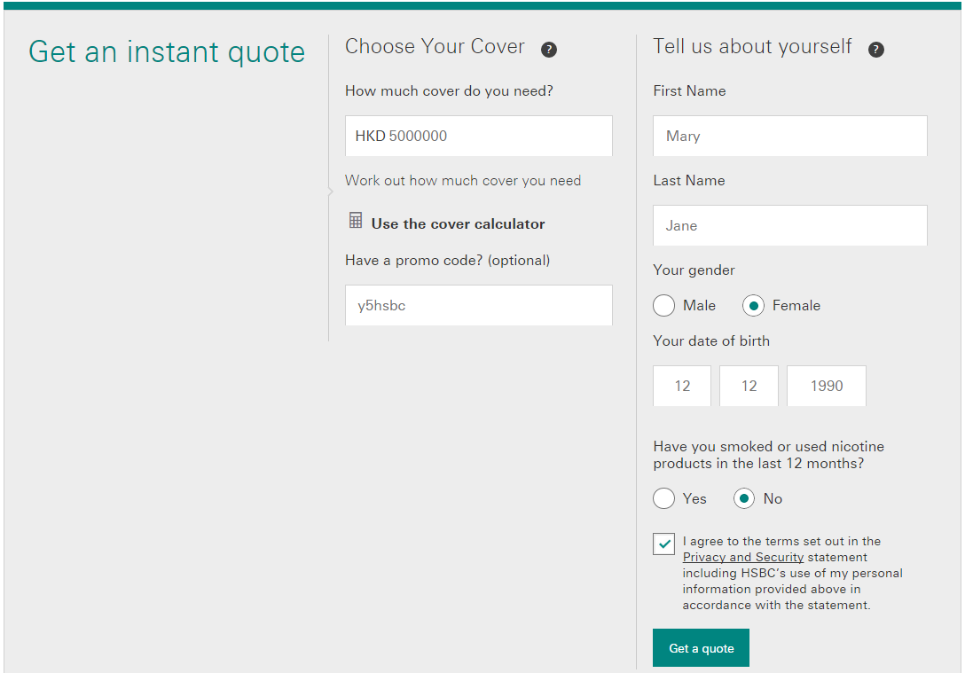
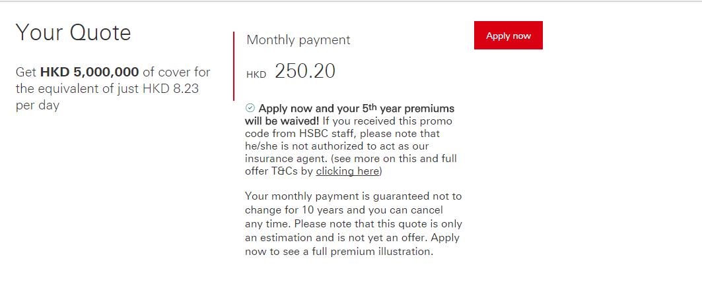
HSBC Term Protector – QQT
Quick Quote
Medical Questions
Applicant Details & Beneficiary
Payment & Declaration
Acknowledgement

Slide 3
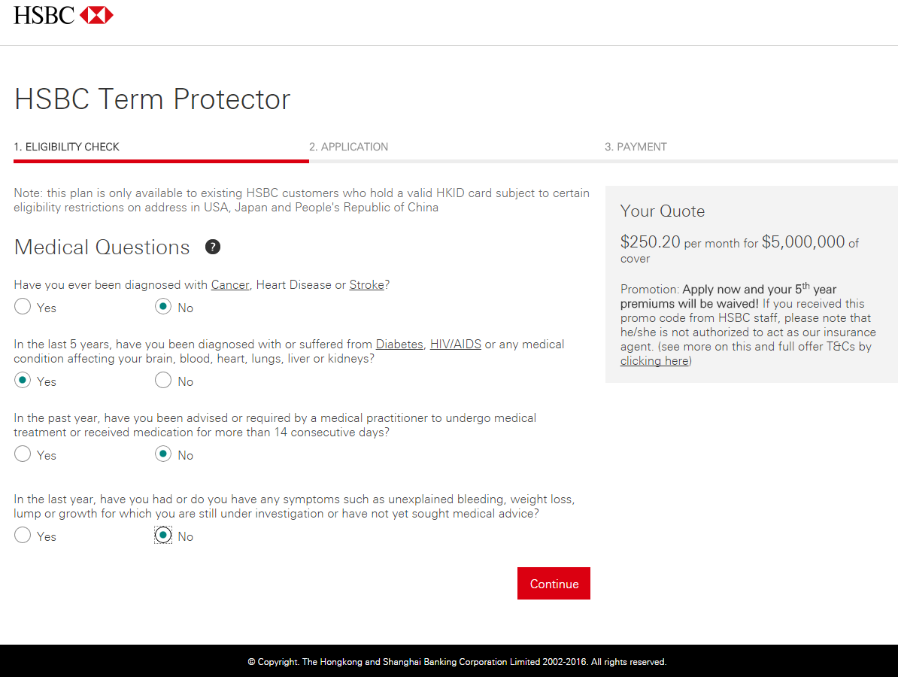
HSBC Term Protector – Eligibility Check
Quick Quote
Medical Questions
Applicant Details & Beneficiary
Payment & Declaration
Acknowledgement

Slide 4
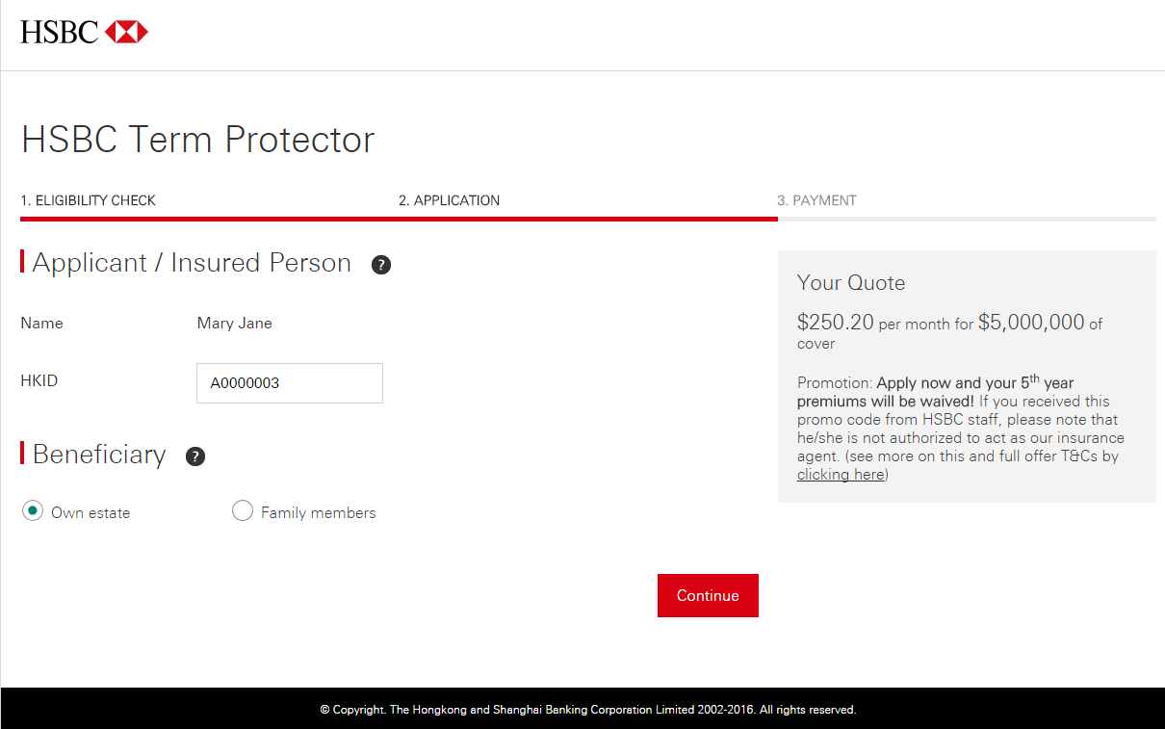
HSBC Term Protector – Application (Own Estate)
Quick Quote
Medical Questions
Applicant Details & Beneficiary
Payment & Declaration
Acknowledgement

Slide 5
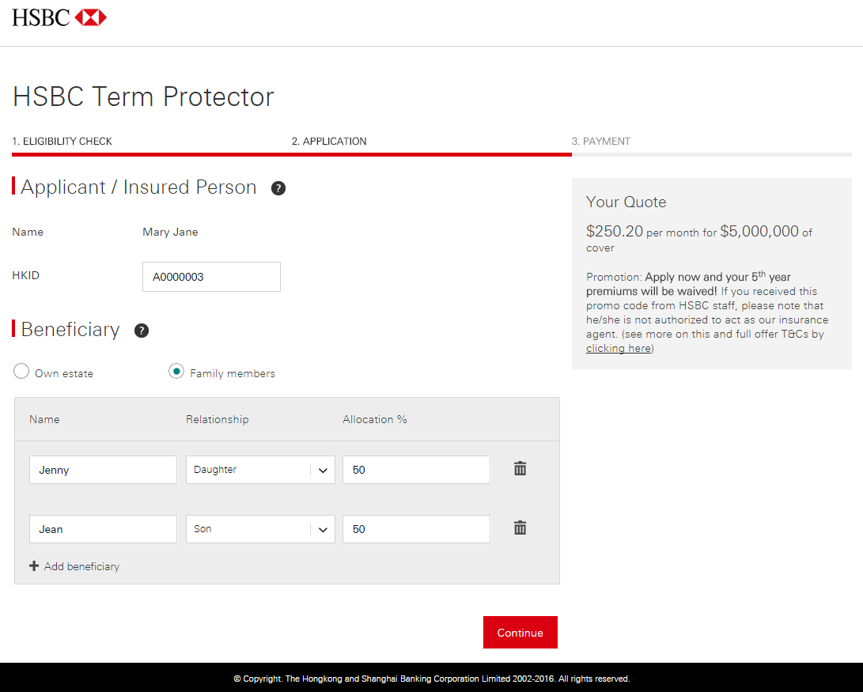
HSBC Term Protector – Application (Family members)
Quick Quote
Medical Questions
Applicant Details & Beneficiary
Payment & Declaration
Acknowledgement

Slide 6
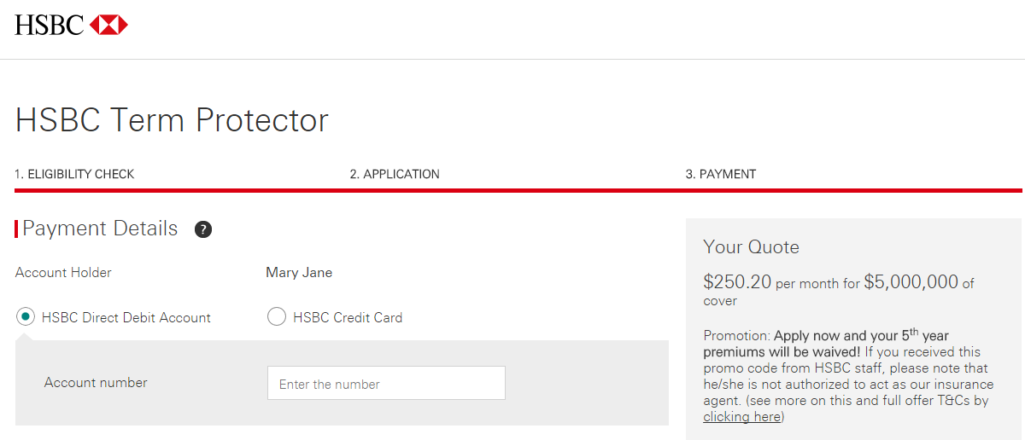
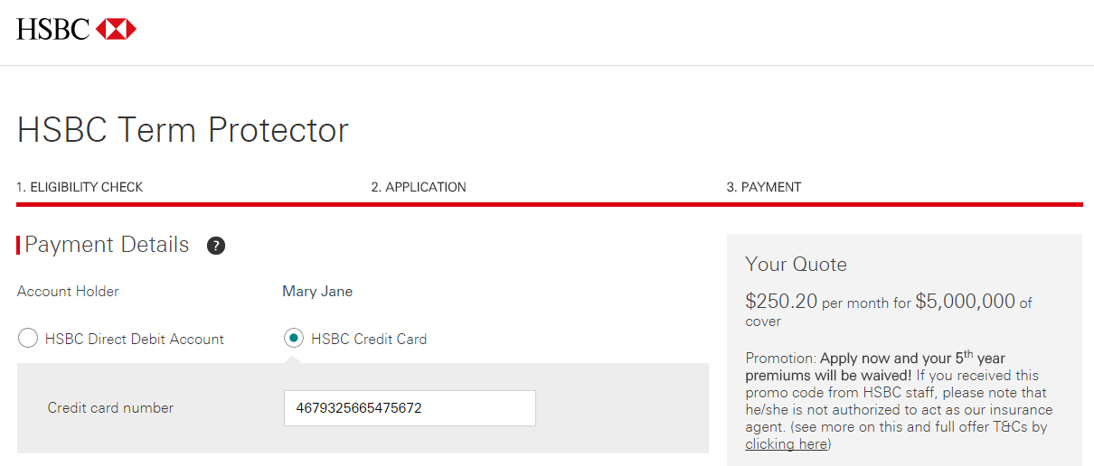
HSBC Term Protector – Payment
Quick Quote
Medical Questions
Applicant Details & Beneficiary
Payment & Declaration
Acknowledgement
1. Debit Direct Account
2. Credit Card

Slide 7
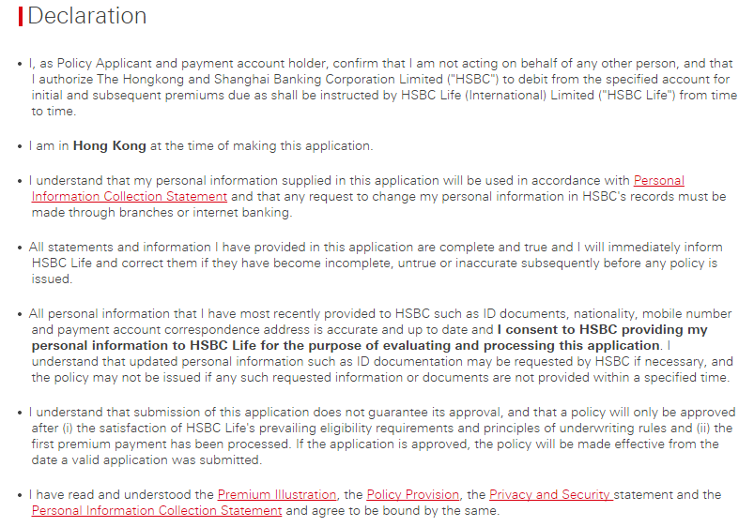
HSBC Term Protector - Declaration
Quick Quote
Medical Questions
Applicant Details & Beneficiary
Payment & Declaration
Acknowledgement

Slide 8
HSBC Term Protector – Declaration (Con’t)
Quick Quote
Medical Questions
Applicant Details & Beneficiary
Payment & Declaration
Acknowledgement

Slide 9
HSBC Term Protector – Acknowledgement
Quick Quote
Medical Questions
Applicant Details & Beneficiary
Payment & Declaration
Acknowledgement

Slide 10
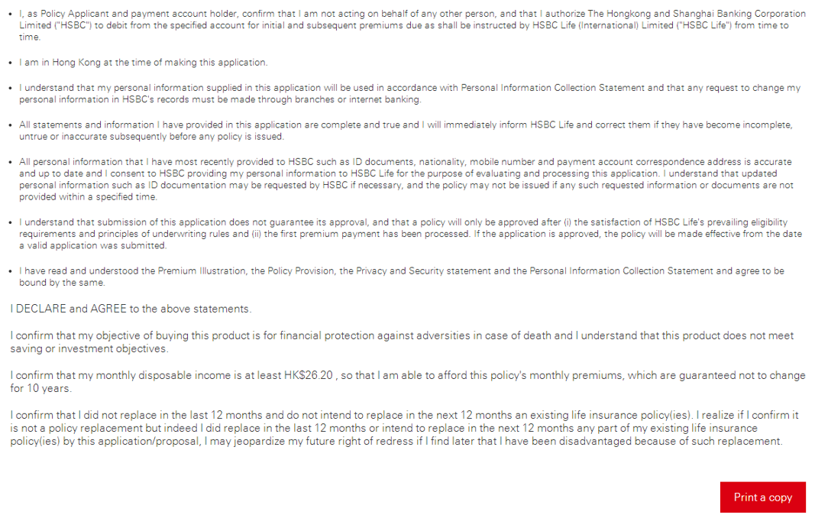
HSBC Term Protector – Acknowledgement (Con’t)
Quick Quote
Medical Questions
Applicant Details & Beneficiary
Payment & Declaration
Acknowledgement

Slide 11
HSBC Term Protector – Opinion Lab Questionnaire

Slide 12
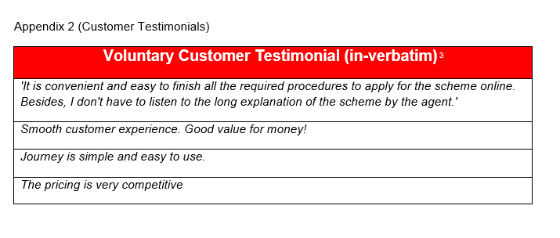
Supplemental slide – Appendices of the paper

