Slide 1
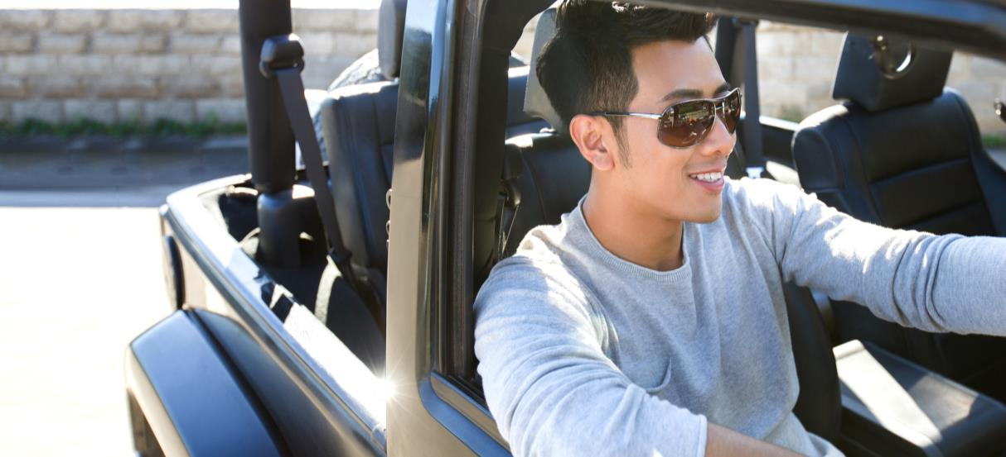

Drivamatics -
A brand new driving experience 27 June 2017

Slide 2

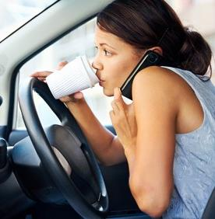
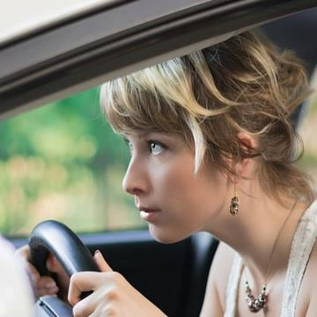


Traditional Motor Insurance works but might not be truly fair
Zoe
Female
25 years old
2 years driving experience
No previous claim
Chloe
Female
25 years old
2 years driving experience
No previous claim
Reckless driver
Careful driver
Different risk, but paying for the same premium
Premium:
$7,000/yr
Premium:
$7,000/yr
FWD believes the fair game should be…
…Policyholders to pay based on how they drive

Slide 3
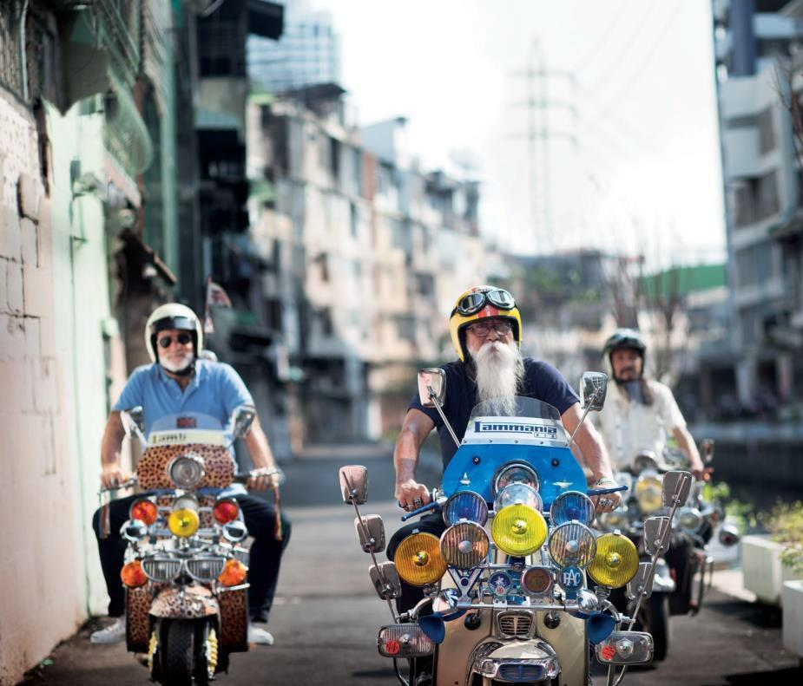




Usage-based
Insurance (UBI)
Personalized premium rate
How much distance you are driving?
How often you are driving?
How well you are driving?

Slide 4


With Drivamatics, we know how safe our drivers drive
FAMILIARITY
TIME DRIVEN
SMOOTHNESS
FATIGUE
SUNLIGHT
ACCELERATION
ROAD USAGE
CONGESTION
SPEEDING
SWERVING
CORNERING
PACE
NIGHT TIME DRIVING
LOCAL DRIVING
Behavior
Measurement
PHONE CALLS
DECELERATION
CONFIDENCE
The first telematics
app in Hong Kong
Driver
Driving
Score
Insurer

Slide 5


We can identify the unique driver via the app
=
Recognize your driving signature
As your
unique fingerprint

Slide 6
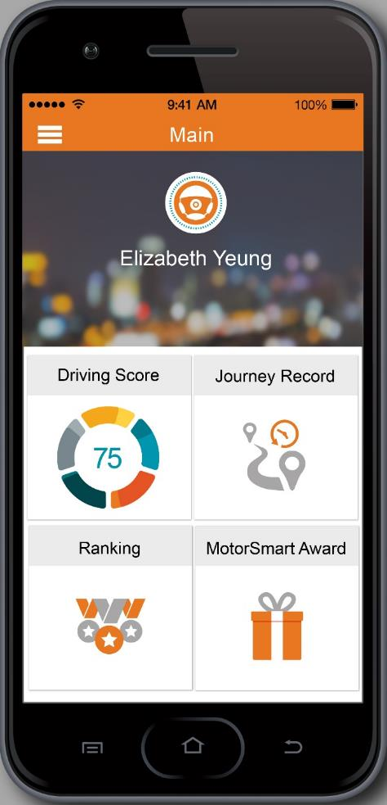
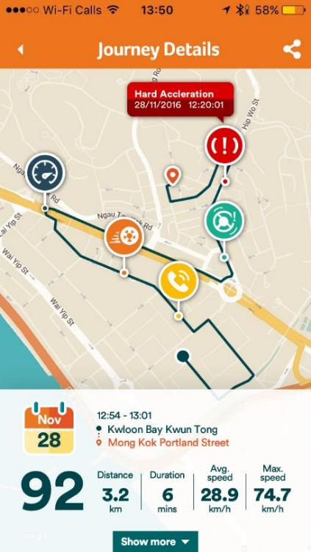
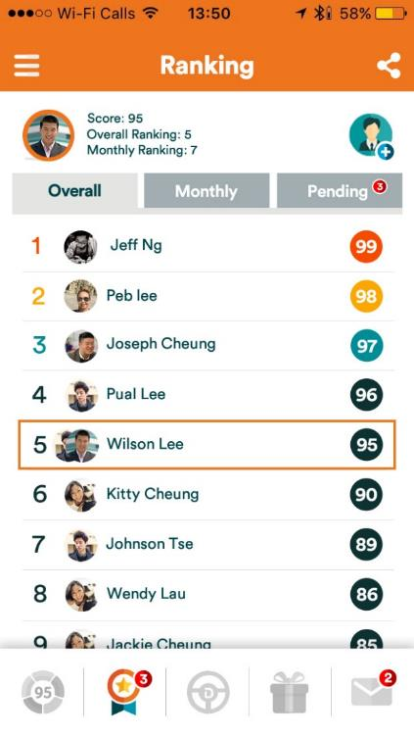
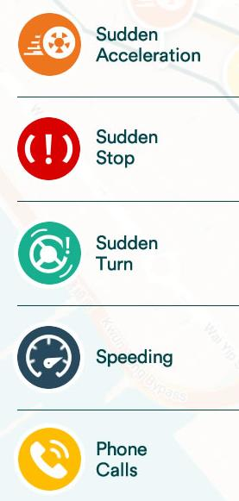
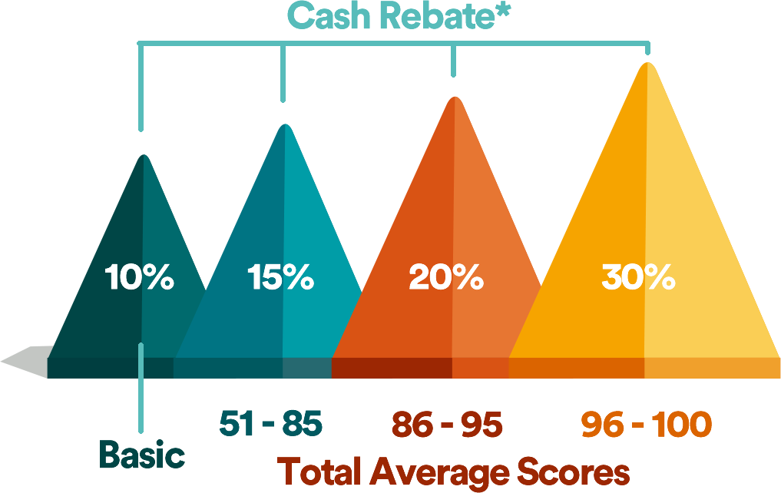
Key app features – The 3S
SCORE
SHARE
SAVE
after every trip
with friends
up to 30% cash rebate
5 Major Driving Attributes
Track over 40 driving attributes to evaluate one’s driving score
Add friends and compete with them by comparing driving scores
Transparent cash rebate scheme to reward higher scores (better driving)

Slide 7






Remarkable download and usage momentum
(In 8 months since launch as of 23 June 2017)
9,155
3.5M+KM
Number of downloads
Total trip length measured
Achieved 180%
of the first year KPI
Go around the earth
88
times

Slide 8


Impact on users’ driving behaviour
Over 90% of drivers
Steady driving improvement recorded
earning at least 15% cash rebate on top of existing NCD
Attributes | Average monthly change rate | Projected yearly change rate
Speeding | -0.7% | -7.6%
On Phone | -5.7% | -49.4%
Braking | -2.7% | -28.1%
Overall Driving Score | +0.8% | +10.3%
70%
Earning 15% cash rebate
18%
Earning 20% cash rebate
4%
Earning basic 10% cash rebate
8%
Earning 30% cash rebate
Score:
Category
<50
Normal
51-85 Medium
86-95
Good
96-100 Excellent
(Data since launch from Oct 2016 to May 2017)
10

Slide 9





WIN-WIN situation for both FWD and drivers
Drivers
Insurer
SAFER DRIVING
LESS CLAIMS
Our ultimate mission:
Every driver in HK can truly enjoy a pleasurable and safe driving experience

Slide 10
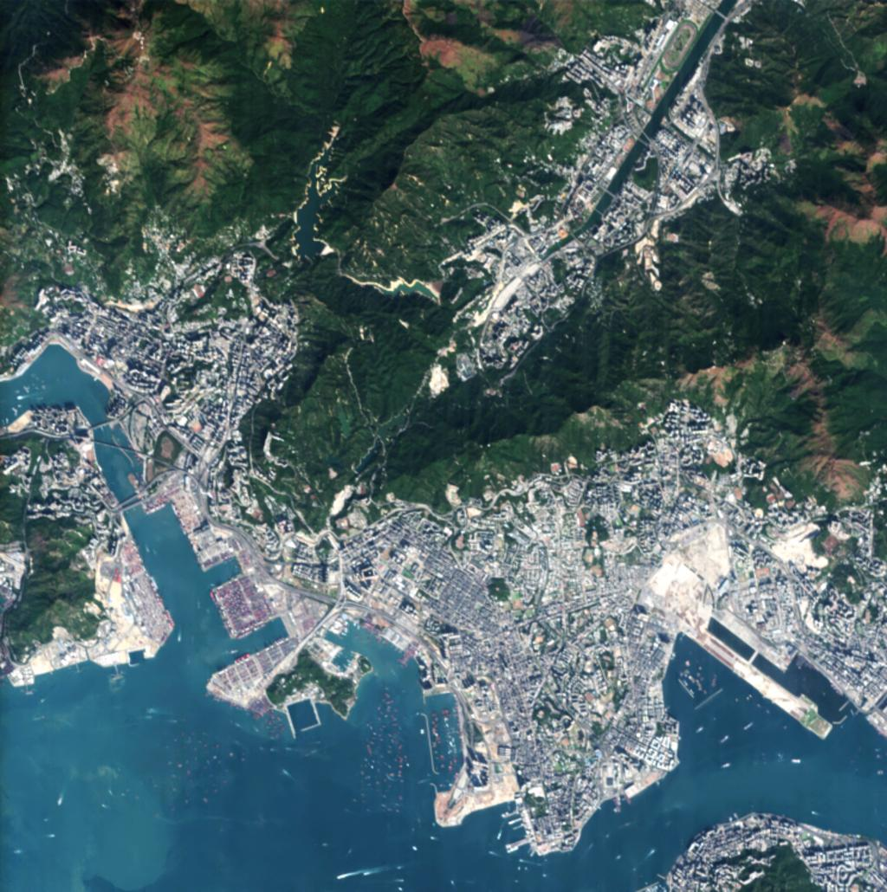




Looking ahead - Enable new marketing tactics
Make insurance more personalized and relevant to lifestyle
Safe Wednesday Offers?
Silent Driving Hours Challenge?
Rural Explorer Award?

Slide 11
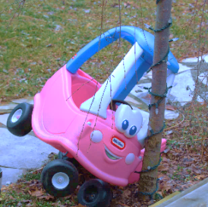

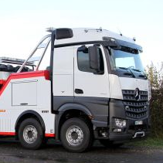
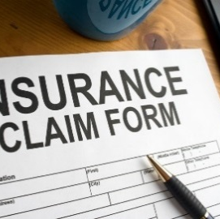






Looking ahead - Crash locator & claim automation
CRASH
ALARM
ACTION
CLAIM
Set off alarm at Contact Center
Call towing truck to user’s GPS location
Motion record and geographical data for automatic claim
Shocking motion detected
Contact Center try to contact the user
Call ambulance to user’s GPS location

Slide 12









Recognition on InsurTech Development
Recognition by the mobile marketing field
Recognition by the HK Government officials
Gold Award
Best App - Finance
Bronze Award
Best App – Targeted Demographics
Bronze Award
Most Innovative Use of Mobile
Best FinTech Grand Award
Best FinTech Award (Banking, Insurance and Capital Market) Gold Award

Slide 13

THANK YOU!
FWD Insurance All rights reserved 2017
FWD Drivamatics

