Slide 1



Text
Text
Text
Sticker zur Kommentierung/ Bearbeitung
TURNING SOCIAL DATA INTO INSURANCE DATA
Information Memorandum
2017

Slide 2
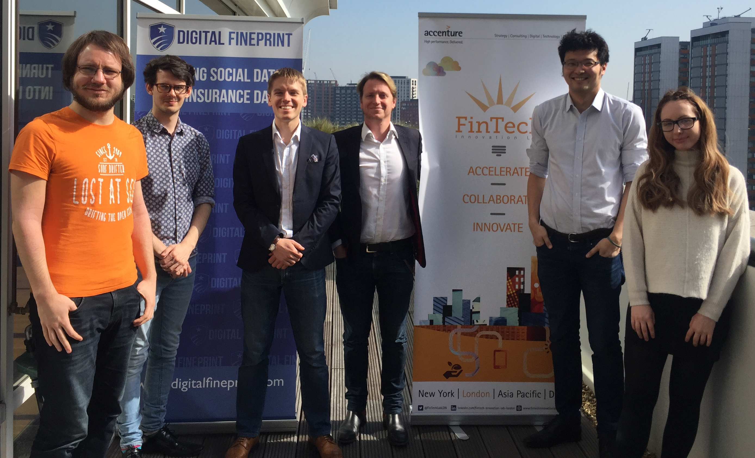




We are a VC-funded, accelerated InsurTech that uses social analytics to help insurers sell online
Executive summary
London-based InsurTech startup using social media analytics to help insurers sell more effectively online
Started out of Oxford University in 2016, built on patent pending technology (UK patent number: 1701560.3)
Post-product and post-revenue, active pilots with MetLife, Hiscox and Allianz, currently scaling to more insurers and new products
Winner of Accenture’s FinTech Innovation Lab (out of 300 seed-stage applicants)
8-person team; management team with expertise in finance, insurance and social media (Twitter, Strategy&, Hiscox)
$400k angel round closed in Q4 2016 (lead investor was early stage VC Eos Venture Partners)
Supercharged by powerful accelerators
Angel round successfully closed in Q4/2016
$400k
from
and other investors

Slide 3


Our solution uses social media APIs and data analytics to connect insurers with consumers
1. Digital Fineprint lets customer use social media to log into insurance application
3. Digital Fineprint then analyzes customer’s social data and provides insurer with results
Insurers
2. Digital Fineprint auto-populates insurance application form with social media data
4. Digital Fineprint independently targets and acquires customers on behalf of insurers
1. Autofill
Our solution meets three key needs
2. Analytics
3. Partner Sales
User-friendly process for consumers purchasing insurance policies
Way to facilitate insurers’ digital transition for online sales
Access to new consumer data for improved analytics

Slide 4
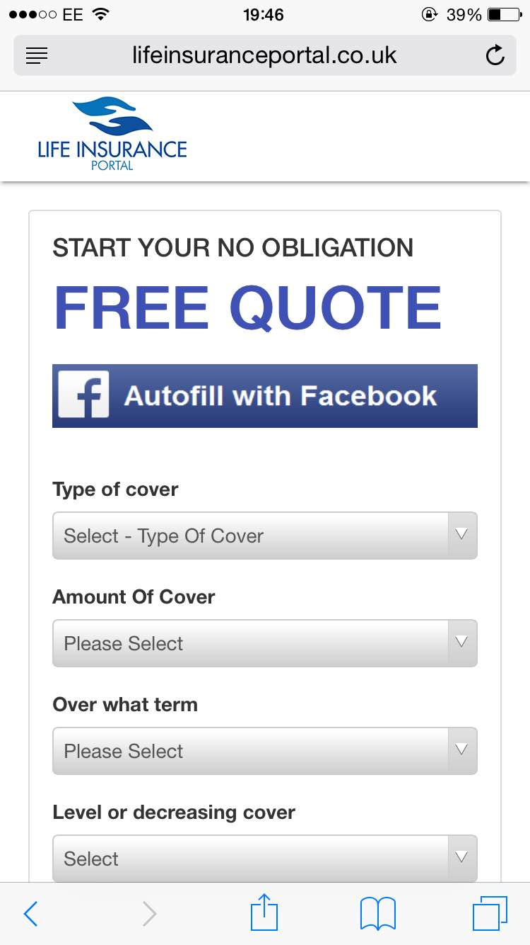

Our business model is tied to our two-phase go-to-market strategy, enabling fast growth
Text
Text
Text
Phase 1
Autofill
Phase 2
Analytics
Sticker zur Kommentierung/ Bearbeitung
Launched in 2016
2017
Paid Pilots
SaaS Subscription

Slide 5
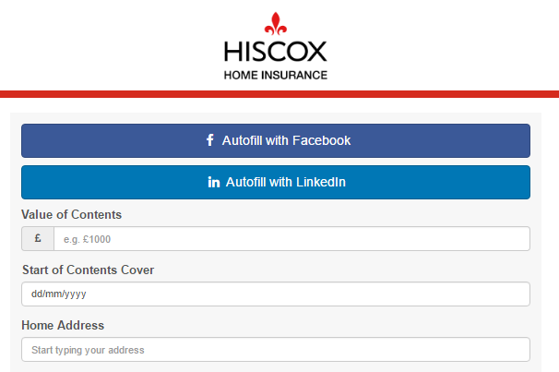
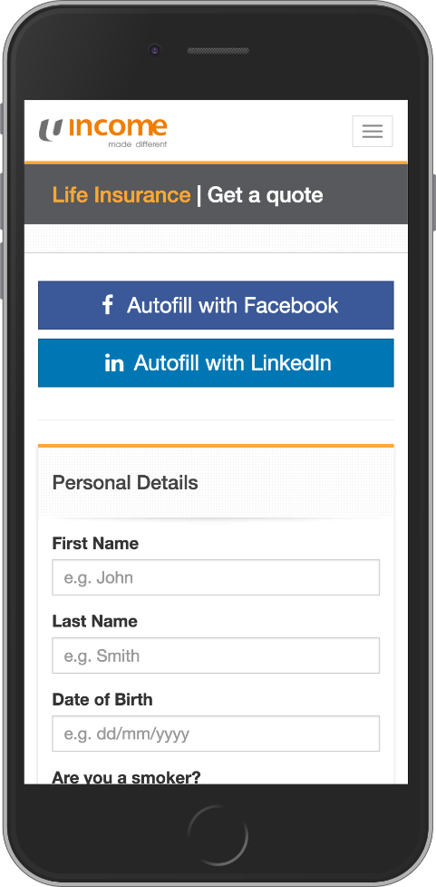
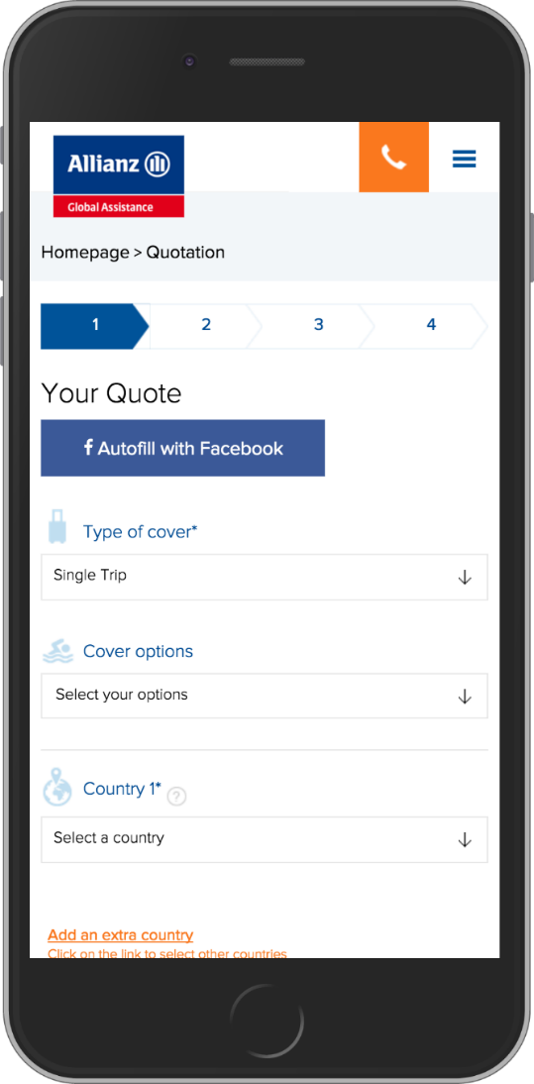
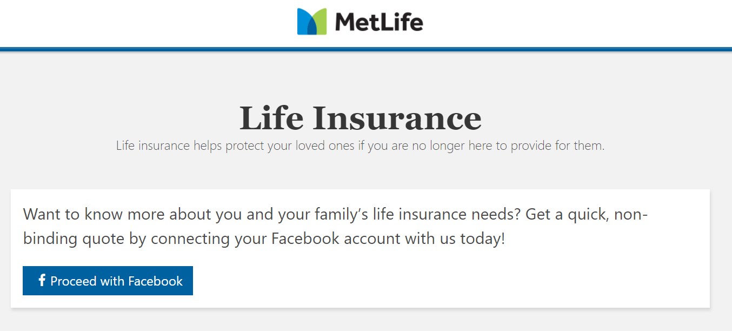
In Phase 1, we provide insurers with a social login button on their website along with an autofill option
Text
Text
Text
Sticker zur Kommentierung/ Bearbeitung

Slide 6
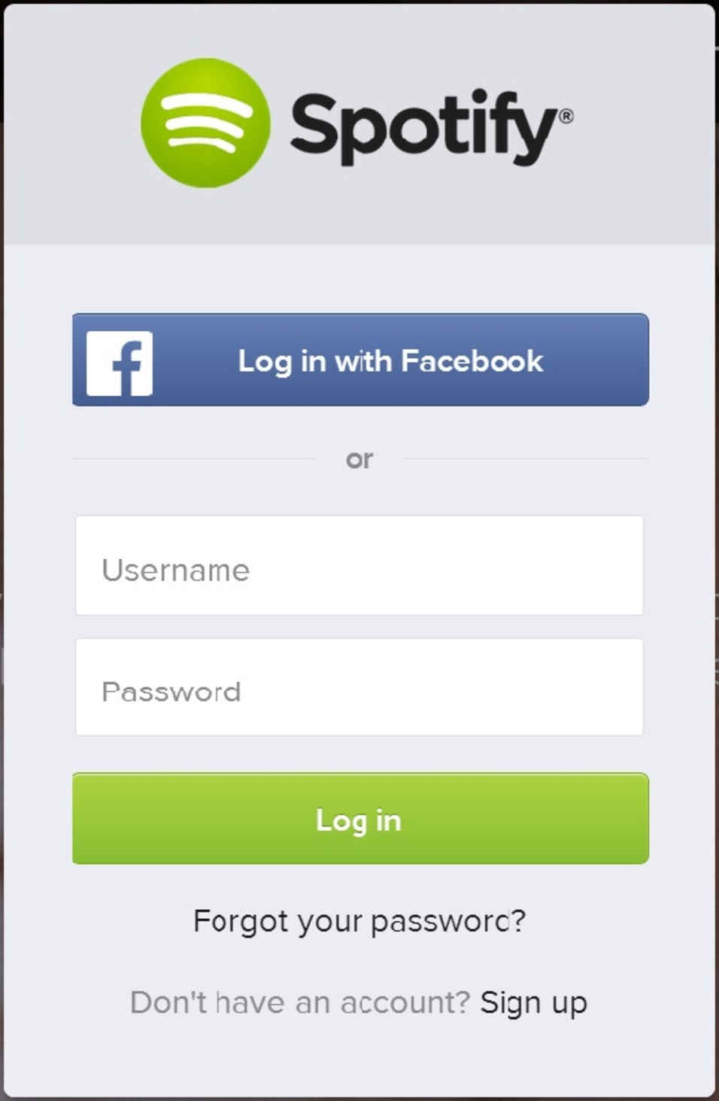
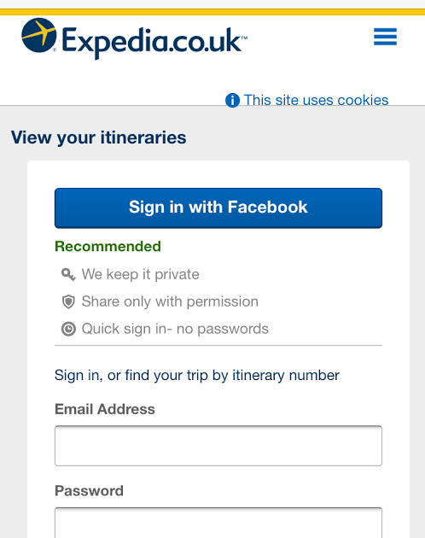
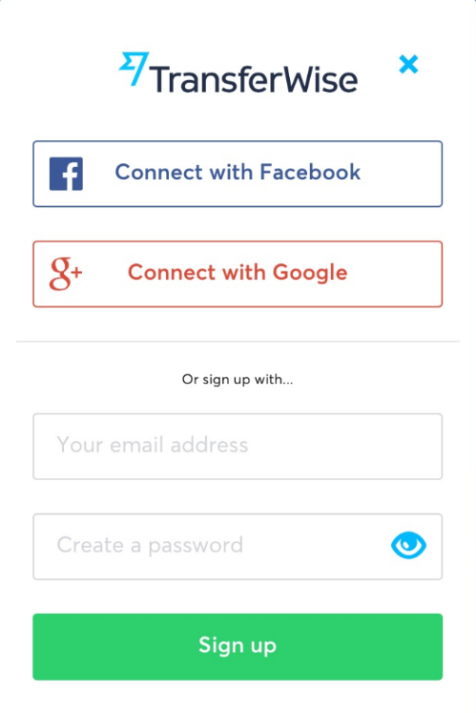

Social login and autofill has had high levels of success in other industries, including insurance in China
Research* indicates that:
  92% of users will leave a site instead of resetting or recovering login info.
  88% of users admit to entering incomplete or incorrect data on registration forms.
  77% of users believe social login is a good registration solution.
Zhong An Insurance in China sold over 2bn policies in 2015 by allowing their customers to purchase and manage policies through Chinese social media WeChat.
* WebHostBuzz: http://www.webhostingbuzz.com/blog/2013/03/21/whos-sharing-what/

Slide 7
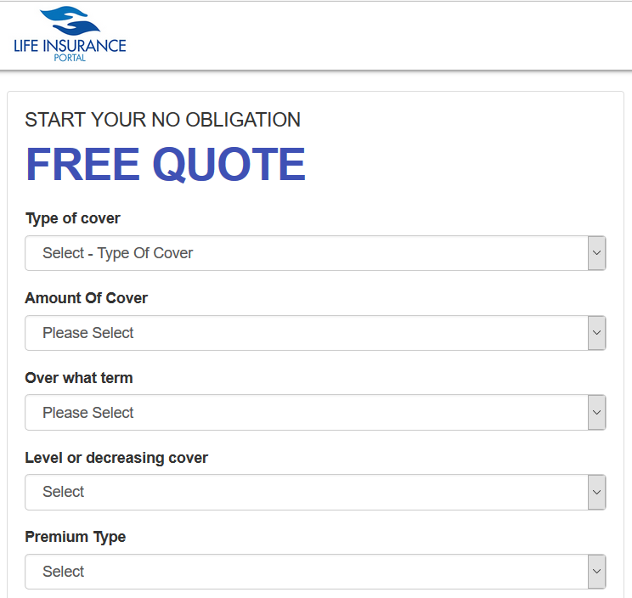
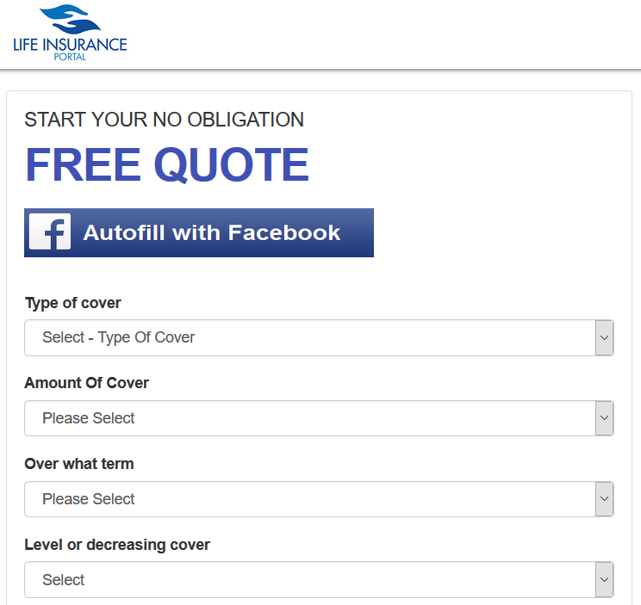
Our autofill option enables 4 times sales with identical marketing investment
Without using our solution
Using our solution
Conversion rate increases from 3.7% to 15.9%
Time spent on site decreased from 2.3 minutes to 1.2 minutes

Slide 8
We are currently developing our analytics product for Phase 2
Text
Text
Text
Phase 1
Autofill
Phase 2
Analytics
Sticker zur Kommentierung/ Bearbeitung
Launched in 2016
2017
Paid Pilots
SaaS Subscription

Slide 9
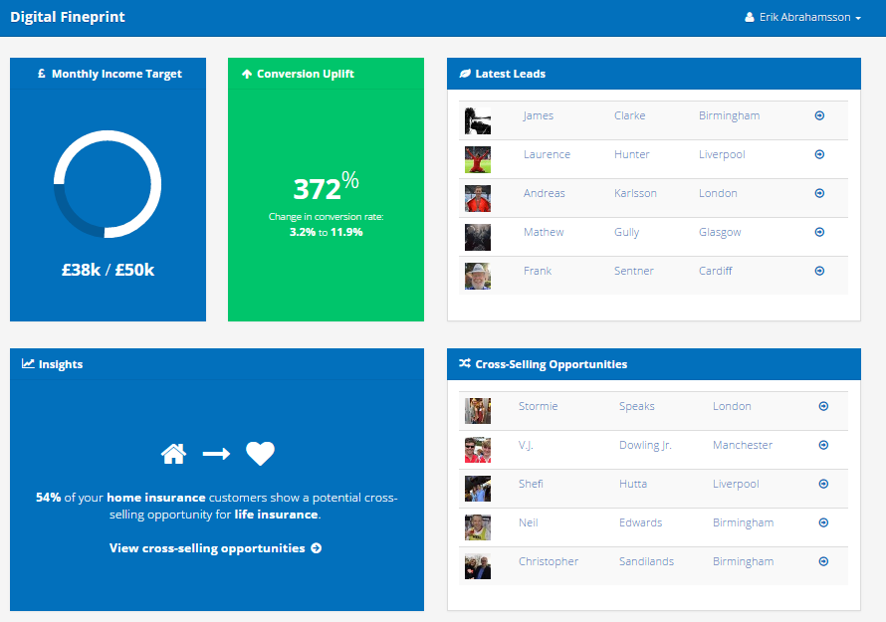
This product will analyze social media data for insights and create risk profiles for insurers after the social login
Text
Text
Text
Our analytics product for insurers
Sticker zur Kommentierung/ Bearbeitung
Predictive risk metrics
Connected platforms to incorporate fitness and lifestyle habits
Social data to improve marketing and customer engagement
Bespoke analytics according to client requests
Easy-to-use dashboard provided for the client to access information

Slide 10













Our revenue pipeline indicates significant industry interest in our product
Insurer 12
Insurer 12
Insurer 10
Insurer 6
Insurer 1
Insurer 11
Insurer 2
Insurer 4
Insurer 7*
Insurer 9
Insurer 8*
Insurer 3
Insurer 5
Early negotiations
(<3 meetings)
Late negotiations
(>3 meetings)
Early revenue
(Pilot/first invoices)
Recurring revenue
*Dark blue box indicates Asian connection

Slide 11
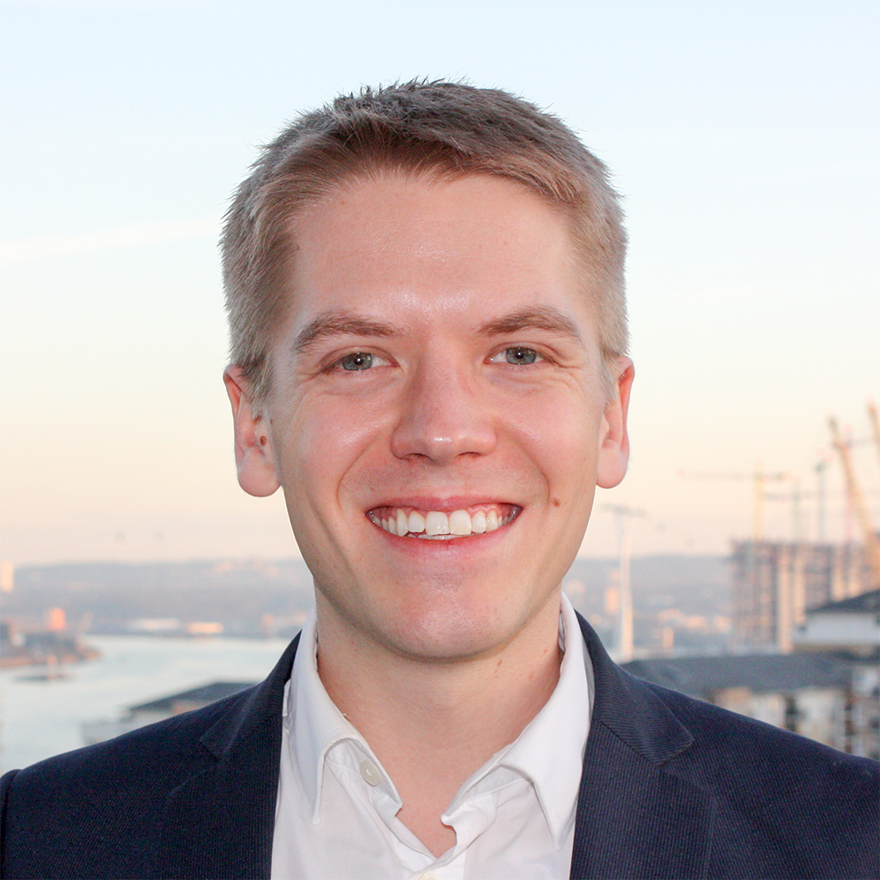

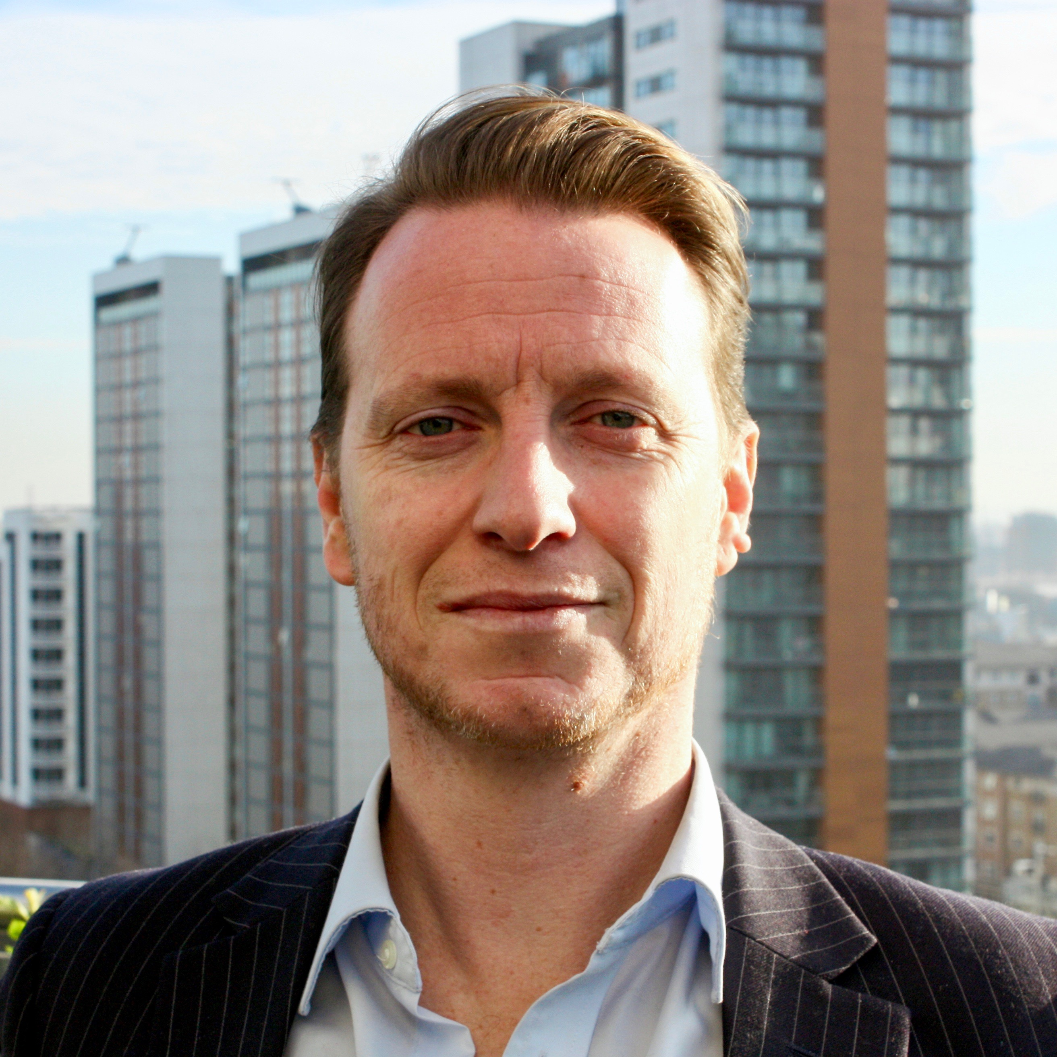

Our management team consists of experienced industry experts and entrepreneurs
Text
Text
Text
Management team combines industry expertise with deep technical know-how
Sticker zur Kommentierung/ Bearbeitung
ERIK ABRAHAMSSON
Founder & CEO
Previously at Twitter and P&G,
Erik brings social media expertise and entrepreneurial drive. After winning a full scholarship to Oxford on academic merit, he founded Digital Fineprint.
JIN CHEN
CTO
A LSE data scientist with over 8 years of experience delivering data analytics driven strategy projects across industries at Strategy&’s consulting and insurance practice.
JAMES CLARKE
Head of Sales
James brings 10 years of insurance expertise and a degree from LSE. Having worked with Hiscox and several international insurance groups in the Nether-lands and Japan, his network helps us grow exponentially.
AUSTIN WELLBELOVE
Head of Development
Austin brings 6 years of full-stack development expertise and a degree from Oxford University. He leads the development of outstanding front-end and back-end solutions for ourselves and our clients.

