Slide 1

Insurance powered by communities

Slide 2



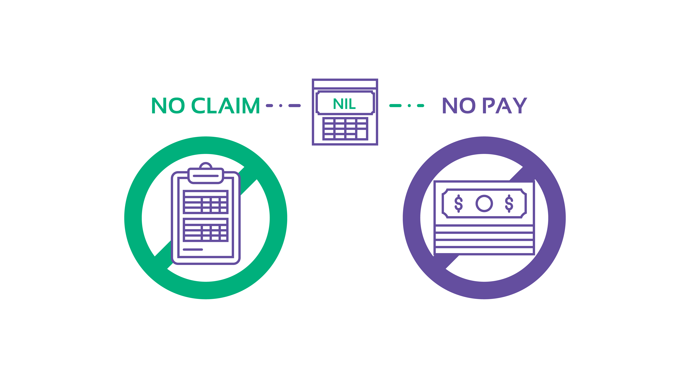
A little bit about ourselves
Who we are
Insurance technology platform
    Enable the public to enjoy protection by forming digital mutual help communities
Our focus
Underserved areas of society
Financial inclusion
Social protection
Financial literacy
What we do
Complement current government policies and existing insurance products to make our social security system more robust and complete
Our mission
To enable fair and transparent insurance coverage for everyone at the lowest possible cost

Slide 3


Uniqueness of Bandboo insurance
100% unconditional rebate
of premiums not utilised to meet any verified claims
Members pay a membership fee to join the Bandboo platform
Premium taken from individual Bandboo Accounts to contribute to a payout only when there is a claim
Premium left in each member’s individual Bandboo Account at the end of membership term
Pay premium
Membership term ends
Unused premium refunded
Individual Bandboo Account
Pay premium
Membership term ends
Unused premium refunded
Individual Bandboo Account
Pay premium
Membership term ends
Unused premium refunded
Individual Bandboo Account
Members receive
100% of unused premium
Form communities
Funds pooled together

Slide 4



Blockchain Ledger
Our Blockchain Platform
Powers a transparent and immutable ledger
Payout and premium contribution needed for each month can be viewed by all members on the ledger.
All records on the ledger are chained together with cryptographic hashes and time-stamped. They cannot be altered by anyone, including the Bandboo administration.
Data on payouts, premium contributions, and any other payments by members are stored in digital blocks
Block is hashed and time-stamped to ensure immutability of records
01011010
01011010
0101010101010101010101010101010101010101010101
Periodically, each block will be mined and chained into an existing long chain of blocks containing past data
Data in hashed blocks can be decrypted and published on our site to be viewed by members

Slide 5



Conflict of Interest
Problems with traditional insurance & the Bandboo solution
Opaque Operations
High Cost
Traditional Insurance | Bandboo Solution
Payouts to policyholders come from the insurance companies and eat into the insurance companies’ profits | Any payouts are funded directly by members of the community and have no effect on the company’s profit
Traditional Insurance | Bandboo Solution
Policyholders have no idea how their premiums are calculated or what they are used for | Members can view any contributions required from members and payouts made for each month on our blockchain-powered ledger
Traditional Insurance | Bandboo Solution
Extra premium that policyholders have already paid go to the insurance companies when claims are lower than expected. According to the OECD, in 2015 only 52% of premium collected in Indonesia paid out as claims | Members pay the exact contribution required to cover claims through our No Claim No Pay principle

Slide 6
Value proposition
Interests of all stakeholders well aligned
Value to members:
Insurance at lowest possible cost
Able to know the premium payments and what payouts have been made
Easy onboarding and claim processes
Value to partner organisations:
Sold as organisation member benefits with little costs to the organisation
Value to partner distribution channels:
Additional product that does not conflict with their existing ones
Value to Government:
Social benefits without the burden on public finance
Societal mutual help and hence no clutch mentality

Slide 7
Our competitive advantage
Insurance business model reinvented
Conventional Insurance | Typical P2P Insurance | bandboo
Fixed premium | Fixed premium
Prepay premiums: People view insurance policies as investment. Policyholders expect returns Susceptible to fraudulent claims Lots of overheads, e.g. agent fees Expensive and rigid | Prepayment of large sums of premium still required initially to obtain coverage Incurs cost of reinsurance | 100% Rebate Premiums: No Claim No Pay No Deduction of premiums if there are no claims Simple revenue model: Monthly membership fee 100% of premiums collected are used only for insurance purposes
Profit
Expenses
Payout
100% Rebate
Premiums
Reinsurance
Fees
Variable Rebate
Fixed Membership Fee
Payout

Slide 8
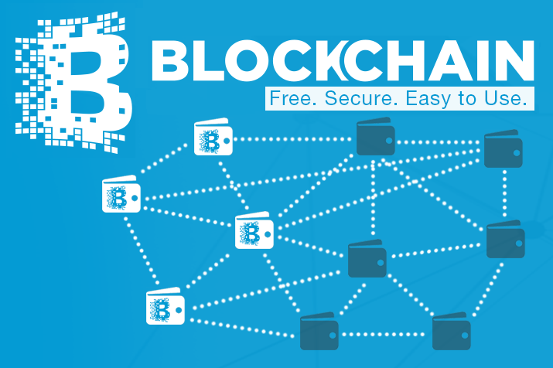
Blockchain and Smart Contracts
Bandboo is leveraging on Blockchain and smart contracts to enhance customer engagement
How?
A Blockchain-based ledger provides immutable transparency and secure audit trail.
Oracles to feed verified data into ledger, triggering claims if pre-defined event has taken palce
Potential Use Cases
Travel Delay in for of flight and rail travel.
Life Insurance
Paremetric based Insurance.

Slide 9



Possible Use Case: Flight Delay Insurance
Customers
Web Interface
API call to verify
Publicly available data
Bandboo Etheruem Network
Flight arrived late?
Flight Data Oracle
Flight cancelled?
Flight Delayed?
Smart Travel Insurance Contract
Immediate compensation upon Trigger of event

Slide 10
Automation of Claims Process
Interests of all stakeholders well aligned
Claims pay out themselves????
Effect on Customer Engagement | Value to Insurers | Value to distribution partner channels
No more claim forms Instant compensation of claims Happy claim experience Shift in negative mindset against insurers | Huge cost reduction: Less resources to administer claims Increase in sales and margins Goodwill | Exciting innovative product pushes sales Higher tender bids to distribute such said products

Slide 11


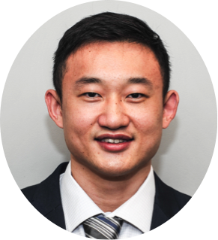

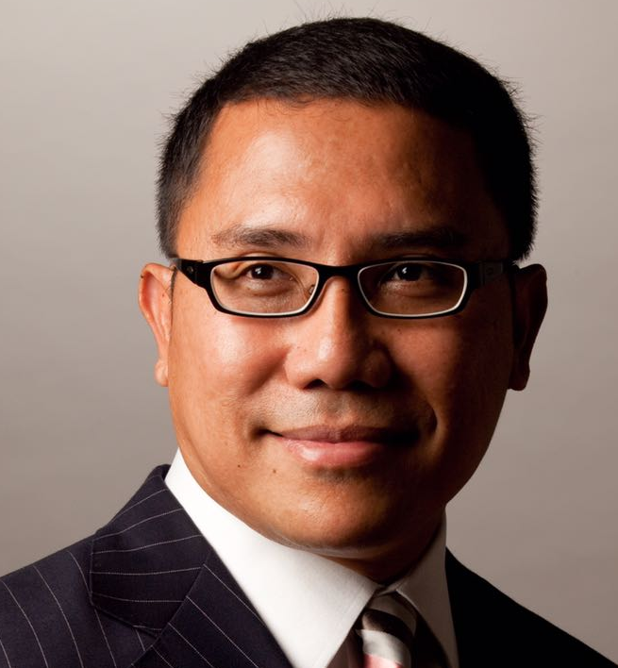
Team
Ashley Kee - Co-Founder & CEO Ashley is a lawyer by training but has erstwhile spent his career in private equity. He has three years of experience in portfolio management and strategic business development. At Bandboo, Ashley is in charge of corporate finance and leads the team to explore new products and venture into new markets.
Ng Zhong Qin - Co-Founder & CTO Zhong Qin was awarded IDA NIS scholarship to read Computer Engineering and has five years of experience developing internet-facing applications at a financial institution. He leads a team of engineers that builds and maintains the IT infrastructure. At Bandboo, Zhong Qin is the creator of the proprietary Community Assurance platform that runs on blockchain.
Ou Zhiqi - Co-Founder & COO Zhiqi holds a degree in Economics. He taught Economics at a local institute for three years before joining as a founding member at a food technology start-up and subsequently an education technology start-up. At Bandboo, Zhiqi develops the forecasting framework for Community Assurance and devises marketing strategies..
Chee Chun Woei – Chairman Chun Woei brings to Bandboo two decades of start-up experience. While practising as an IP lawyer, he has co-founded and advised numerous start-ups. More recently, he co-founded Global IP Exchange, a platform that facilitates investment of intellectual property. At Bandboo, Chun Woei develops the business strategy and directs its execution.
Nizam Ismail – Advisor Nizam is a partner of RHTLaw Taylor Wessing with 25 years of experience in financial services regulatory compliance and litigation. He also co-founded and currently spearheads RHT Compliance Solutions, a dedicated financial services compliance consultancy and solutions provider. At Bandboo, Nizam advises the team on regulatory issues in the region and helps Bandboo develop partnerships with organisations overseas.

Slide 12

- END -

