Slide 1
Aditya Birla Health Insurance

Slide 2
Why Aditya Birla Health
Aditya Birla Health Philosophy – Know your health, Improve your health, Get Rewarded
Engage customers end-to-end with Aditya Birla Health Philosophy
Allows 2 way engagement between ABHI and Customer by being a Health Partner
The only product which intelligently shows customized interface based on customer type (retail & group)
Sales Automation
End to end sales fulfillment
Connected Health and Wellness Eco-System
First of its kind non-traditional Health Insurance Engagement Platform in the Country
2

Slide 3
First of its kind
Changed Health Insurance from boring & transactional to engaging & rewarding
Rich digital platform
New Business
Wellness Features
Comprehensive integration with wellness program
Digital Service & Support
Work as Health Partners of every individual by helping him stay fit & improve his health
Activ Health integrates with 3000+ Health & Fitness Apps
Captures 100+ health and activity data points of the customers then processed to assess customer fitness levels & health risks
Personalized Digital Health Records on the go
2 way Customer Engagement - Embedded Wellness, DRM, Cashless
Chronic Management Program
Developed a 2000+ network of doctors/hospitals
Integration of health & wellness concepts with tracking – all delivered digitally
3

Slide 4
Earn Health Returns
Sales Automation
Shortest time to market
Cash-back for staying fit and healthy
Simple dashboard to check earnings
Choose to use Health Returns to pay for next year premium or other medical expenses etc
Get a Quote and Buy Insurance
Generate Lead
Instant Issuance
Works both offline and Online
One stop solution for sales – to track their biz and performance
No other Health/Life/ General Insurance company in the country today has a digital platform as engaging, as service rich and as customer focused as Activ Health

Slide 5
Building Excellence
Building Digital Ecosystem
Standardization & seamless exchange of data, accessible across touch-points & ability to do analytics to provide better services
Better Fraud management
Stronger control of data flow & privacy controls
Shortest Software Development LifeCycle (SDLC)
Rolled out 52 features in 120 days
Better customer service
Policy servicing on-the-go
Integrated partner network & seamless flow of interaction
Need of the hour: Going digital
Overcome being the last mover disadvantage: Differentiation across verticals

Slide 6
Sales Automation
First time in industry - 100% digital at launch
Increase sales efficiency
Information at fingertips
Lead Management System
Anytime Anywhere access
Ease in customer onboarding
Ease of Sale and Learning
Paperless logins, Digital experience
Device & Platform agnostic
100% adoption
Online & Offline application
Online and Offline payment mode
Cost effective

Slide 7
Best Practices Implemented
Cross functional POCs
Business owner, Product owner & Technology owner defined for each feature thus, enabling parallel feature development on the platform
Responsive Design across mediums
View app/website across various screen sizes without any breaks. This helps us to deal with future scalability of devices and support our multi-device users of today.
Dummy Policy testing of the platform
Made employees test functionality end-to-end before launch as a pilot user base
Testing wellness proposition using the employee base
Gave employees fitness bands & cumulatively tracked activity data before going to market
Customer Connects
Spoke to customers using our app and got their feedback to later determine process improvements.
7

Slide 8
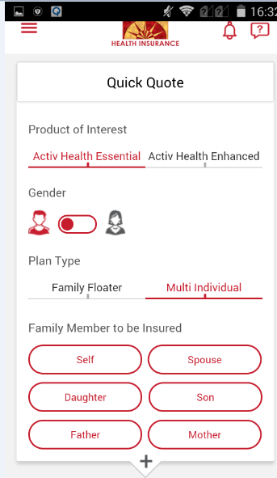
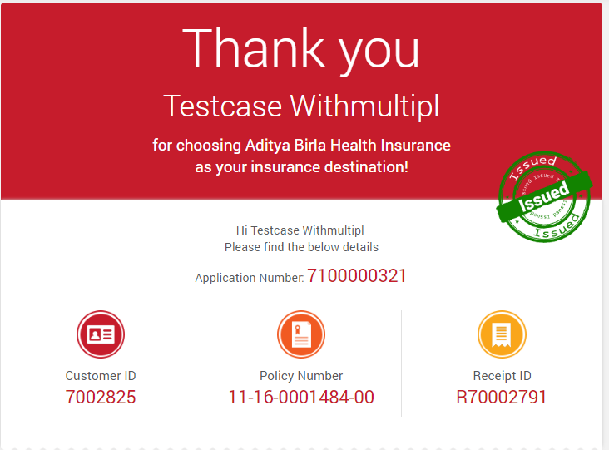
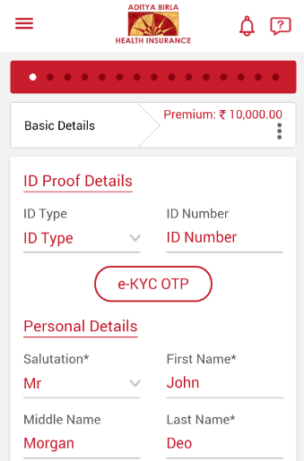
H-app-Y – Health App For You
Proposal Form
Quote Page
Thank You Page

Slide 9
KMS
9

Slide 10
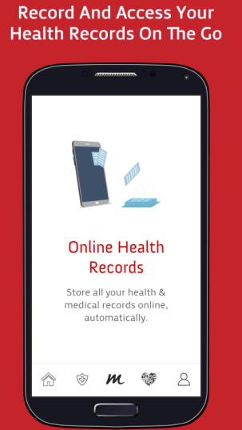
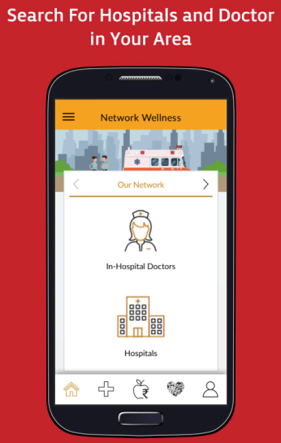
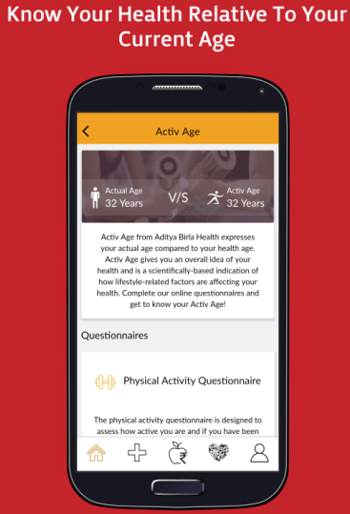
Snapshots of our Activ Health app
Simple user interfaces, explanatory user flows and good pictorial representations

Slide 11
Impact of the project
Made On-time Business Launch possible
Negotiated better healthcare provider rates for customers
Reduction in Service Level TATs
Real Time Engagement with Customer using fitness bands / beacons
Structured Data & system integration - enabled analytics & less paper work
Extensive database of health and wellness services
Customer’s medical reports available real time 24x7 on the go
Successfully motivated users to stay healthy & achieve goals through extensive tracking
11

Slide 12
Thank You

