Slide 1
Krungthai-AXA Life Insurance PCL – pithan.roj@krungthai-axa.co.th

Slide 2
Million registered smartphone users in Thailand
On average, spend hours on the phone
Million of them actively use
Source: WeAreSocial.com

Slide 3
Among Thailand’s growing ecommerce…
Fashion
Entertainment
IT
Home
Beauty
Insurance
Tourism
Kids
Source: 2015

Slide 4
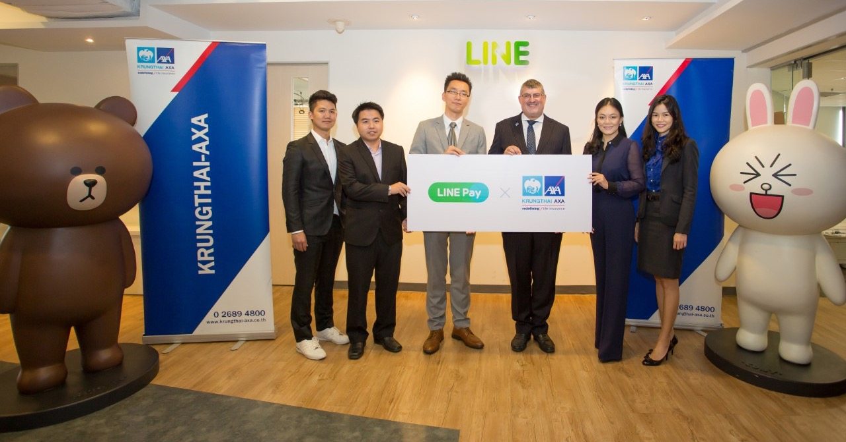
Partnership between Krungthai-AXA Life x LINE Pay
First of Thailand Insurance Industry
First for LINE, globally

Slide 5
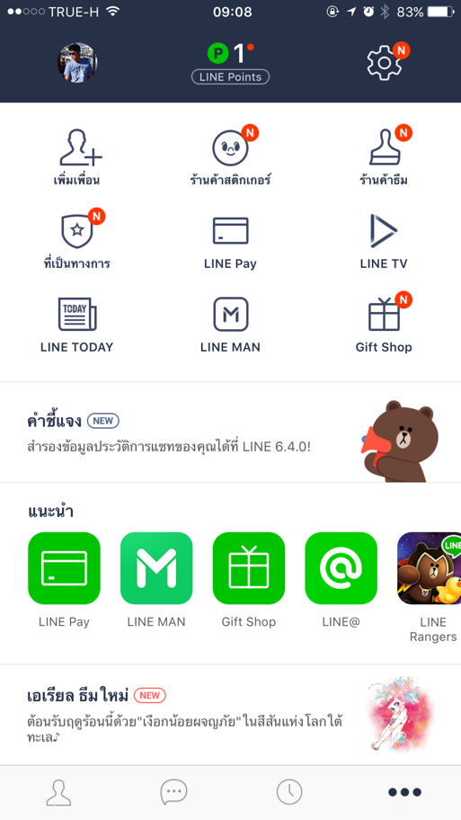
Users access LINE Pay,
LINE’s ePayment feature,
from LINE
Mobile Application
“More” tab

Slide 6
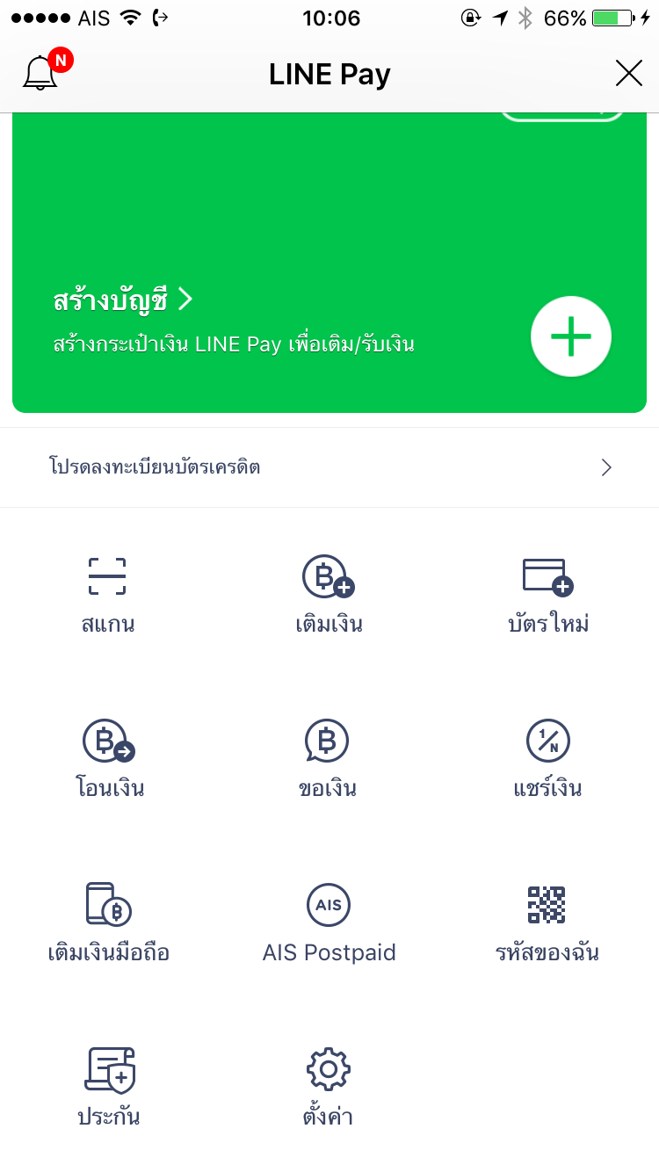
Dedicated & exclusive
menu for “Insurance”
on
LINE Pay
main screen

Slide 7
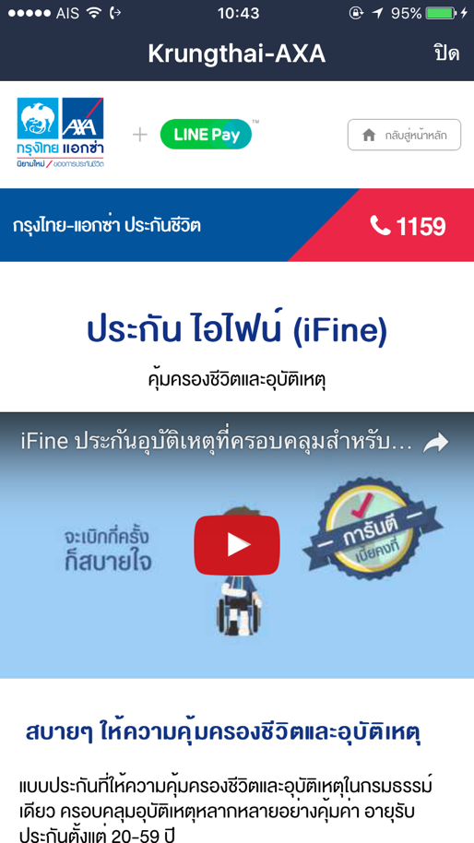
Users can learn about
Life insurance products…
Get a quote…
Buy right here
and pay with LINE Pay!

Slide 8
Customer Behavior
Key Messages
With advanced ecommerce tracking, we have been able to track exactly when was the first time visiting us for a customer
How many times each customer repeatedly visited us before he/she buy
How many days each customer took before he/she buy
This enabled us to gain insight into these customers’ behavior like never before

Slide 9
Time, Locations & OS
Key Messages
In addition to behavior, we know what time were the transactions which is very interesting to see customers bought life insurance at 9pm to 1am or even 4am!

Slide 10
Customer Demographics
Key Messages
This LINE Pay channel proved to be effective in reaching customers age between 25-44, most of whom are employees
This reflects the same demographics of Thai LINE users and Thai ecommerce buyers

Slide 11
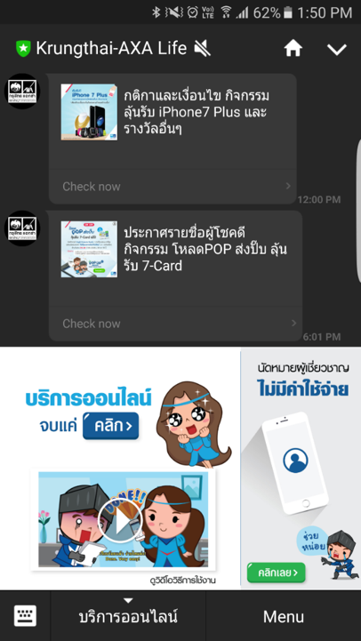
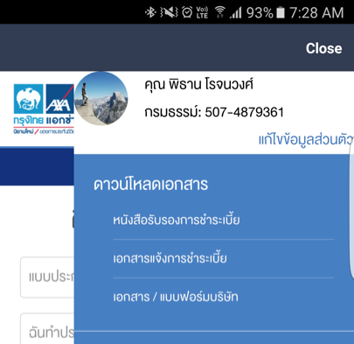
Digital Service for Customers on LINE
Self-service on LINE application for all KTAXA customers
No need to download any mobile application
Easy access through KTAXA official account
1st time registration only
LINE authentication – Login not needed

Slide 12
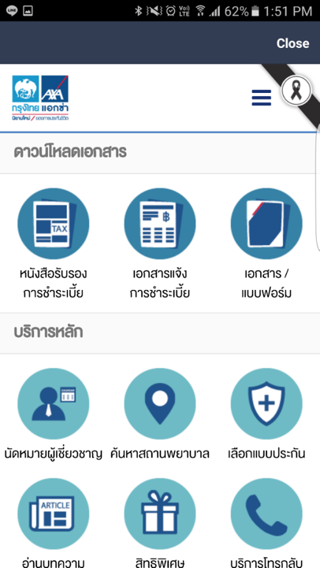
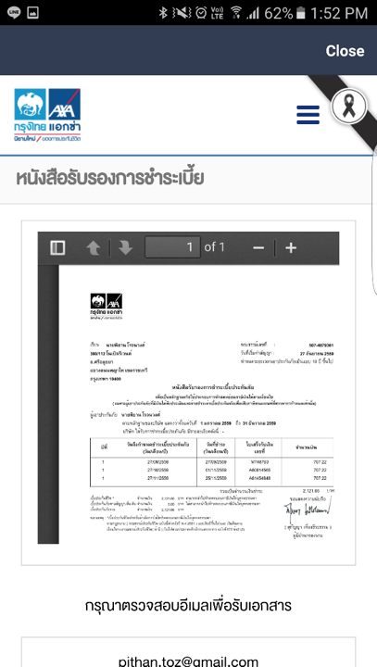
Digital Service for Customers on LINE

