Slide 1
An introduction to SecureNow Insurance Broker Private Limited
Confidential

Slide 2
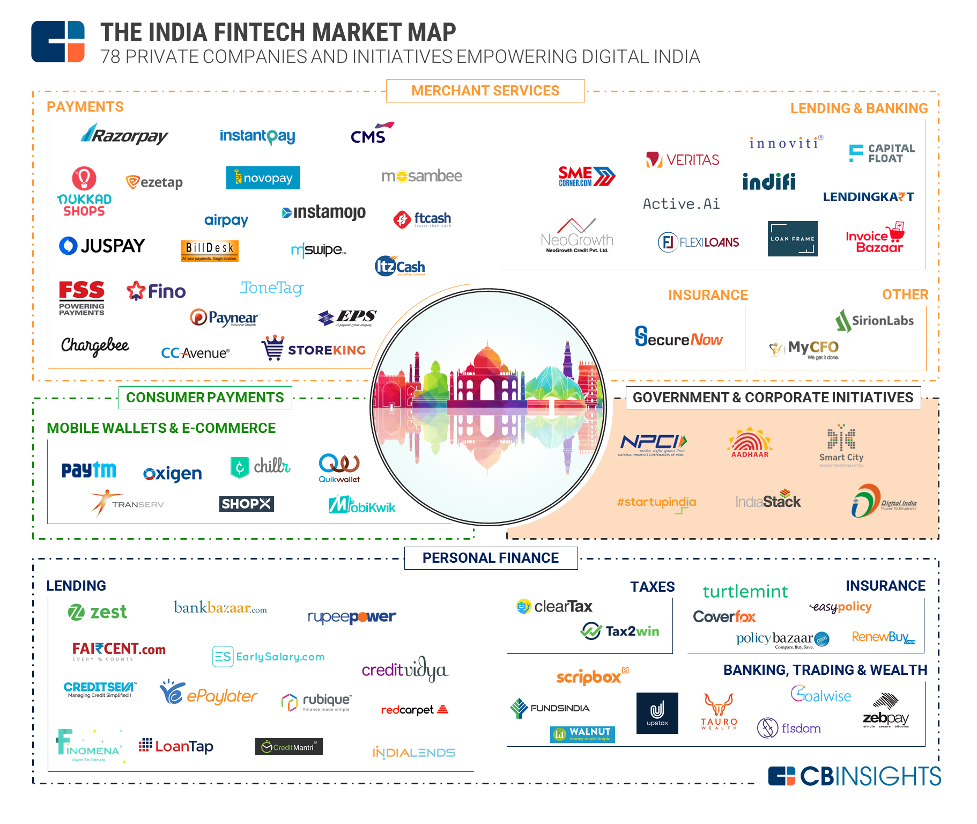

Slide 3
SecureNow is addressing a huge insurance intermediation opportunity in the SME segment through disruptive technology
☑ Attractive market
Insurance opportunity
SME
Opportunity
World average: 2.8%
Huge
opportunity
Estimated # of SMEs in India ~ 48 mn
Highly under-penetrated insurance market US$ 15 bn, CAGR ~ 18%
Huge opportunity in the vast SME segment –
Highly underpenetrated and underserved by organized players
Highly fragmented and sub-scale insurance service providers lack capability to grow
Broking opportunity
Under-served SMEs - unable to buy insurance effectively
Insurance service providers
Customers
Key issues addressed through disruptive technology
Insurers
Relatively easy for companies to shift insurers and intermediaries on renewal
Underpenetrated and fragmented broking market – less competition

Slide 4
SecureNow – an online insurance marketplace, connecting clients and insurers
☑ Disruptive Technology - Moving towards an Online Insurance Exchange
Traditional Model
SecureNow
Client
Client
Intermediary
Online Insurance Exchange
Insurer
Insurer
“Sales-Push” model with focus on renewals
Time consuming and iterative
Insurer / TPA driven servicing
End to end tech-enabled platform with joystick like options – eliminating manual intervention in many products
Insurers’ underwriting team provided with key parameters and live chat for reverse auction
Automated servicing with tools for claim reporting, submission and tracking
Typical Process
Execution
Resultant Impact
TAT: 3 Weeks
Pricing : 100%
TAT: 24 Hours
Pricing: 50%

Slide 5
Online Calculators

Slide 6
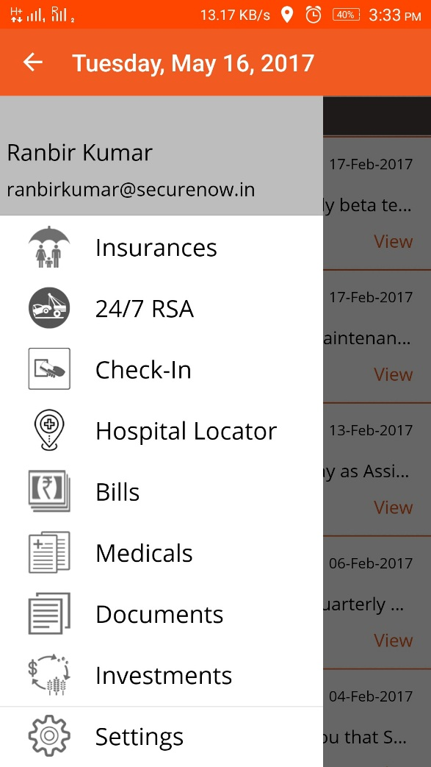
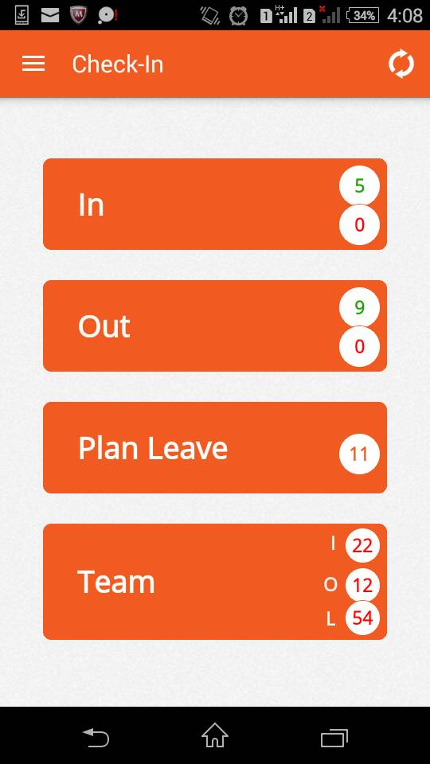
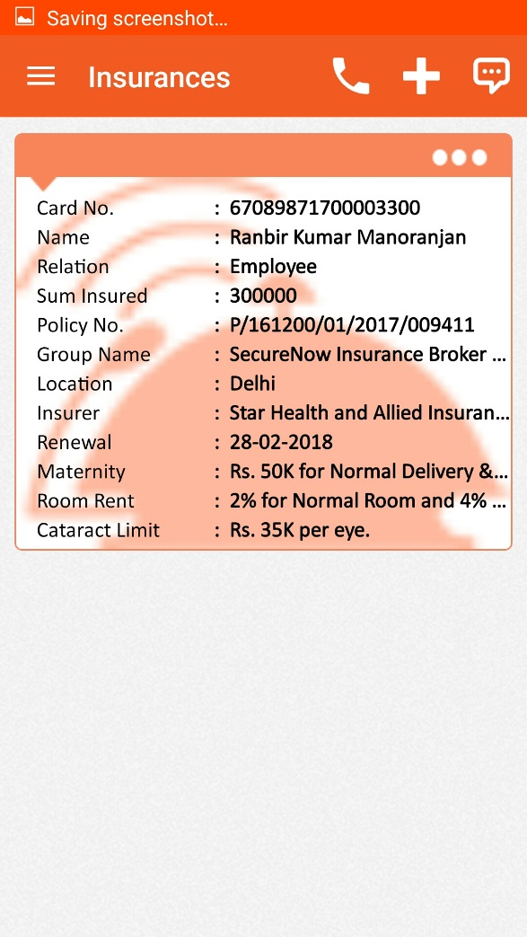
Notify Mobile App

Slide 7
Policy Administration System

Slide 8
Insuropedia

Slide 9
Hospital Locator

Slide 10
SecureNow Overview
☑ Strong proof of concept – Journey so far…
➲ Company overview
Started operations in early 2012 Based in Gurgaon with branches in Bengaluru, Hyderabad, Mumbai, Delhi, Chandigarh, Kolkatta and Noida Full service insurance broker - specializes in commercial insurance Offers both life and non – life with focus on non- life insurance Series A investment of US$ 3 million in 2016 by Elevar Equity
Team of 150 people
20+ products
20+ insurers
Over 3500 corporate clients - adding 15 new customers a day, spread across 10 cities and multiple industries
Select exclusive products deployed (e.g. Group health insurance for SMEs, liability for start-ups, medical malpractice for doctors)
Essential technology platforms developed
Key milestones achieved in just 5 years
Early inroads into building a B2B2C business leveraging mobile technology
Profitable from 2nd year. Significant investments made over the past year
Awarded top three broker position in Asia by Asia Insurance Review 2015 & 2016
“Notify” shortlisted for Spotlight Award in TechHR
Strong public presence – “Mint SecureNow ratings” of health insurance products, Mint - weekly column, Service partner for FICCI, Articles in IRDAI journal
Appointed on the Board of the Insurance Broking Association
➲ Management background
Managing Director Earlier MD & CEO of a life insurance company. Has worked with Max New York Life, McKinsey and Unilever Over 23 years of experience (>13 years in insurance) Principal Officer Earlier worked with McKinsey with focus on insurance Over 12 years of experience in insurance business advisory

Slide 11
Thank you

