Slide 1
Why Telematics?
Webinar: Insurance Aggregators In Asia
29th September 2015
Webinar: Data & Analytics from a Life & Health Perspective
Notes:
Introducing the panelists
Introducing the discussion agenda

Slide 2
Our Panelists

Slide 3
Discussion agenda
1
Presentations:
Torsten Duwenhorst: Essentials of establishing D&A capabilities and a data-driven corporate culture
Dr. Hongjuan Liu: An insurer’s view on data & analytics
Alistair Wickens: Using data & analytics to build your business
Joe Van Niekerk:How data & analytics are at the heart of Vitality Life
2
Questions and Answers
3
Snap Poll – share your view

Slide 4
Questions & Answers
How to participate:
If you have a question please type into the messaging area and send to the presenters
Session format:
The moderator will use a combination of his own questions and those from the audience

Slide 5
Torsten Duwenhorst @KPMG:
Essentials of establishing data & analytics capabilities and a data-driven corporate culture

Slide 6
Dr. Hongjuan Liu @AEGON:
An insurer’s view on data & analytics

Slide 7
Essentials of establishing data & analytics capabilities and a data-driven corporate culture
Strategy & Vision
Corporate culture
Requirements
Pain points
Data Sources
Internal / External
Data sourcing (Social Media, public sector, digital platforms, data vendors, personal devices)
Data Modeling / Insights
Building predictive models
Collaboration between analytics professionals and subject matter experts
Consider IT platforms for development (proprietary vs. open source; on premise vs. cloud
Algorithms
Monitor Model’s Performance
Review and adjust model / data sources
Deployment
Work flow Integration
People & Change
Customer roll out (Apps; Wearables)
Evaluation
Model comparison
Accuracy
Training vs. Test comparison

Slide 8
Market Challenges
Data Privacy
Call-Blocking Apps
customer consent, do-not-call list
i.e. Whoscall
Rising Complaints
Increasing Costs
any dissatisfaction e.g.marketing channel, selling techniques
due to market competition
Low Persistency Rate
Sales
due to product-push approach
reliance on top sales

Slide 9
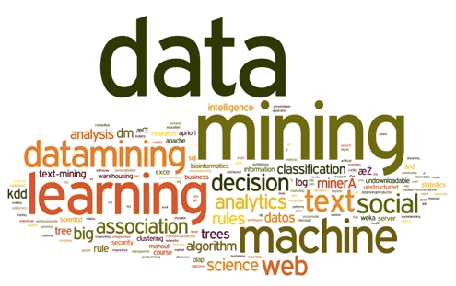
Data & Analytics is Key to Understanding Customers
Demographics
Digital Footprint
Transactional
Interactions
Notes:
In the past, insurance companies, especially in Asia, struggle to have much data. Unlike in the US, where we can buy the whole consumer database, in Asia we rely on in-house data: demographics, transactional & interactions. For agency distributed business, agent tend to keep the information to themselves. E.g. many of the contact information is the agent’s contact detail. With the big data world, digital footprints help to lessen this challenge

Slide 10
Impact of Propensity to Buy Models
An AEGON Case Study
Up by 70%
Test group (targeted using propensity model)
Control group (targeted randomly)

Slide 11
SMART 360⁰: Customer Journey Scores
Enriched Single Customer View for ultra personalization
Customer Life Stage
Insurance Needs
Concerns about Child Education
Purchase Journey
Consideration stage
OBTM friendly
Channel Preference
Married w Kids
Smiley face
Quality Requirement
Mood (Sentiment)
Notes:
There are 6 key pieces of information for selling insurance. (a) Customer life stage because insurance needs depend on it. (C) where the customer is on the purchase journey, (d) preferred channel, (e) desired level of service standard (easily complaint) and last but not least, the mood
For non-life (or P&C), policies with annual renewable contract, renewal date is most important

Slide 12
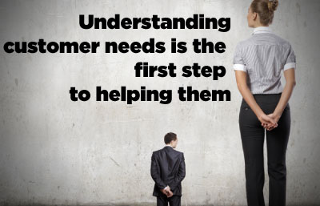
Thank you

Slide 13
Alistair Wickens @Quealth:
Using data & analytics to build your business

Slide 14
Creating one of the world’s most effective predictors of disease risk

Slide 15
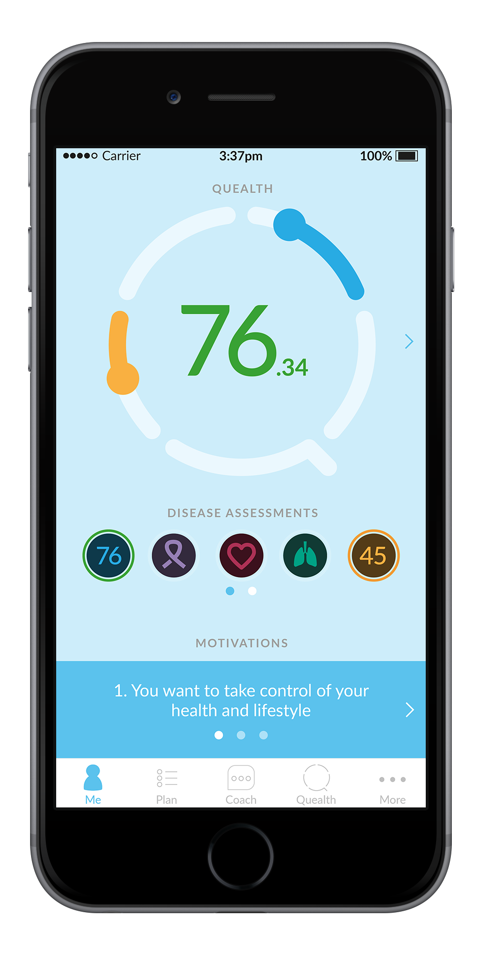
Quealth answers the ‘so what?’ question arising from the tsunami of app and wearable-generated data.
Notes:
So, what makes Quealth unique…?
How do we differentiate from the 165,000 apps already in the market…?

Slide 16
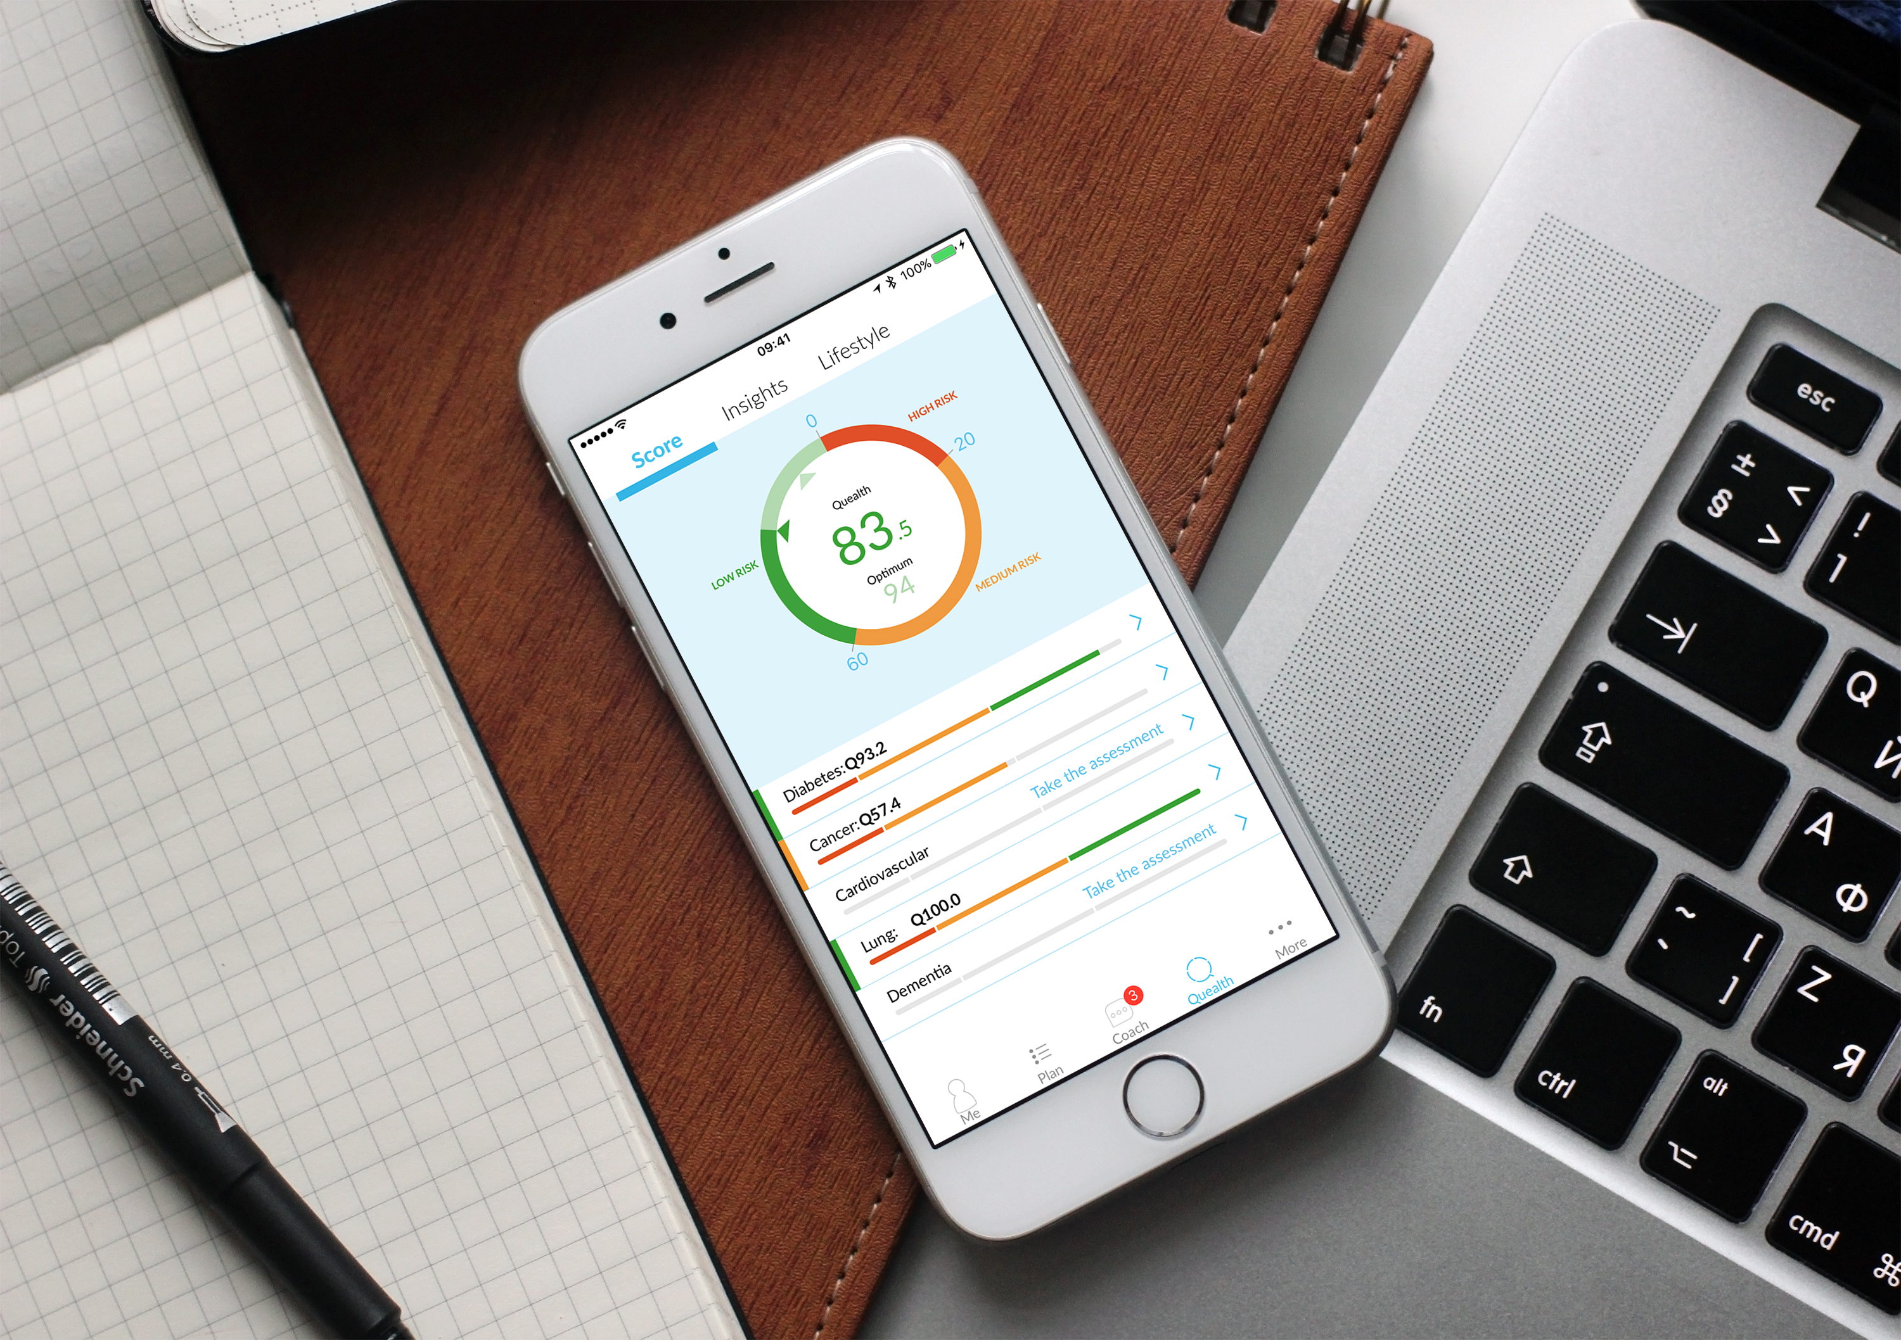
Distils health and fitness data into one easy-to-understand Quealth Score™.
Notes:
Health is influenced by multiple factors — calls into question the long-term value of disparate trackers.
“So what?” if I walk 10k steps?
Has the ability to aggregate data from >250 of the world’s most popular devices.
Realtime data leads to instant impact on Quealth score.
Data is used to calculate the disease risk for 5 conditions: Diabetes, Cancer, COPD (Lung), CVD and Dementia.
Single score output, based on a relative risk model.
Credited as being one of the world’s most effective metrics for disease risk prediction.

Slide 17
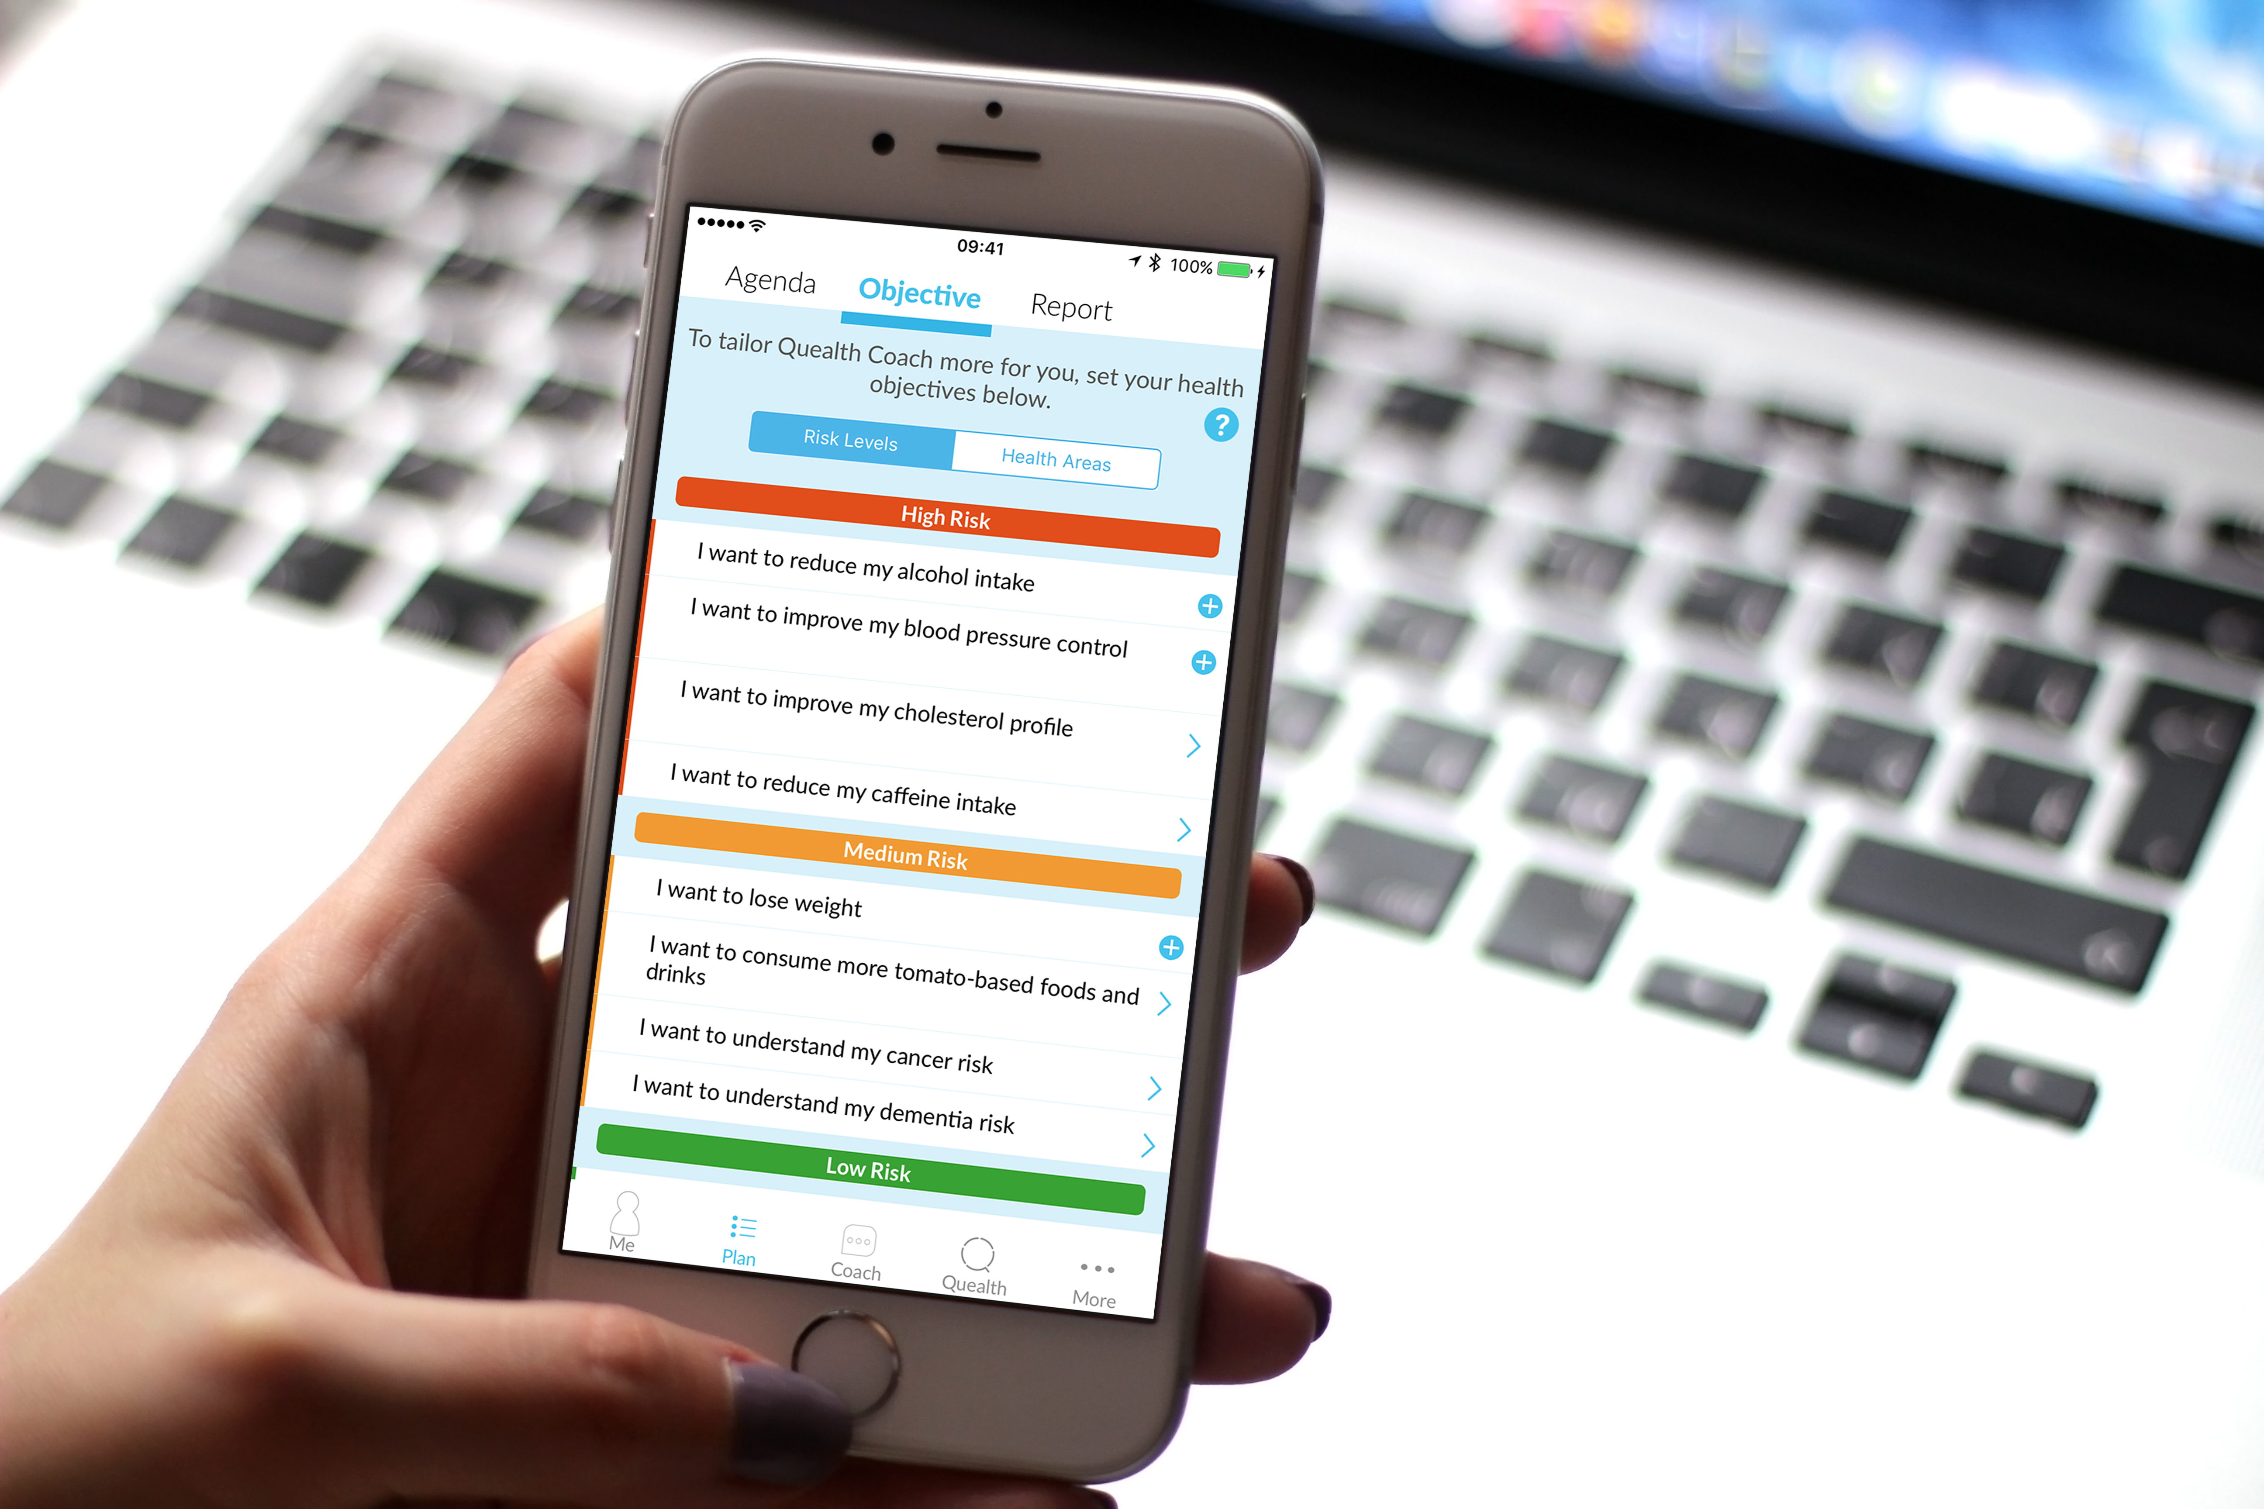
Set a personal health agenda
Notes:
We’re all motivated in different ways….

Slide 18
Change behaviours and reduce risk using the intuitive health coach
Notes:
“Let me introduce you to healthcoach".
Mechanism based on known smartphone behaviours — developed with from UI/UX specialists at Apple Health team in London.
Latest integrations include linguistic style and timings of interventions.
Key area….machines are as effective as human 1-2-1 interactions in affecting behaviour change. Health outcomes provide evidence.

Slide 19
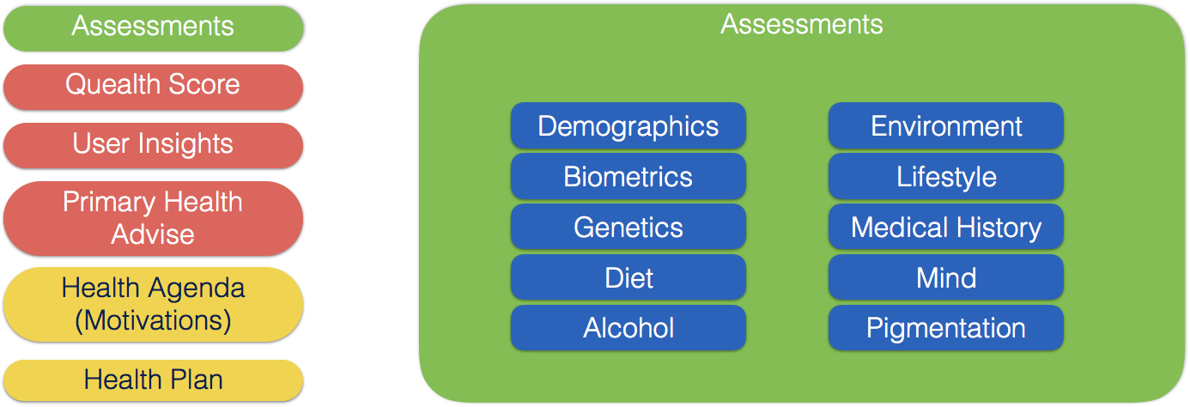
API’s provide immediate access to third parties
Notes:
So, what makes Quealth unique…?
How do we differentiate from the 165,000 apps already in the market…?

Slide 20
Joe Van Niekerk @ Vitality:
How data & analytics are at the heart of Vitality Life

Slide 21
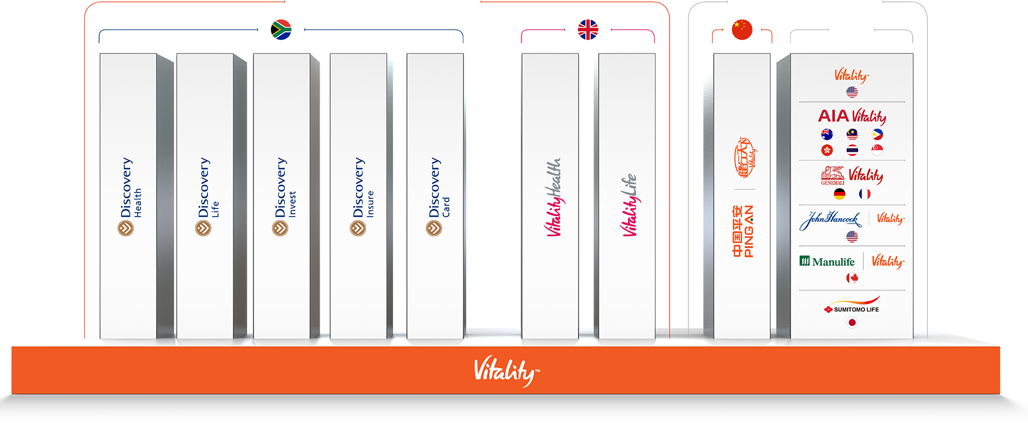
DISCOVERY PRIMARY MARKETS
DISCOVERY PARTNER
MARKETS
OTHER
Notes:
Business context
Business Drivers
Digital assets to enable the business

Slide 22
THE NATURE OF RISK HAS CHANGED
2016
2003
Physical inactivity, poor nutrition, smoking, alcohol
1900
4
Physical inactivity, poor nutrition, smoking
3
60
4
Pneumonia & tuberculosis
1
50
4
60% of deaths worldwide
Cancer, diabetes, heart and lung diseases
Together caused 30% of all deaths
3
50% of deaths worldwide
Cancer, diabetes, heart and lung diseases
Source: WHO
2
Diarrhoea and enteritis
Diptheria
Source: Oxford Alliance Group
Source: CDC
Notes:
Third, is the proliferation of chronic diseases as a result of the changing nature of risk — in part, a consequence of increased life expectancy
A shift in disease burden has taken place (and continues to do so) from communicable diseases to preventable non-communicable diseases, accompanied by a high increase and prevalence in behavioral risk factors
Mortality and morbidity risk, which used to be primarily pre-existing or incapable of being influenced, is now dynamic and based on lifestyle choices
In 1900 – three communicable diseases accounted for 30% of all deaths. Today four risk factors (poor diet, physical inactivity, tobacco use, and excess alcohol intake) lead to four chronic diseases (cardiovascular disease, diabetes, chronic lung disease, and various cancers) that contribute to 60% of deaths worldwide and 80% of the disease burden

Slide 23
THE TRADITIONAL UNDERWRITING MODEL
Traditional mortality curve
Risk evaluated only at policy inception based on pre-existing conditions
Premium remains static over time
Mortality rate
Premium
Relationship is transactional
Age
Notes:
In fact, to date insurers have built products based on a static approach to underwriting. Risk is evaluated at policy inception based on pre-existing conditions at that point, and remains unchanged during the currency of the policy, as does the premium. This leads to a transactional relationship – where insurance is a grudge purchase
Life insurance has never promoted life – “death insurance”

Slide 24
VITALITY SHARED-VALUE INSURANCE DELIVERS POWERFUL INSURER AND MEMBER BENEFITS
Sales
Selection
Behavior
Lapses
Shared value
More clients join; take-up more rider benefits; and buy-up cover
Healthier lives join
Consumers engage and change their behavior
Healthy lives stay
Unhealthy lives leave
Higher profits for insurers
Better health, longevity and significant financial incentives for members
Lapse effect
Sales & Selection effect
Behavioral effect
Notes:
Actuarial value is created and shared, including:
Sales (Increased new business; higher rider benefit take up; cover buy up)
Selection (Initial selection of healthier lives)
Behavioral (Consumer engagement and behavior change)
Lapses (Lower lapse rates for those who get value from program; positive selective lapses of unhealthy lives)
The outcome of which is: Higher margin/profit for the insurer; and better health, mortality and significant financial incentives for members

Slide 25
Getting Healthy
Living Longer
87 yrs
81 yrs
67 yrs
250 000
Vitality Health Checks
10 million discounted gym visits
20 million HealthyFood baskets bought
Over 10 000
Team Vitality members
63 yrs
Getting Rewarded
R1 billion HealthyFood cash back
1 million discounted flights booked
2.5 million discounted movies
1.8 billion Discovery Miles earned
South Africa
SA insured population
Vitality members
Gold and Diamond Vitality members

Slide 26
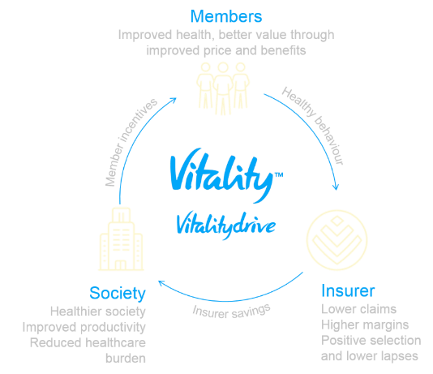
MATHEMATICS OF THE VITALITY SHARED-VALUE INSURANCE MODEL
Value
Incentive
∆ Behaviour
Bent (qx)
Value
=
×
×
×
Member
Member
Incentive
∆ Behaviour
Bent (qx)
Vitality chassis
Make people healthier
Surplus sharing
=
Engagement
Vitality Age
Vitality Points
Vitality Status
Rewards
Screening
Exercise
Nutrition
Weight Loss
Morbidity & mortality
Accidents
Defaults
Health insurance
Life insurance
Short-term insurance
Banking
35m years health data; >5 years mortality data; over 4.5bn km of telematics linked driving

Slide 27
Questions & Answers
2
How to participate:
If you have a question please type into the messaging area and send to the presenters
Session format:
The moderator will use a combination of his own questions and those from the audience
Notes:
Hugh will pull up the poll

Slide 28
Snap Poll
3
Q. Which of the following best describes your current Data & Analytics Programme?
How to participate:
Just respond to the question when it appears on your screen
Notes:
Hugh will pull up the poll

Slide 29
Digital Insurance Conference in Asia
Bringing our community in Asia together for an innovative conference on digital insurance in 2016
Location: Hong Kong
Date: 23rd November 2016
http:asia2016.the-digital-insurer.com

Slide 30
Post webinar activities
Recording will be emailed to registered participants
Next Webinar will be in January 2017 – date and topic TBC
Please give us your feedback
If you would like to follow up with any of the panelists
- Simon Phipps: simon.phipps@kpmg.com
- Torsten Duwenhorst: torsten.duwenhorst@kpmg.com
- Dr Hongjuan Liu: juan.liu@aegon.com
- Alistair Wickens: alistair.wickens@quealth.co
- Joe Van Niekerk: JoeVa@discovery.co.za
- Andrew Dart: Andrew.Dart@the-digital-insurer.com
- Hugh Terry: hugh.terry@the-digital-insurer.com

