Slide 1
TATA AIG – BUSINESS PROPOSAL
niki.ai
It’s that simple!
NIKI.AI – A CHAT-BASED UNIFIED TRANSACTIONAL INTERFACE

Slide 2
niki.ai – INTRODUCTION
WHAT DEFINES US?
PRODUCT
VISION
MISSION
AI based bot to facilitate sales through a single chat interface
To be the layer of interaction between brands and consumers
Enable one-to-one sales at scale
100,000+
27.5%
50+
USERS
Conversion Rate
BRANDS ASSOCIATED
*Substantially higher conversion than traditional web/app interface ~ <2%
48 mins
0.8 USD
AVG TIME SPENT ON MESSAGING PER USER PER DAY ~40%
AVERAGE COST OF PROCESSING A CALL

Slide 3
NIKI - HIGHLIGHTS
WHAT DEFINES US?
Instant Messaging

Based on Instant Messaging as a Platform of interaction

Advanced AI Capabilities
Experience built on state-pf-the-art NLP and Machine Learning Techniques
Niki.ai
ONE STOP SOLUTION - AI POWERED CHATBOT FOR COMMERCE WITH 40+ MERCHANT INTEGRATIONS

Discovery Made Easy
Unique AI capabilities to solve the discovery related concerns in E-Commerce

Transactions Made Easy
Platform Independent

Provide an end-to-end experience coupled with personalized recommendations
Can be extended into any platform – web/app integrations, social media channels, , OS, OEMs, etc
niki.ai

Slide 4
THE PROBLEM
HOW CAN INSURANCE COMPANIES ENABLE ONE-TO-ONE SALES AT SCALE & AUGMENT MARKETING CHANNELS
Lack of personalized digital sales agents
Insurance companies spend millions of dollars on insurance agents, with the average cost per month being over 10,000$ per agent
An insurance agent is not as accessible to customers
Avg cost per customer query resolution (pre-sales/post sales engagement) is ~4.5$, which over their life cycle becomes ~50$. This may or may not even lead to sales
Deployment of manual call/chat agents limits scale of operation and is cost intensive
Notes:
Conversion rates <-> highlight
Avg. cost of processing an order % + % time ppl spend on a chat platform

Slide 5
THE SPECIFICS
HIGHLIGHTS AND ADVANTAGES OF THE CHATBOT
Highlights
Advantages

I
II
Intuitive & Interactive
Diverse Text Handling
Consumer Friendly

Compliance Friendly

Stateful Dialog Handling
Tips & Utterances
Consistent Experience

Highly Scalable
III
IV

Better RoI

Slide 6
CHATBOTS IN INSURANCE - POSSIBILITIES
OPPORTUNITIES FOR CHATBOTS IN INSURANCE SPACE




Discovery
Recommendation
Sale
Post Sale


Re-Sale
Engagement & Retention
Notes:
Customer Life time value
Up sell + cross sell
Re-engage – cross sell, up sell, life event (marriage, divorce,..)
Post sale – soft sell + happy anniversary(policy review) cross sell
Major painpoint is communication between sale to sale and leverage this engagemet by better communication (that too happens with an agent). Agents aren’t incentivized for consumer engagement and only for next sale.

Slide 7
SERVICES ON CHAT
A GLIMPSE OF THE SERVICES TO OFFER ON CHAT
DISCOVER SERVICES
PROVIDE RECOMMENDATIONS
Discover services (Insurances) offered by just chatting in free text.
E.g., “ I’m looking for a Health Insurance ”
Helps users figure out the optimal Insurance plan via recommendation
E.g.: “ Suggest me a cheapest Health Insurance ”
IN-DEPTH COMPARISIONS
Helps users figure compare and contrast the various options available on the platform based on the attributes provided.
E.g.: “ Compare by plans (Silver, Silver Plus, Gold, Platinum and Senior Plan) etc.”
CALCULATE/PAY PREMIUM
SET UPDATES / REMINDERS
The users can effortlessly estimate the Premiums, Insurance Eligibility criterion over chat.
The users can track the Dates to fill premium of their insurances through instant reminders
niki.ai

Slide 8
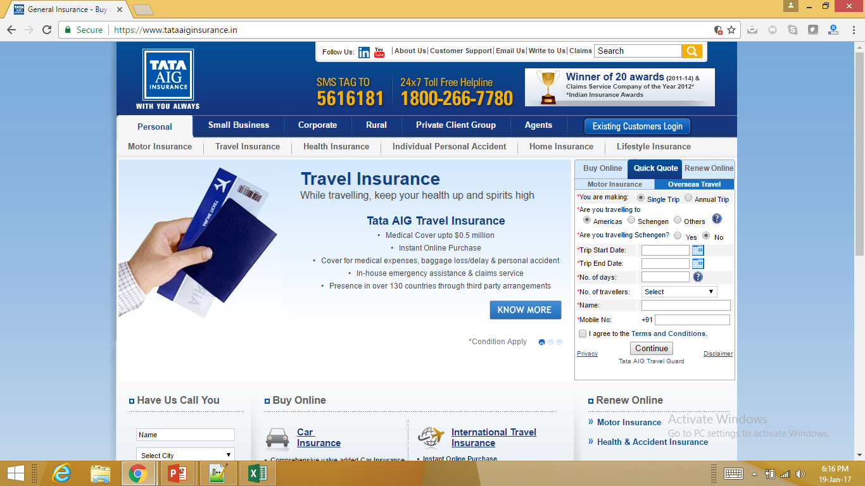
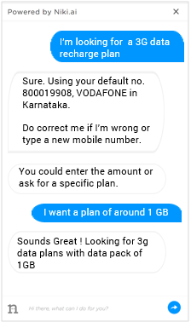
NIKI SDK – THE SPECIFICS
HIGHLIGHTS OF THE CHAT INSTANCE ON WEB
KEY POINTERS OF NIKI CHAT SDK
Small plug-n-play SDK (under 500 kb)
One-time authentication (needed for personalized experience)
Powered via Artificial Intelligence (Machine intelligence)
Instant replies (completely automated)
Human-like conversation (dialog manager)
Personalized recommendation (based on user preference)
Chat with multiple users simultaneously (SOA to handle scale)
niki.ai

Slide 9
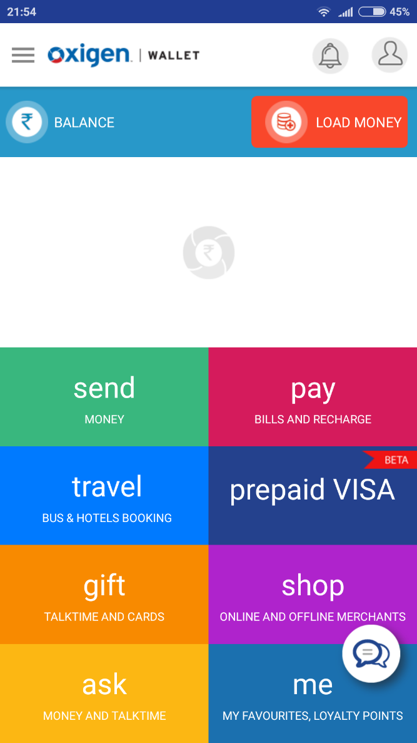
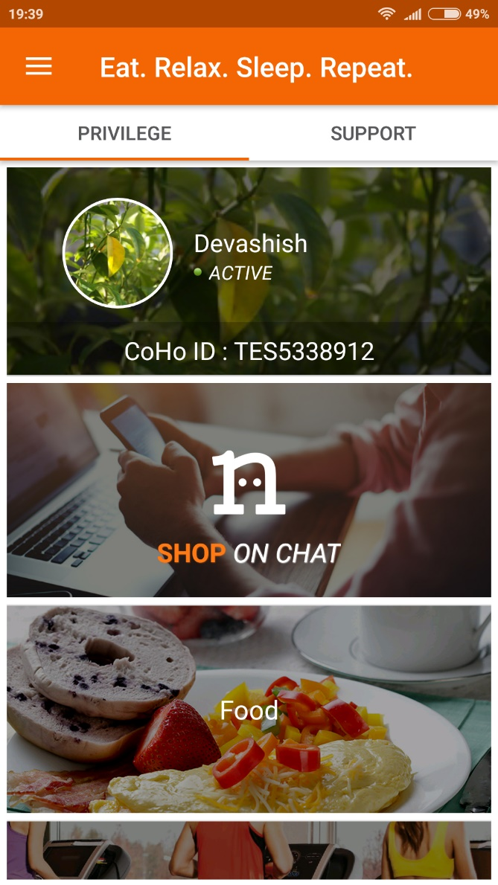
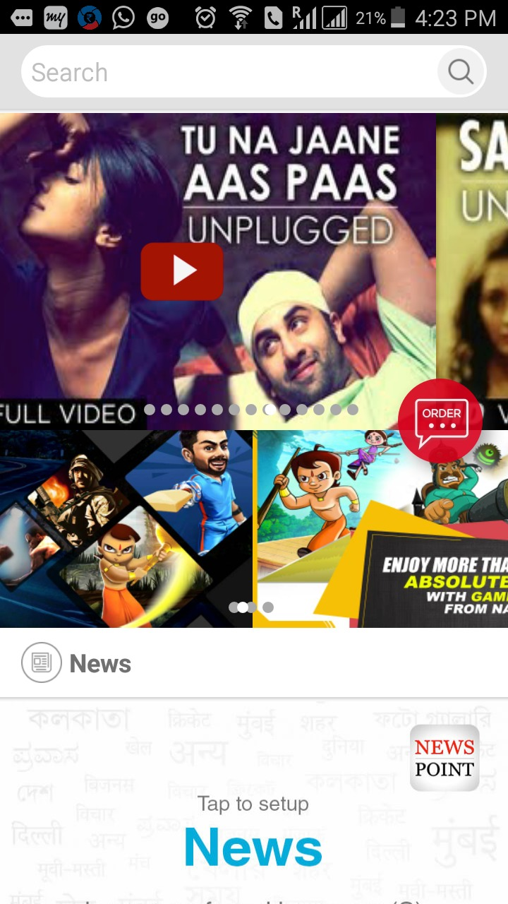
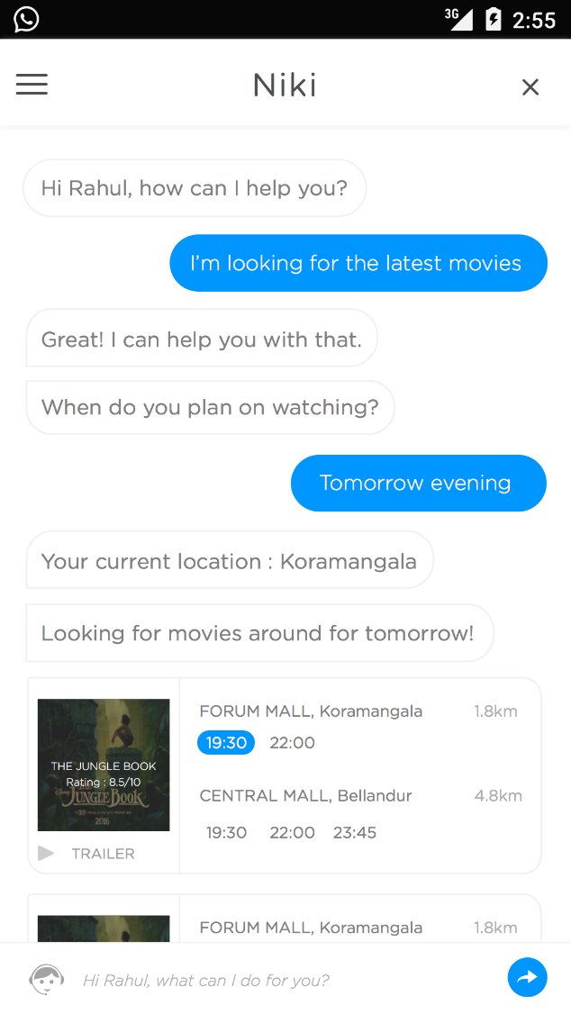
NIKI SDK – CURRENT IMPLEMENTATIONS
CURRENT INTEGRATIONS OF NIKI SDK
Oxigen Wallet
Coho Resident App
Intex OEM
Chat Interface - Discovery
niki.ai

Slide 10
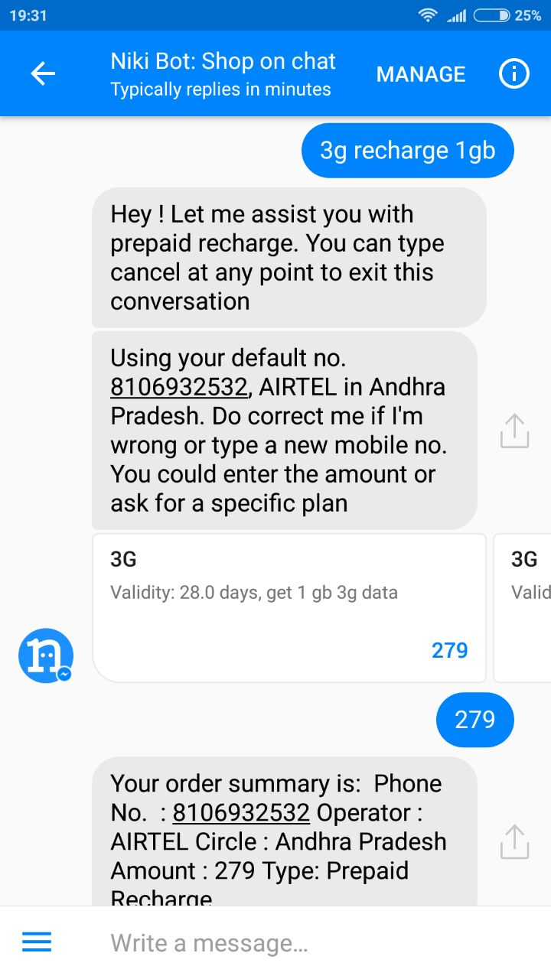
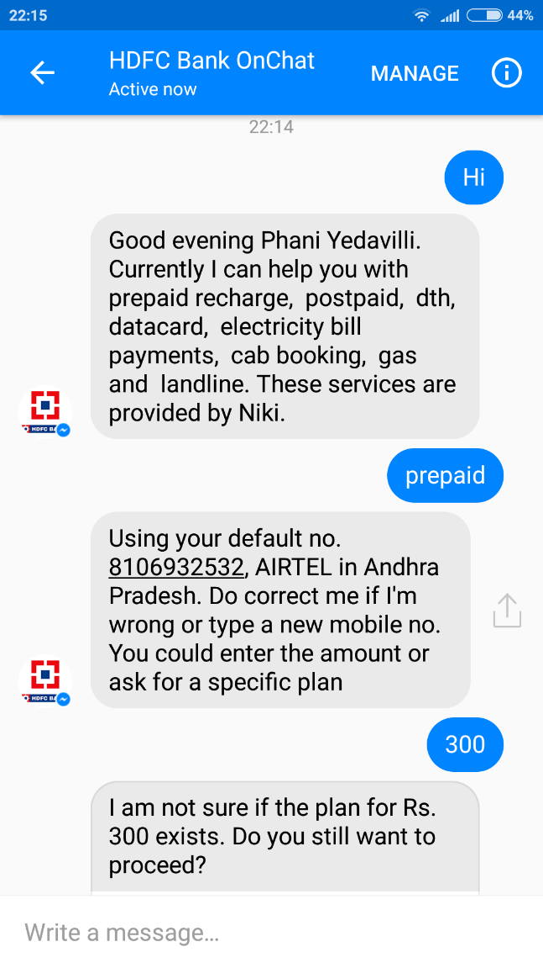
NIKI – THE MESSENGER BOT
SUCCESS STORY OF THE MESSENGER BOT
HIGHLIGHTS
Offers Cab Booking, Recharges & Bill Payments
Extends presence to Web, iOS platforms
First-of-its-kind In-chat payments
Driving 10x more transactions than mobile web interfaces
RECOGNITION
FB has recognized Niki as one of the best Messenger bots
FB has extended an early access for its new features
Special mention of Niki by Mr. David Marcus, VP of Messenger as one of the superior bots
Featured as one of the 10 best bots globally by The Guardian
niki.ai

Slide 11
BENEFITS TO PARTNER
BETTER MONETISATION PIPELINE
PLUG AND PLAY SDK
One chat SDK that brings in everything together in a clutter free and natural interface. No development efforts required from the Merchant end.
TECHNOLOGY IMPROVEMENT
Chatbot needs constant improvement and training on machine learning model. Niki being a product company strives to improve the experience and will avail the same on a regular basis.
INCREASED PLATFORM UTILITY
Increased utility of your platform will ensure better user engagement and improved retention rates hence resulting in greater user loyalty towards the brand.
MULTIPLE PLATFORMS INTEGRATION
Backend architecture is platform independent. It can be integrated with Mobile App (Android and iOS), Website, Facebook Messenger or any other chat platform
niki.ai

Slide 12
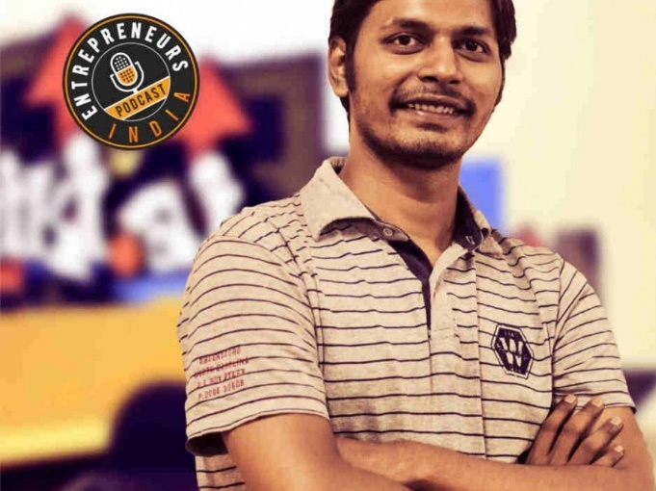
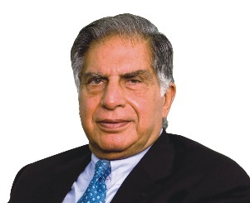
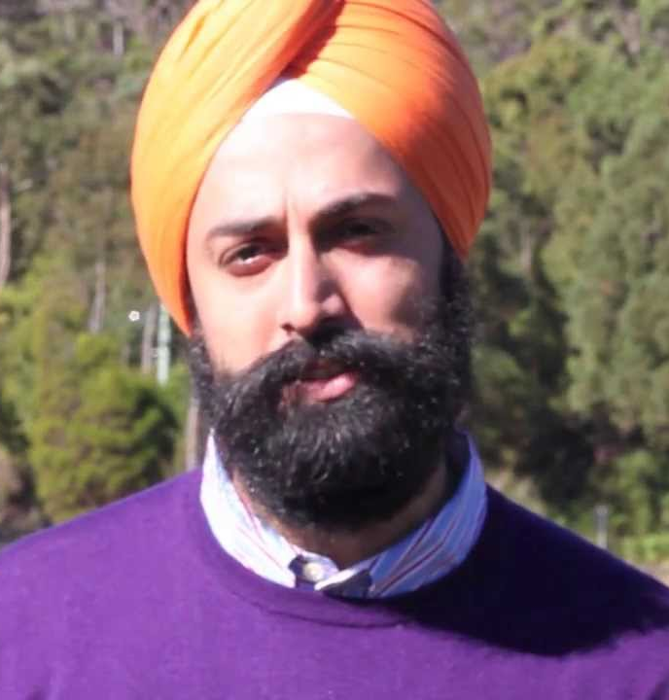
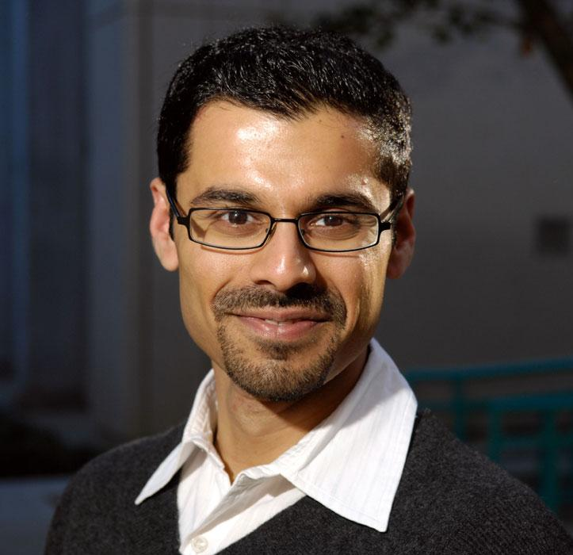
TECHNOLOGY & CONSUMER OBSESSED MANAGEMENT TEAM
WHAT SETS NIKI APART
INVESTORS
SACHIN JAISWAL
IIT-KGP 2011
SHISHIR MODI
IIT-KGP 2012
B.Tech Electrical
Co-Founder, Innovaccer
Oracle
NIKI.AI
Co-founder
Dual Electrical
IndiaReads.com
Energo
NIKI.AI
Co-founder
UNILAZER VENTURES (RONNIE SCREWVALA)
MR. RATAN TATA
Strong team of 21 members comprising developers, designers and growth hackers.
NITIN BABEL
IIT-KGP 2013
KESHAV PRAWASI
IIT-KGP 2011
ADVISORS
SUNDEEP SAHNI
VP, New Initiatives – Ola Cabs
Co-Founder & Managing Director – Lazada Group
M. Sc. Economics, 2013
Ipsos
NIKI.AI
Co-founder
B.Tech Computer Science
Amazon
NIKI.AI
Co-founder
PROF. ASHWIN ARAVINDAKSHAN
Prof. in University of California,
Ph. D. in Marketing, IIT Madras
niki.ai

Slide 13
niki.ai
PHONE
+91 8106932532
EMAIL
phani@niki.ai
OFFICE ADDRESS
No 862, 1st Floor, Prabhat Arcade 80 feet road, Koramangala 8th Block, Bangalore 560095

