Slide 1
Your Fintech Partner for Robo-Advisory
Notes:
New markets (ANZ, EU, US)
New partnerships (Finacle)
B2B2C (Robosaver)

Slide 2
What we do
Bambu is a B2B Robo-Advisor firm offering financial and non-financial firms the ability to integrate and benefit from the shift in digital wealth.
Your Fintech solution partner for Robo-Advisory

Slide 3
Our Clients
Global Asset
Manager (NDA)
Notes:
smaller font size
background (lighten or darker)
align words

Slide 4
Our Traction
US$1M
Funds Raised
US$430K
In Revenue
First
Robo Advisor platform
launched in Singapore
Winner
Best Early Stage Startup
at FinTech Finals 2017
Alumni
SuperCharger 2.0 Accelerator Program
Finalist
Jumpstarter 2017 by Alibaba Entrepreneurs Fund

Slide 5
The Opportunity
Total Asia AUM
USD75tn
Projected Market Size in 2020 Source: BCG 2016
Likelihood to Open
Robo-Advisory Account
Projected Robo AUM
Robo-Advisory Threat
44x
43%
87%
of surveyed investors in APAC
of surveyed global wealth management firms are concerned
increase from 2015-2020
Source: AT Kearney 2015
Source: Ernst & Young 2016
Source: CEB TowerGroup 2016
7

Slide 6
MATURE
GLOBAL
OPPORTUNITY
WEST
EAST
EARLY
9
Notes:
UNREGULATED can go anywhere
EXECUTION we’re growing the fastest
Time to take center stage in GLOBAL market

Slide 7
How Bambu is Different
Our unfair advantage
Powered by proprietary intelligent algorithms and Neural Networks
Goal-based Investing produces valuable data about users lives
Strategic Partnerships with DriveWealth and Thomson Reuters

Slide 8
Intelligent Advisor
Empowering your Relationship Managers with Big Data
Offers a unified view of the Market and House View
Recommends relevant Investment Ideas for Client Portfolios
Business Partner:
Market leader in news, data and information for professional and financial markets

Slide 9
White-Label Robo
Full-stack Robo-Advisor integrated to your backend for custody & execution
One-click Financial Planner, Digital Onboarding, Account Health Checks and Admin Analytics
Extensions for Chatbot, KYC Automation, Aggregation
Offered directly to clients as a white-label solution
Direct from:
Our in-house Investment, Design and Integration teams will configure your Robo

Slide 10
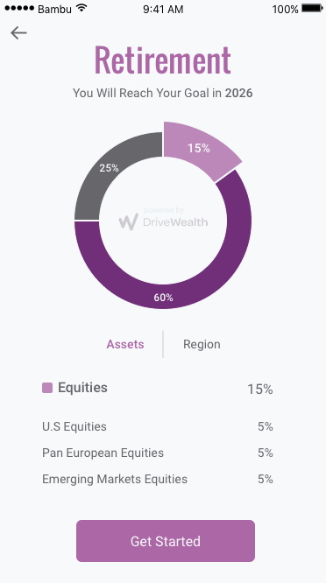
Robo-In-A-Box
Full-stack platform for any company looking to offer Robo-Advisory to clients
One-click Financial Planner, Digital Onboarding, Account Health Checks and Admin Analytics
Licensed to onboard clients in 140+ countries worldwide for U.S. listed investment products
Business Partner:
Leading B2B2C brokerage in the world with 400+ end customers
18

Slide 11
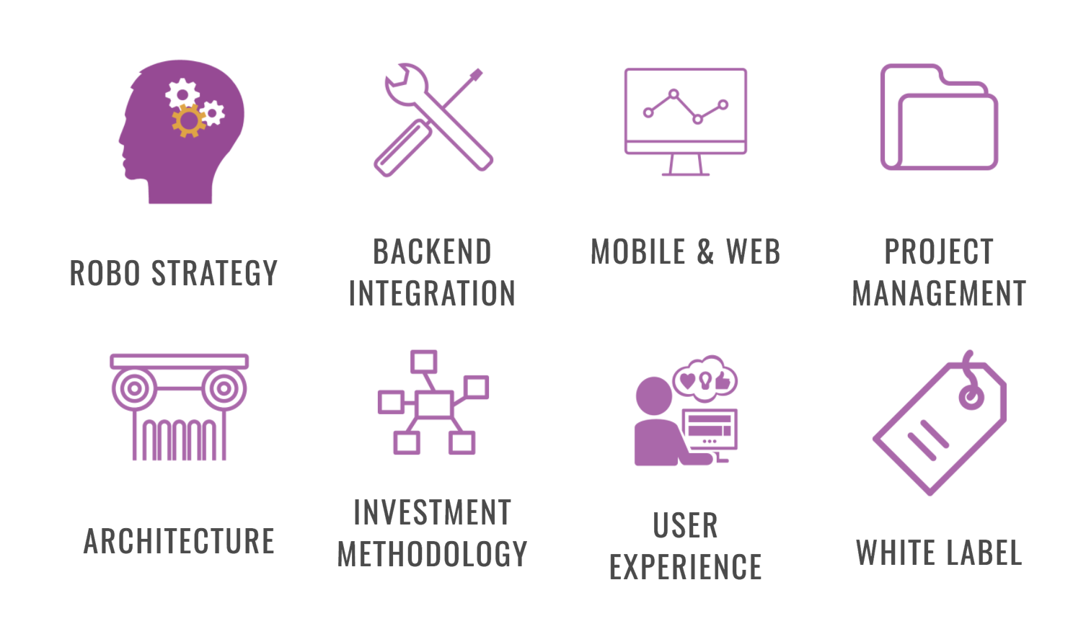
Our end-to-end Services

Slide 12
Bambu Platform
ADVISOR UI Whitelabel
CUSTOMER UI Whitelabel
ADMIN UI Website
USERS
REST API (Microsoft .NET)
RISK
PORTFOLIOS
ACCOUNTS
REBALANCE
ONBOARDING
BACKEND
BAMBU ENGINE (Python)
PREDICTIVE MODELING
FINANCIAL PLANNING
PEOPLE LIKE ME
OWNERSHIP
REST/FIX/BATCH API
Customer
INTEGRATION
Bambu
EXECUTION
CRM
DATA FEEDS

