Slide 1
June 2017
conVRse
Digital Insurer Award Submission

Slide 2
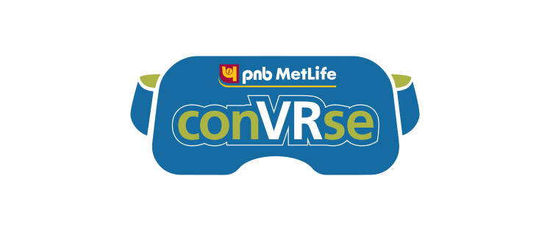
conVRse, MetLife’s virtual reality (VR) servicing branch, is a product of LumenLab’s Innovation Framework
The conVRse journey started in late 2015 in collaboration with PNB MetLife in India – where we spoke with real customers on the ground at branches to gain insights and learn about their problems.
We collated the information we had collected into a persona: a representation of the typical customer whose problems we would then work to solve

Slide 3
Meet RAMESH
Married
India
Software
Engineer
$$$
Medium
“
I would like my insurer to be available at my convenience instead of it being the other way around.
“
“
When I have a query or issue regarding my insurance policy, I want to talk directly with an expert who can resolve my issue right away.
“
Attitudes
Behaviours
Wants & Needs
Barriers
Concerned about the well-being of his family. Worries about his children's’ future, parents’ health and his own retirement.
Saves meticulously and ensures that the family doesn’t spend frivolously.
Wants his insurer to offer more customer friendly and convenient servicing.
Prefers face to face discussions with an expert.
Doesn’t have much time to spare and dreads the long trips during working hours to his insurer’s offices.

Slide 4
We had key learnings and insights from testing each iteration of conVRse
Crafted virtual reality experiences engender an emotional connection – you feel as if you are living through it
Interaction with elements in the room and customized data is equally as important as the conversation with the avatar
Customers who are usually irate in branches appear to be cooler and more rational on conVRse
4. Lag / Audio sync has a large impact on experience quality

Slide 5
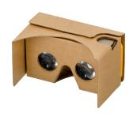
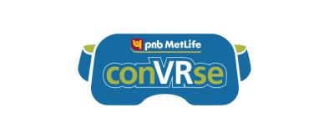
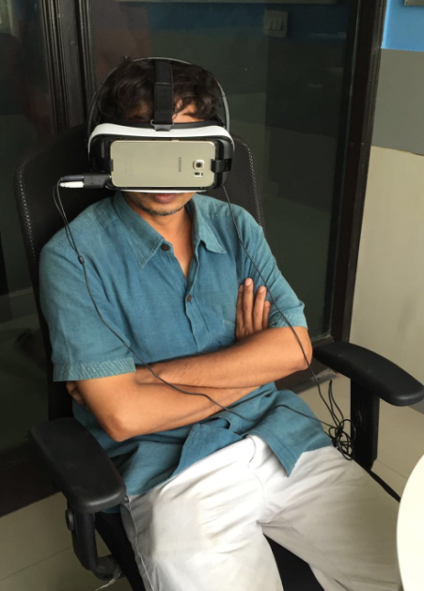
You need a solution slide here
VR was perfect to solve Ramesh’s problems – allowing him to speak face to face with a specialized PNB MetLife Agent at his convenience
Google cardboard or other mobile VR headset
Mid-range smartphone
Our application
Inside conVRse, customers find themselves sitting in a room with ‘Khushi,’ a 3D avatar voiced by a live expert from PNB MetLife with who they can converse with completely naturally with for any servicing requests. Inhabiting the same physical space, even digitally, allows customers to have a more emotionally engaging conversation. This sets VR apart from a video chat, where one simply speaks to a two dimensional face on a screen.
conVRse currently allows customers to view and update their policy details real time, to raise service requests right there, to inquire about the status of their claims, and to submit any required documentation related to a transaction or documents related to the Know Your Customer (KYC) requirements using the rear facing camera of the phone through an immersive and interactive experience.
Customer being serviced through conVRse

Slide 6
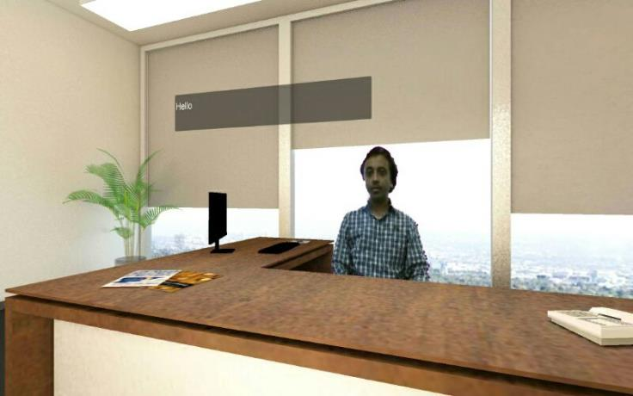
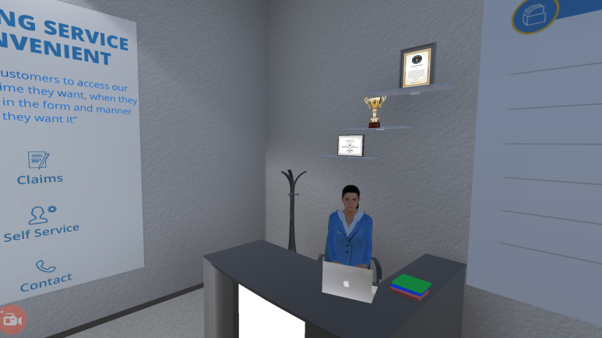
We used our test and learn approach to build conVRse - iterating each subsequent version based on customer feedback and data
October 2015
December 2015
April 2016
August 2016
October 2016
December 2016
Build 1 – Pretotype - Servicing and Sales
Build 2 –Prototype - Live Customer Service
Build 3 - Prototype - Stability and Scale in Operationalization
Public Launch
Real customers transact on conVRse. 3000+ interactions till date
Testing/Operation
Pretotype: Focus Group Tests
Build 1 (Single Window Image)
Build 2
(Dual Screen VR – Video playable in PowerPoint)
Build 3 (Single Window Image)

Slide 7
conVRse improves the customer servicing journey not only on the surface, but also at a deeper emotional level
Experience Before (The Problem)
Action:
Become aware of problem
Find a branch
Meet generalist
Wait for resolution
Emotion:
Irritation
Irritation
Anxiety
Fear, Uncertainty, Doubt
Experience After (Our Solution)
Action:
Become aware of problem
Access VR branch
Speak to specialist
Quick resolution
Emotion:
Irritation
Relief
Confidence
Satisfaction

Slide 8
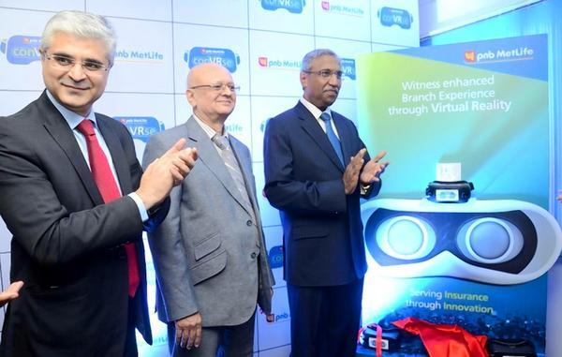
Even the Indian insurance regulators were on board –attending the formal launch conVRse on the 19th of December 2016
conVRse is now live in
15 Branches
across
10 cities
In India
(from right) Insurance Regulatory and Development Authority of India (IRDAI) Chairman TS Vijayan; Member-Life IRDAI Nilesh Sathe; and former Managing Director and CEO PNB MetLife Tarun Chugh, at the launch of conVRse in Hyderabad

Slide 9
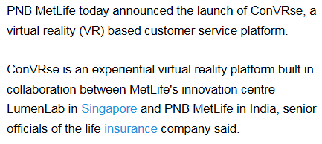
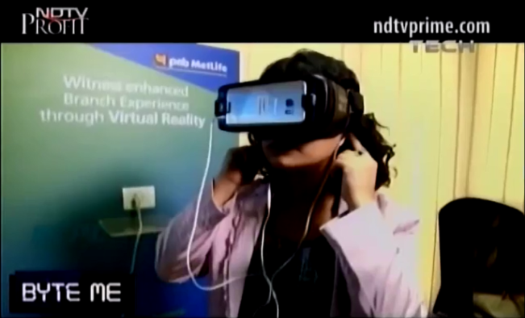
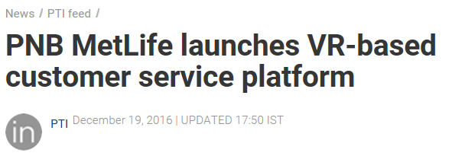
Our success with conVRse is widely recognized
conVRse has been featured
110+ times
In national Indian print media such as ‘The Times of India,’
in regional newspapers such as ‘Vishwavani’ in Bangalore,
in many online sources such as Business Standard, finextra, pymnts.com, etc.
in a published case study by IDC,
and even in televised news on NDTV Profit (This news is the video clip we have attached as the final part of the submission. Please note – we do not own this content)

Slide 10
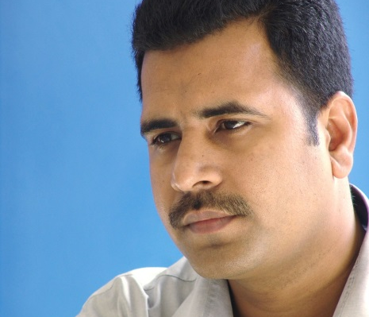
But most importantly, we’ve had an incredible response from the 3000+ customers serviced through conVRse
I would prefer virtual reality to a face to face interaction
92% of customers
I am happy with this interaction
97% of customers
I have a more positive impression of the PNB MetLife Brand after the experience
95% of customers

Slide 11
conVRse demonstrates that LumenLab’s innovation framework works
We identified a customer problem through interviewing and interacting with real customers at our branches,
We built a solution using our test and learn methodology, improving the solution iteratively based on data collection and customer feedback,
And we finally rolled out a solution which not only drastically improved customers’ experiences while interacting with MetLife, but revolutionized the possibilities of customer interactions but for customer service-centric industries globally.
And all of this in 15 months.

